Slide 1
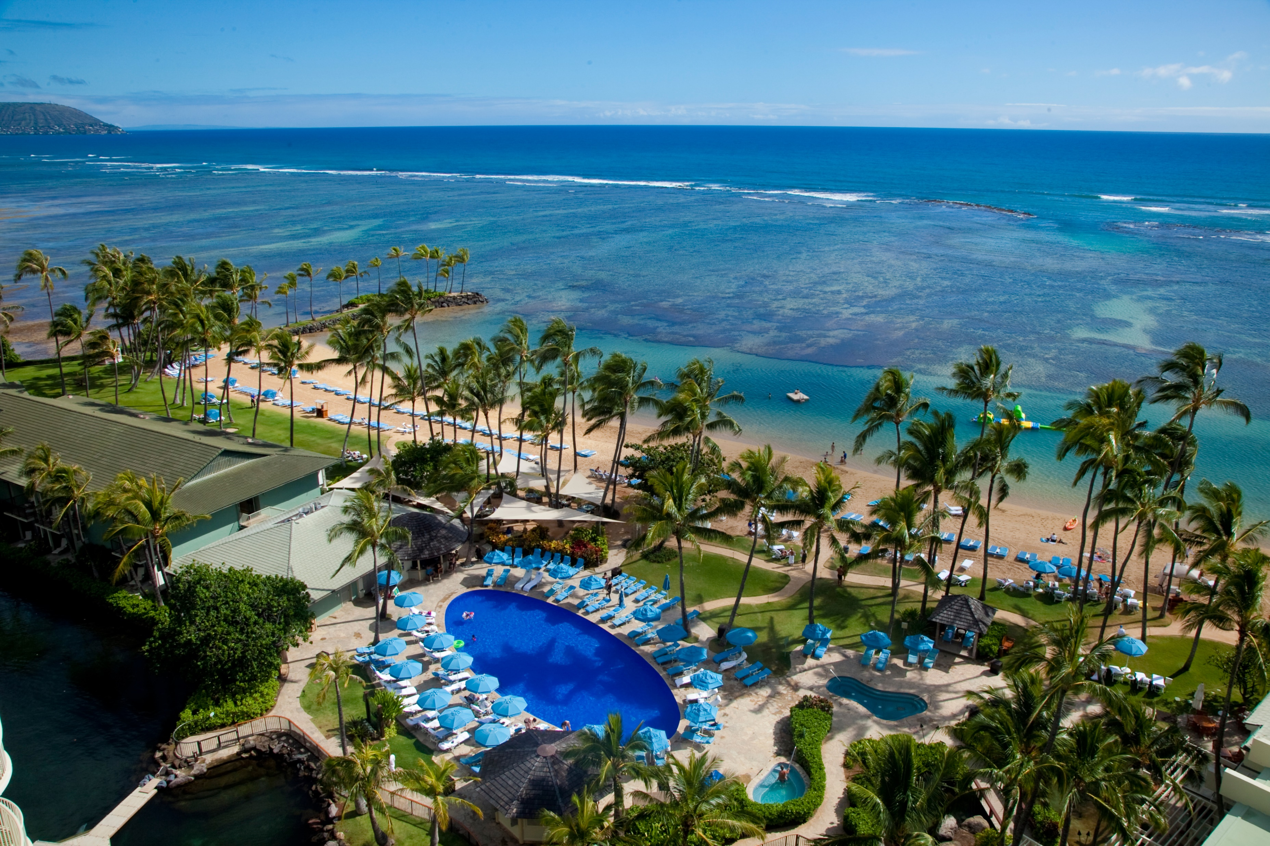
UCSF High Risk EM Hawaii
March 10-14, 2026
Kahala Hotel and Resort, Oahu
HighRiskEM.com

Slide 2
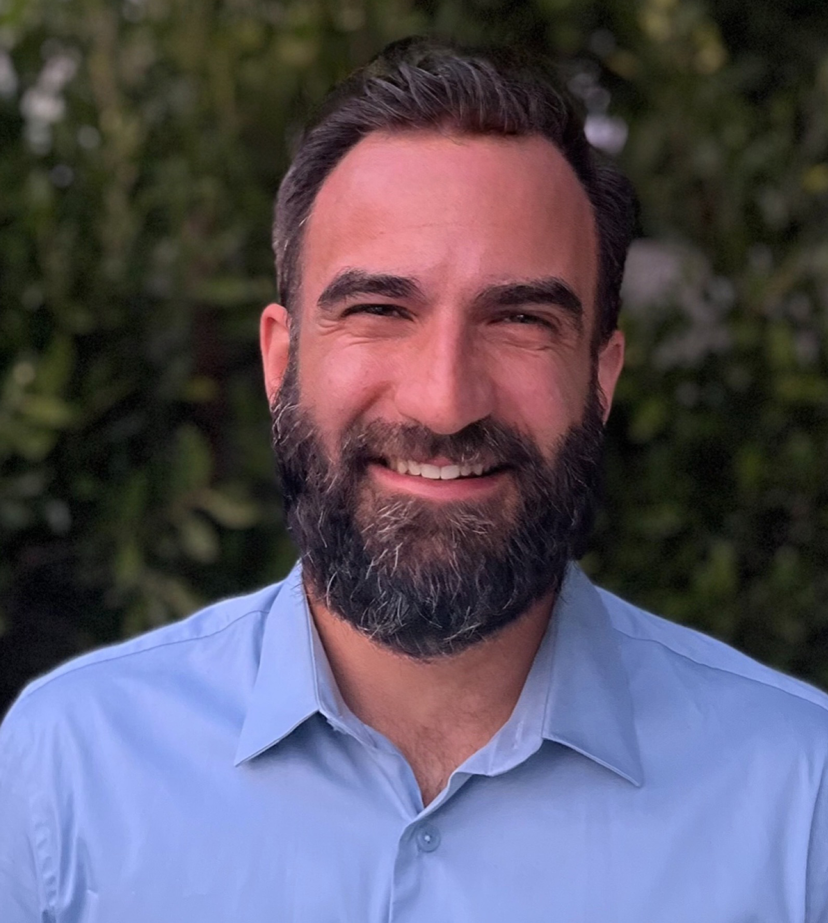
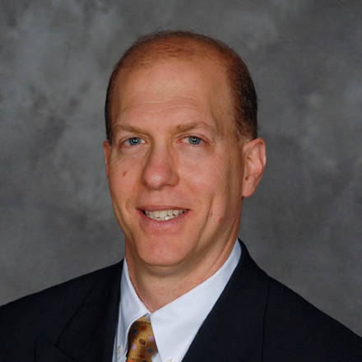
High Risk EM 2026
Course Chairs
Dr. Kevin Hanley
Assistant Professor UCSF School of Medicine
Dr. Jeffrey Tabas
Professor
UCSF School of Medicine

Slide 3
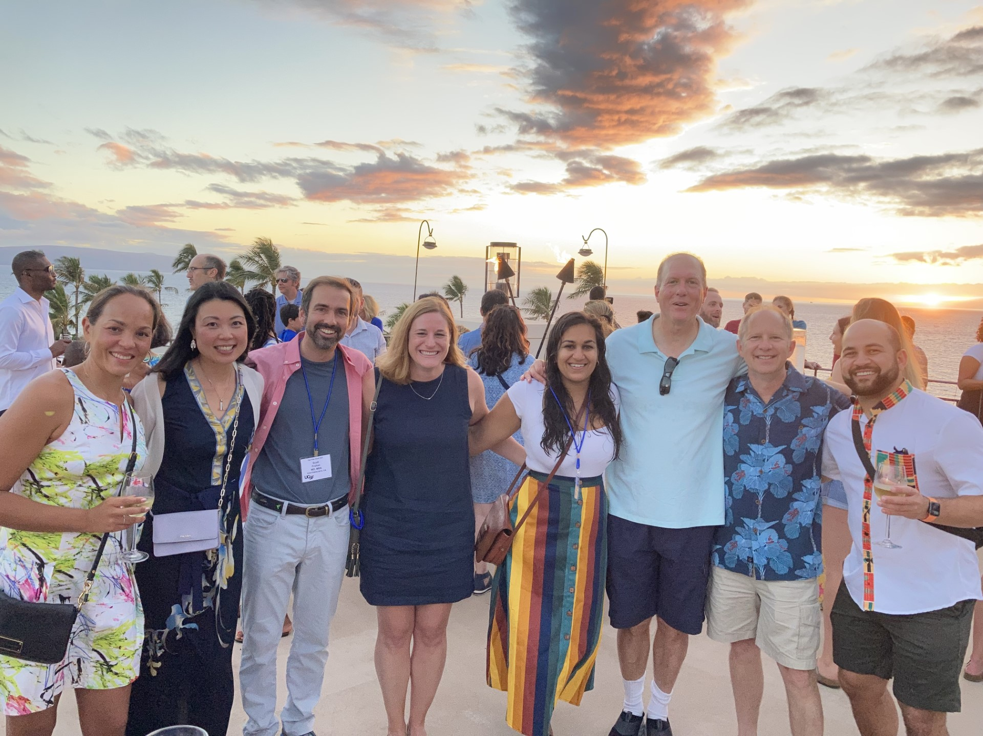
Meet the Faculty Reception
TODAY! 6:00pm
Plumeria Garden

Slide 4
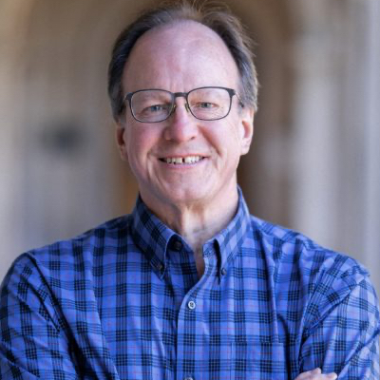
The Health Effects of Climate Change
Bonus Lecture at 5pm here!
Dr. Michael Wysession
Professor of Geophysics, Department of Earth, Environmental, and Planetary Sciences, Washington University

Slide 5
WIFI Access
Network = Kahala_Guest
Last name=101/Room=9001

Slide 6
Schedule for Tuesday, March 10
6:15 | The Day in Review
6:30 | Deadly Errors in Patients with Headache | Dr. Diane Birnbaumer
7:00 | Imaging in Suspected Stroke: Optimizing the Tube of Truth | Dr. Debbie Madhok
7:30 | Life-threatening Soft Tissue Infection | Dr. Starr Knight
8:00 | Cardiogenic Shock: Runs, Drips, & Errors | Dr. Bill Brady
8:30 | Medically Optimizing the Intubated Patient | Dr. Zlatan Coralic (PharmD)
9:00 | Q&A | Drs. Birnbaumer, Madhok, Knight, Brady, and Coralic
9:30 | Break

Slide 7
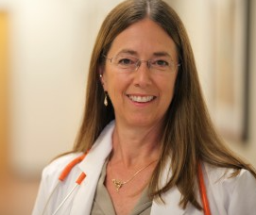
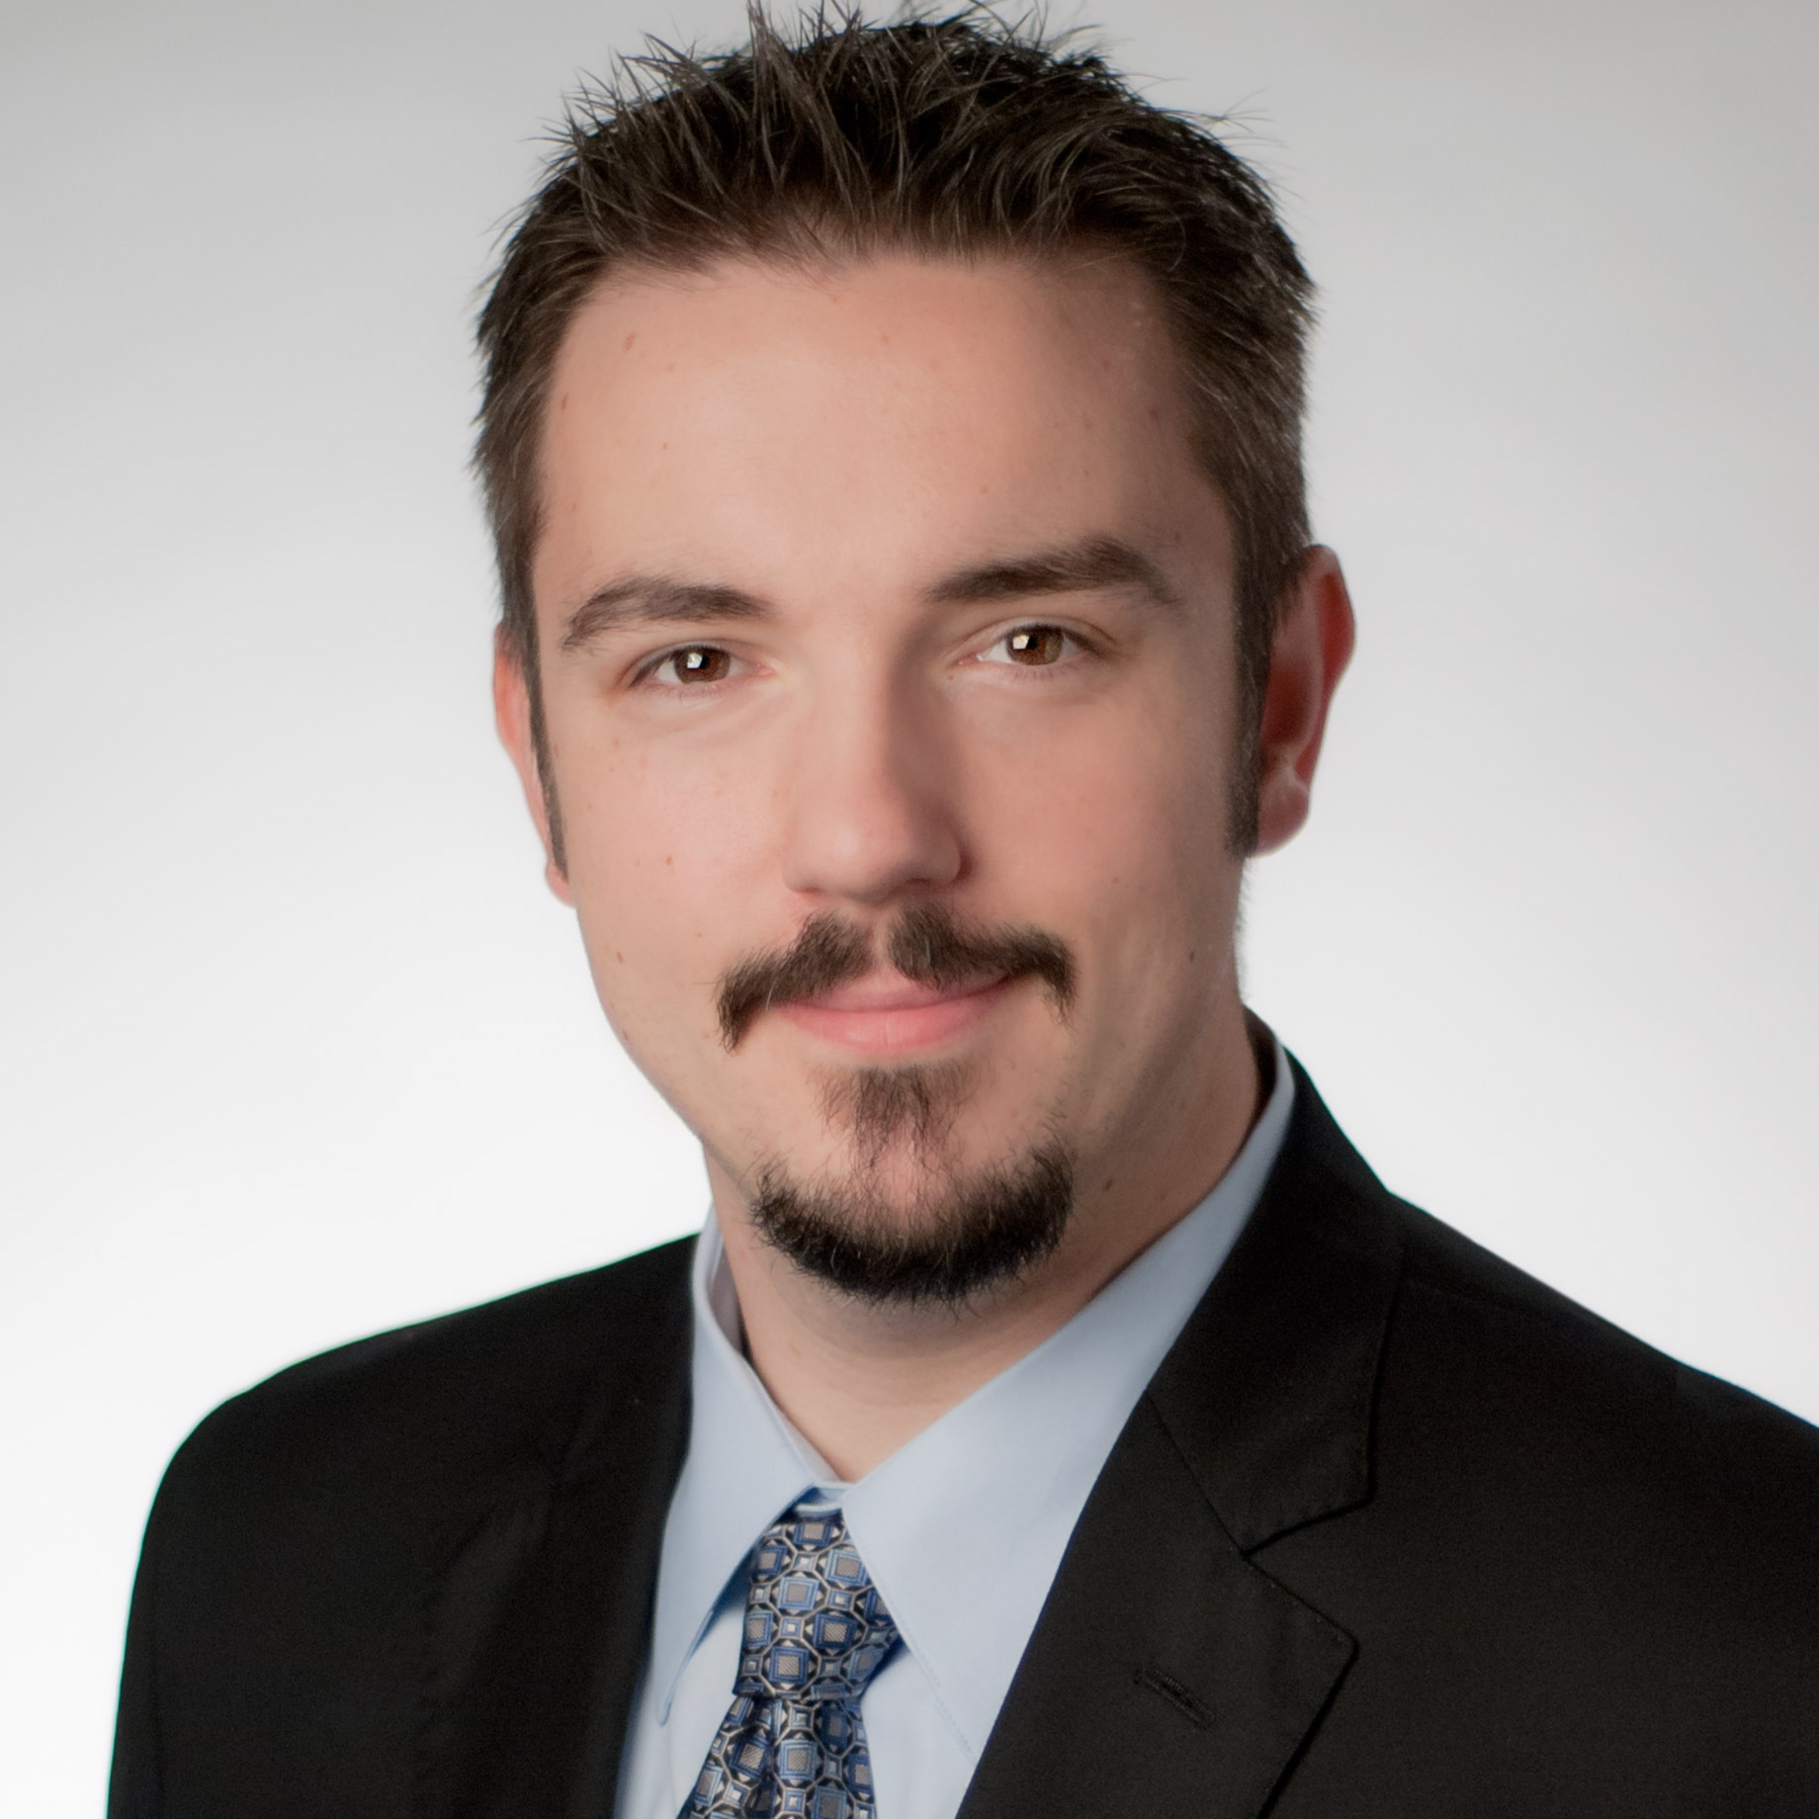
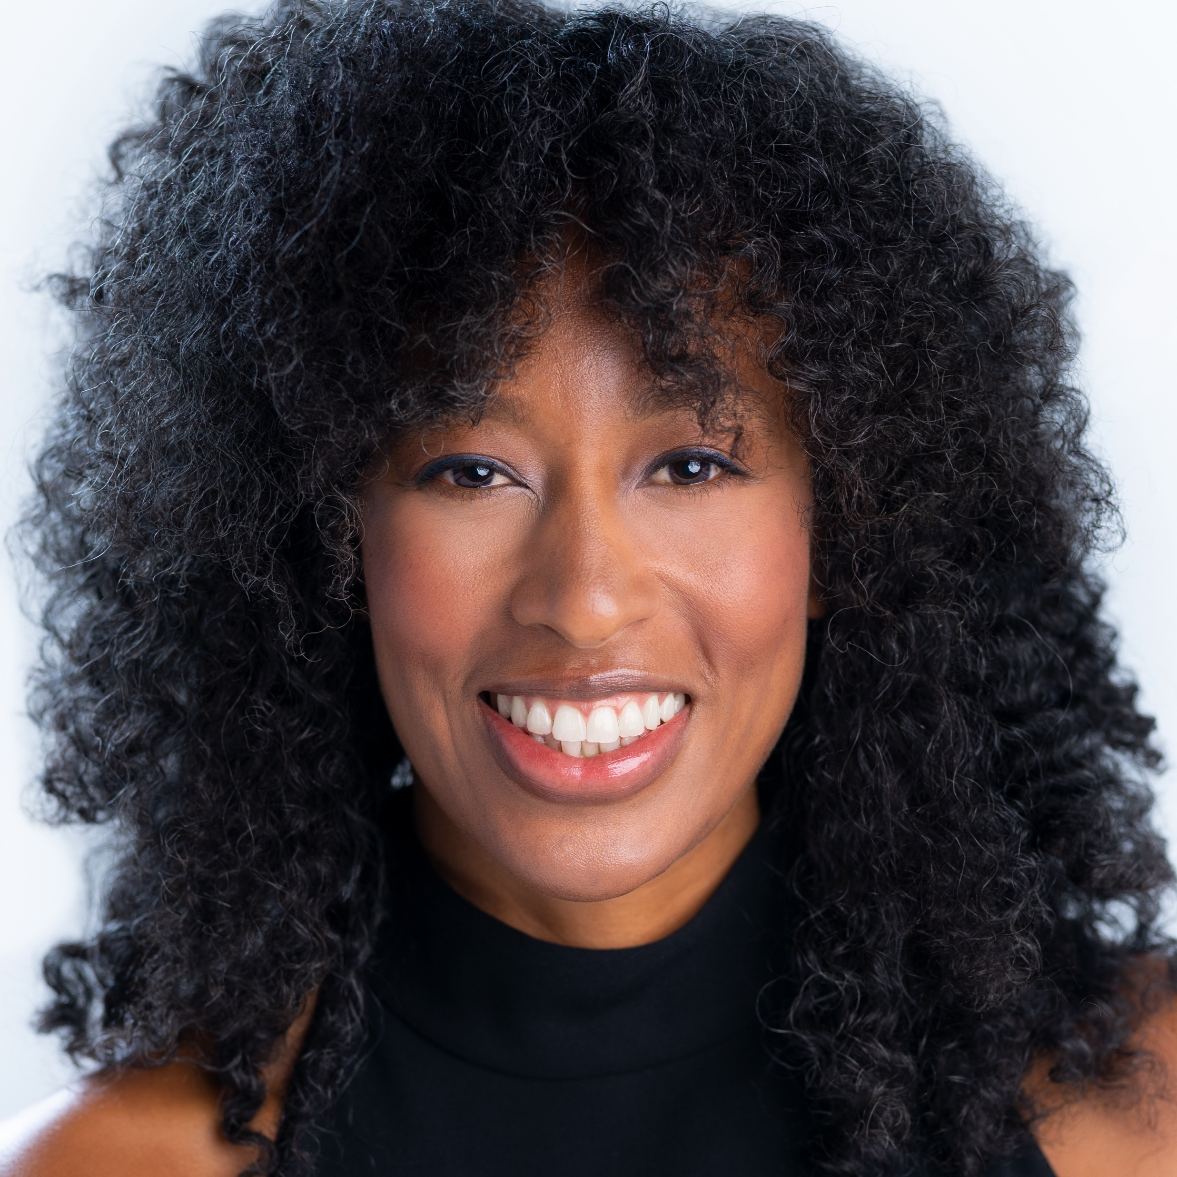
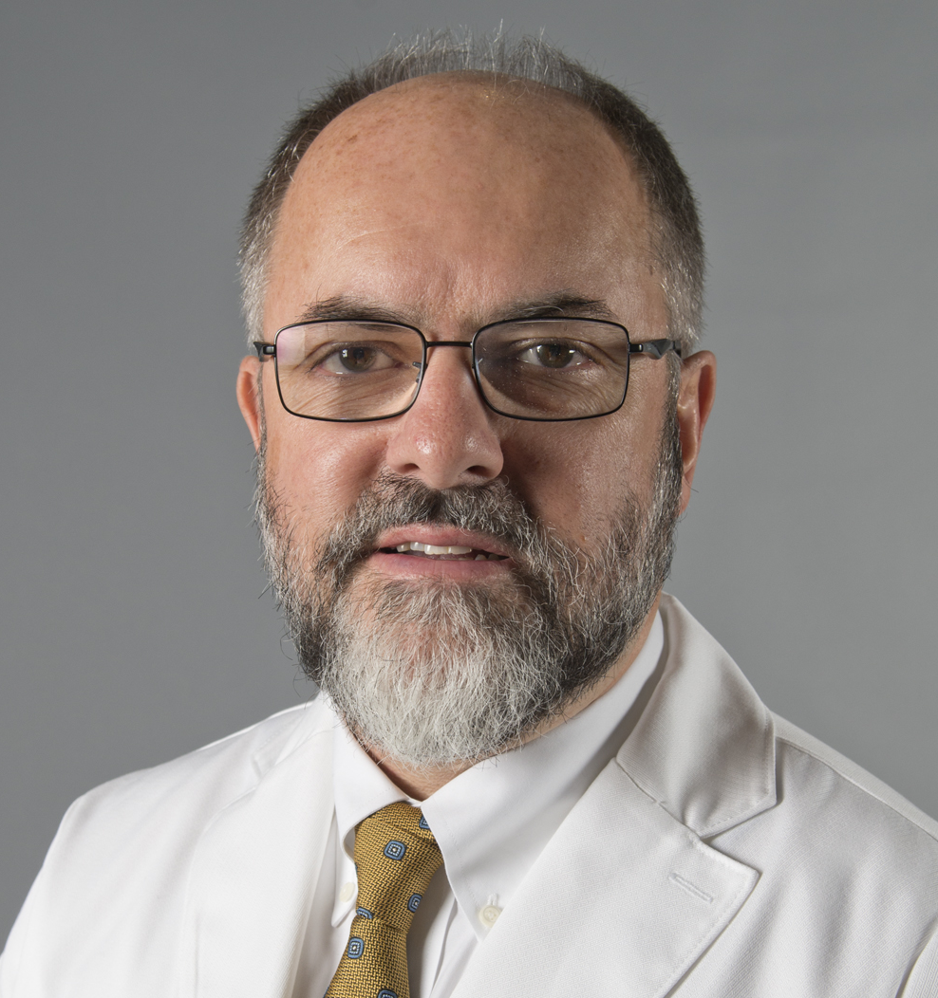
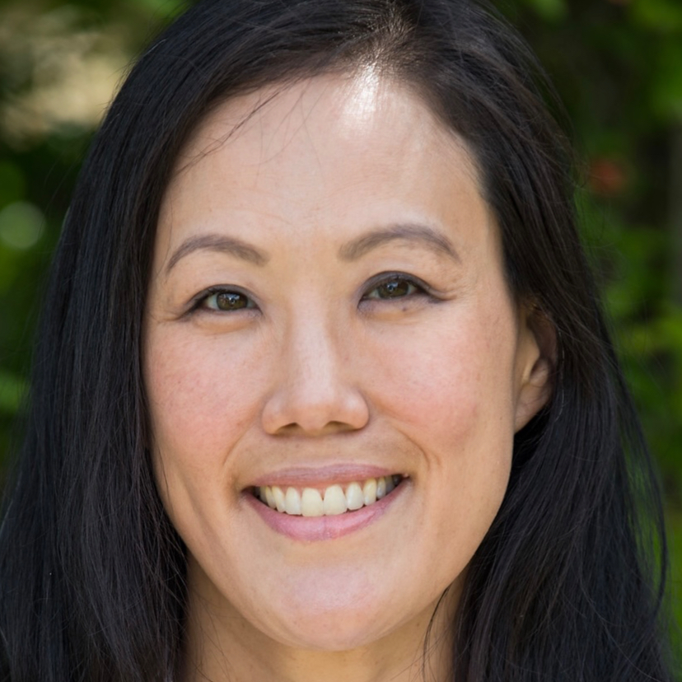
Day 1 Speakers
Diane Birnbaumer, MD Professor Emeritus
David Geffen School of Medicine at UCLA
Zlatan Coralic, PharmD
Associate Professor and Pharmacist, UCSF EM
Starr Knight, MD Director of Ultrasound
Associate Professor, UCSF EM
Bill Brady, MD Professor of Emergency Medicine
And Cardiovascular Medicine, UVA
Debbie Madhok, MD
Neurocritical Care
Associate Professor, UCSF EM

Slide 8
Schedule for Tuesday, March 10
9:30 | Break
9:45 | Challenging Peds Cases in the Community ED—2026 Update | Dr. Mimi Lu
10:45 | No Pulse? No Problem: LVADs in the ED | Dr. Kevin Hanley
11:00 | Feeling Blue—Hypoxic, Poisoned, or Just Depressed? | Dr. Craig Smollin
11:30 | Stabilization of the Critically Ill Infant | Dr. Dina Wallin
12:00 | Personal Stories in EM: Mass Casualty Incident | Dr. Christopher Colwell
12:15 | Q&A | Drs. Lu, Hanley, Smollin, Wallin, Colwell
12:45 | Adjourn

Slide 9
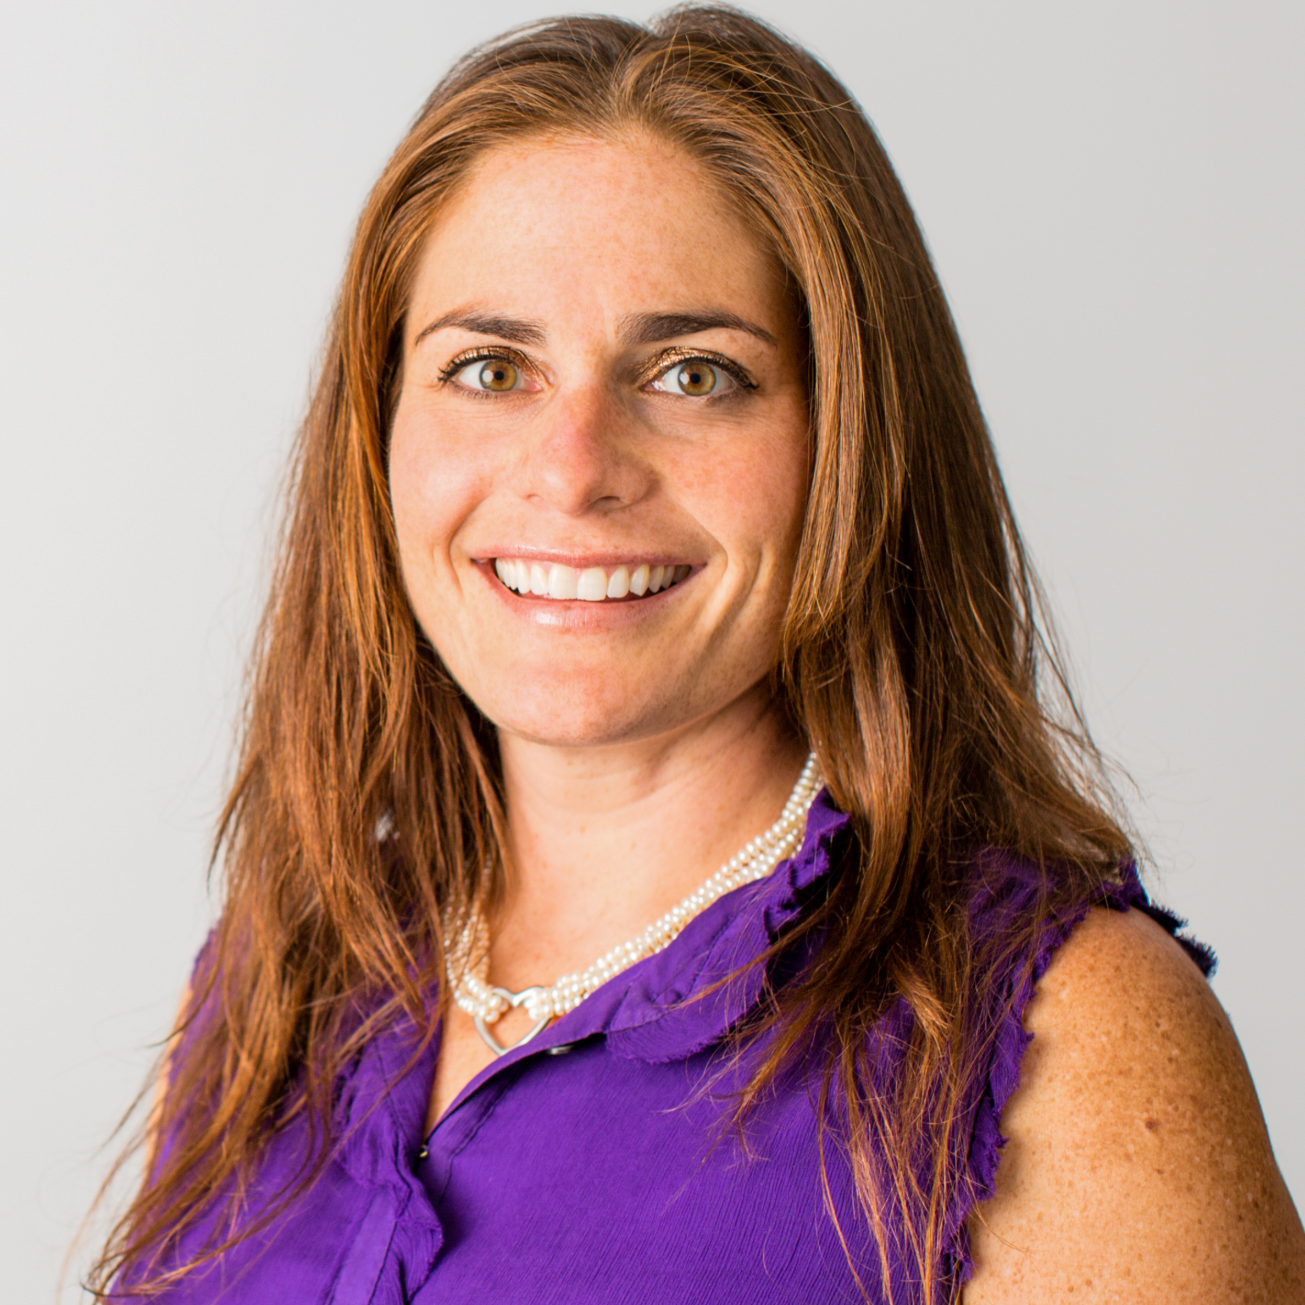
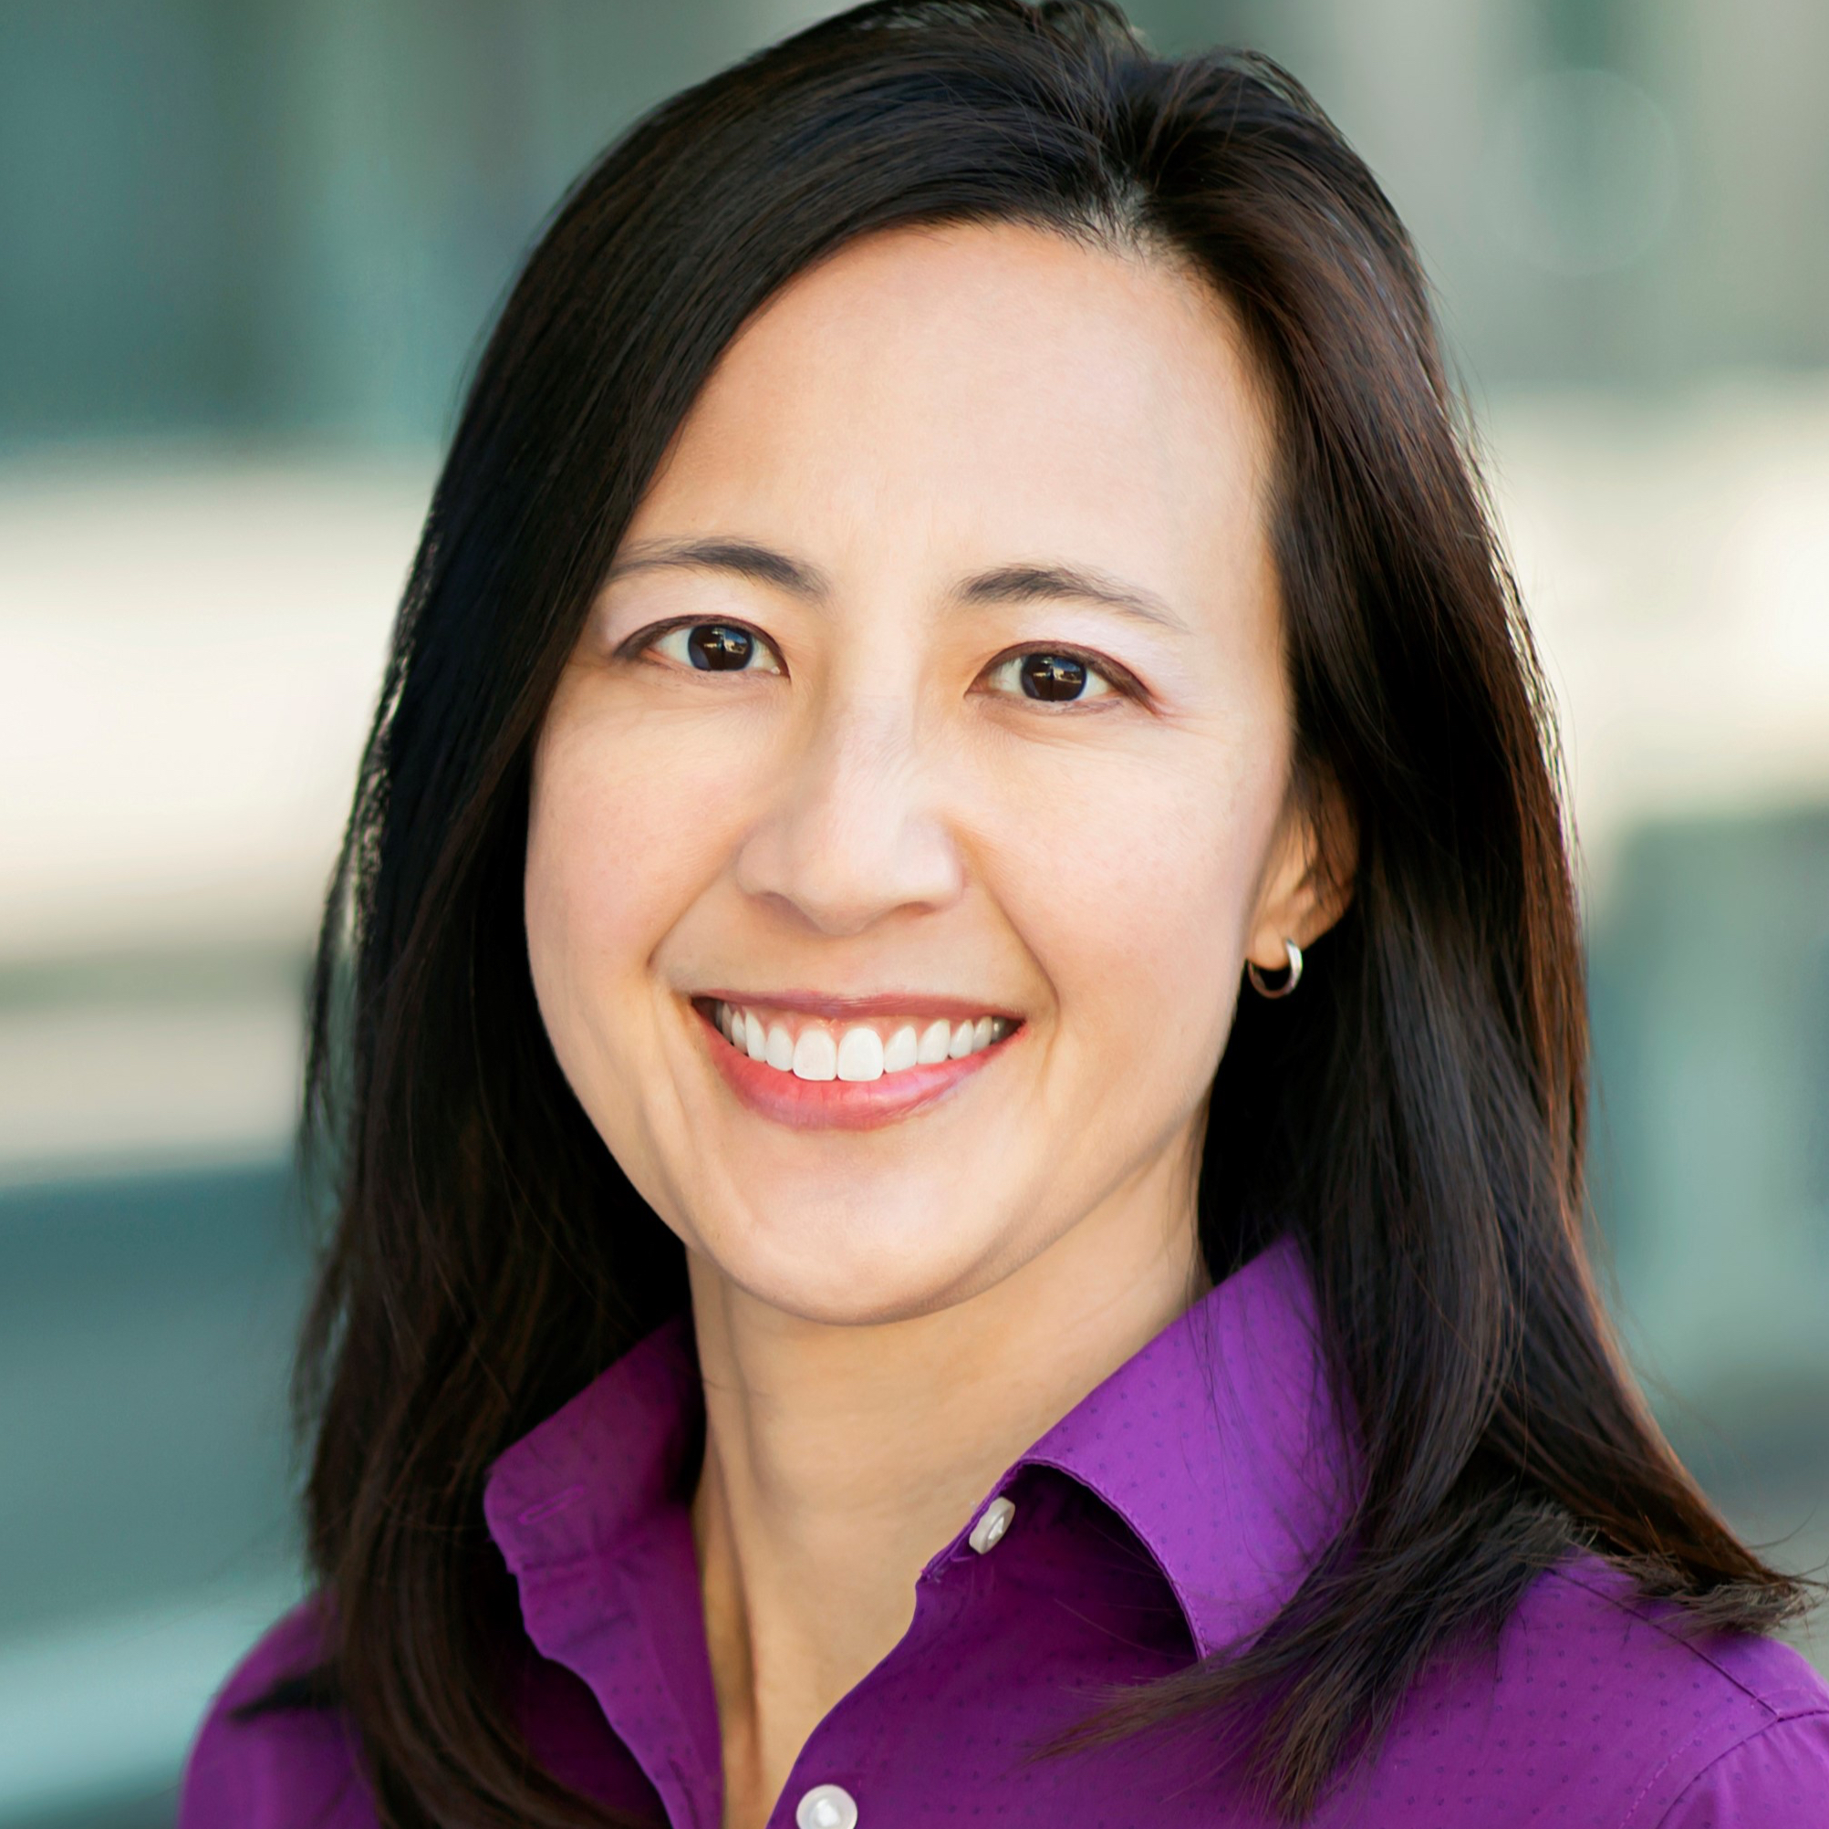
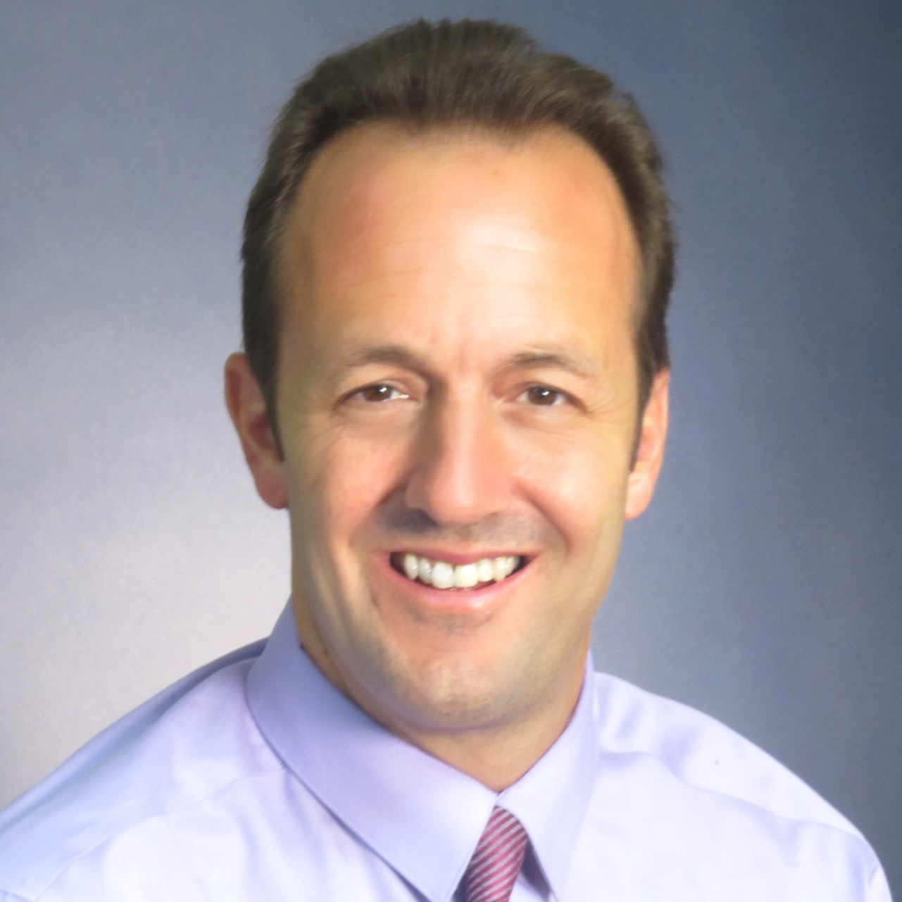
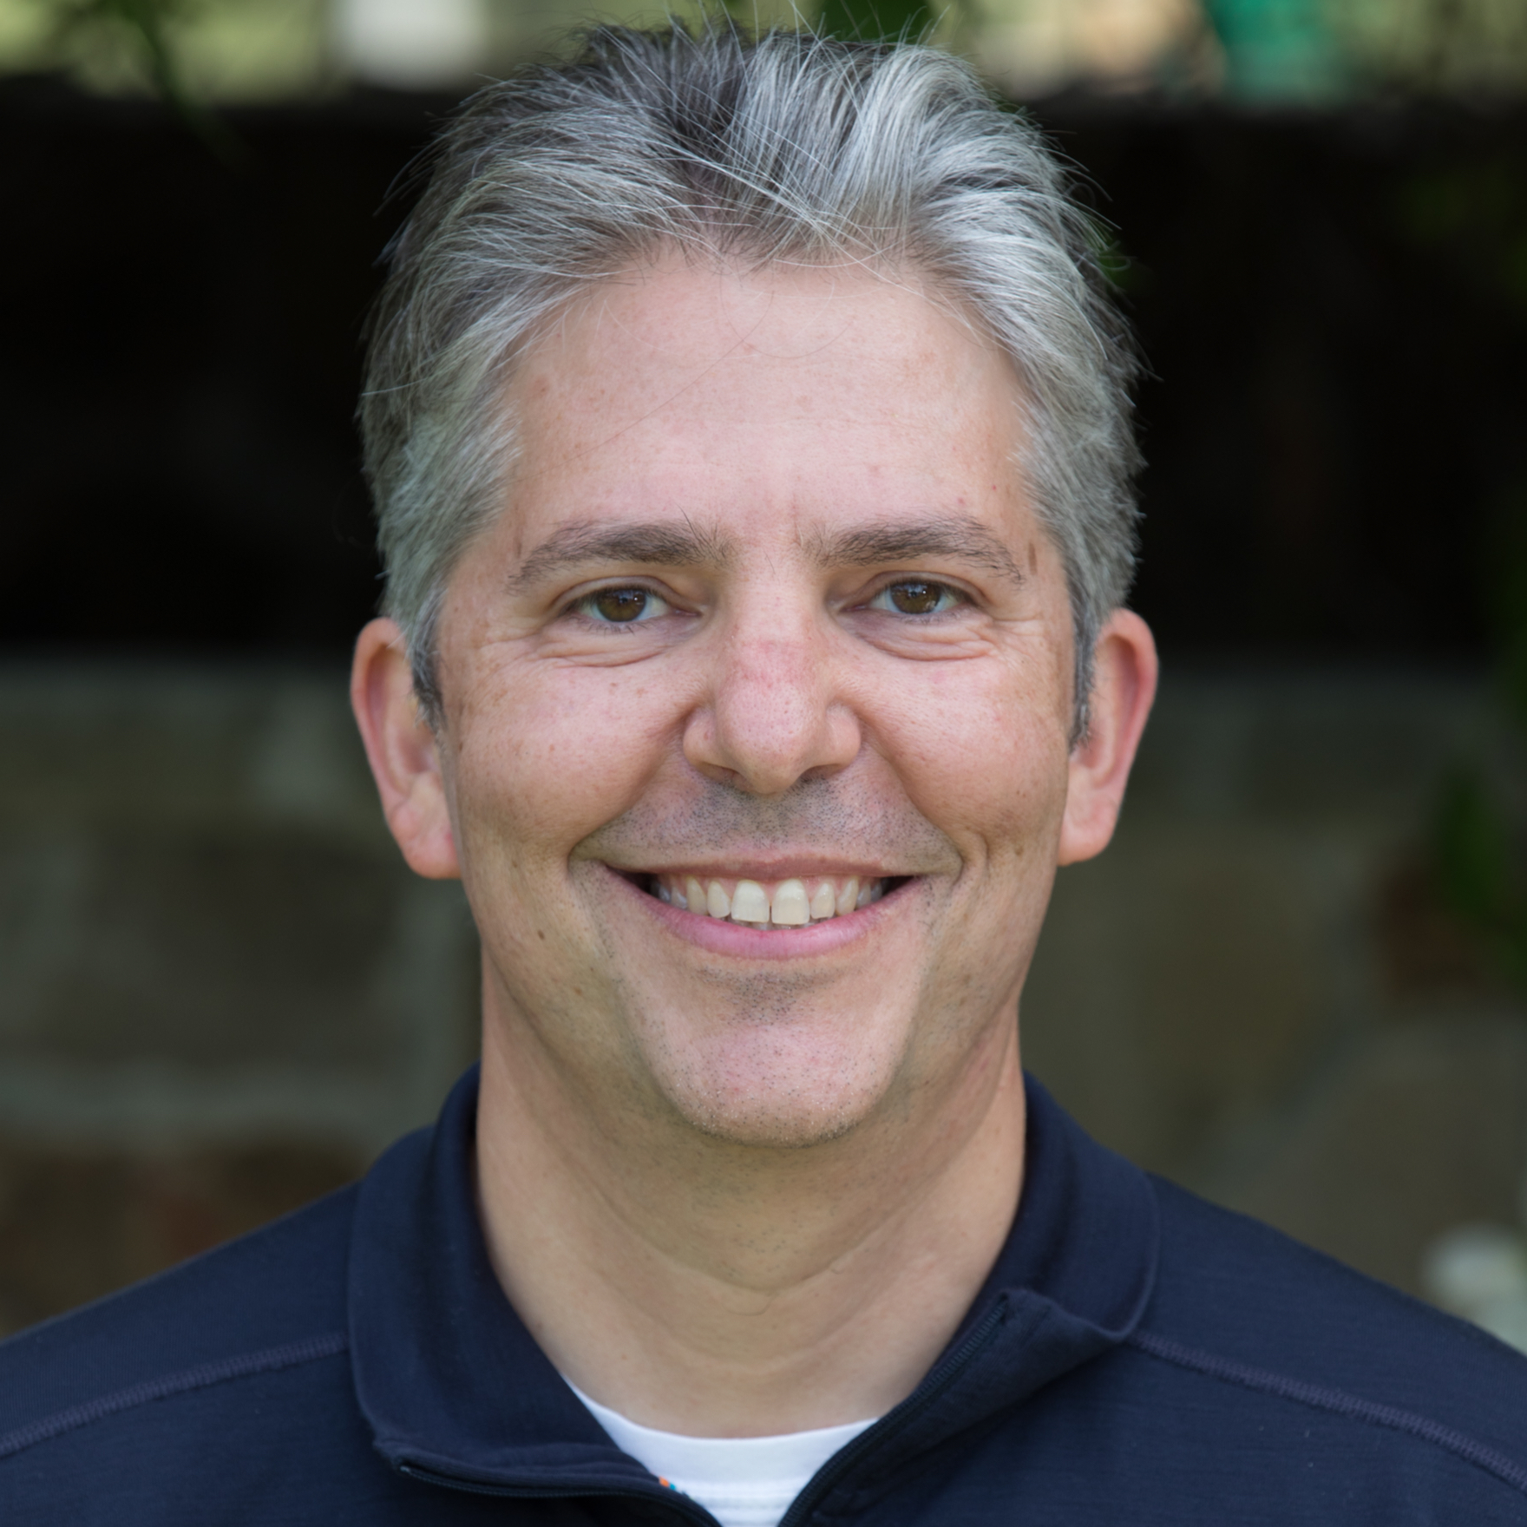
Day 1 Speakers
Kevin Hanley, MD
Assistant Professor
UCSF EM
Dina Wallin, MD
Associate Professor of EM and Pediatrics, UCSF EM
Mimi Lu, MD Professor of EM and Pediatrics
UCSF EM
Craig Smollin, MD Director, SF Poison Control
Professor, UCSF EM
Chris Colwell, MD
Chief of EM, San Francisco General Professor, UCSF EM

Slide 10


Please set your cell phone to
silent mode
Please be considerate of
your colleagues!

Slide 11
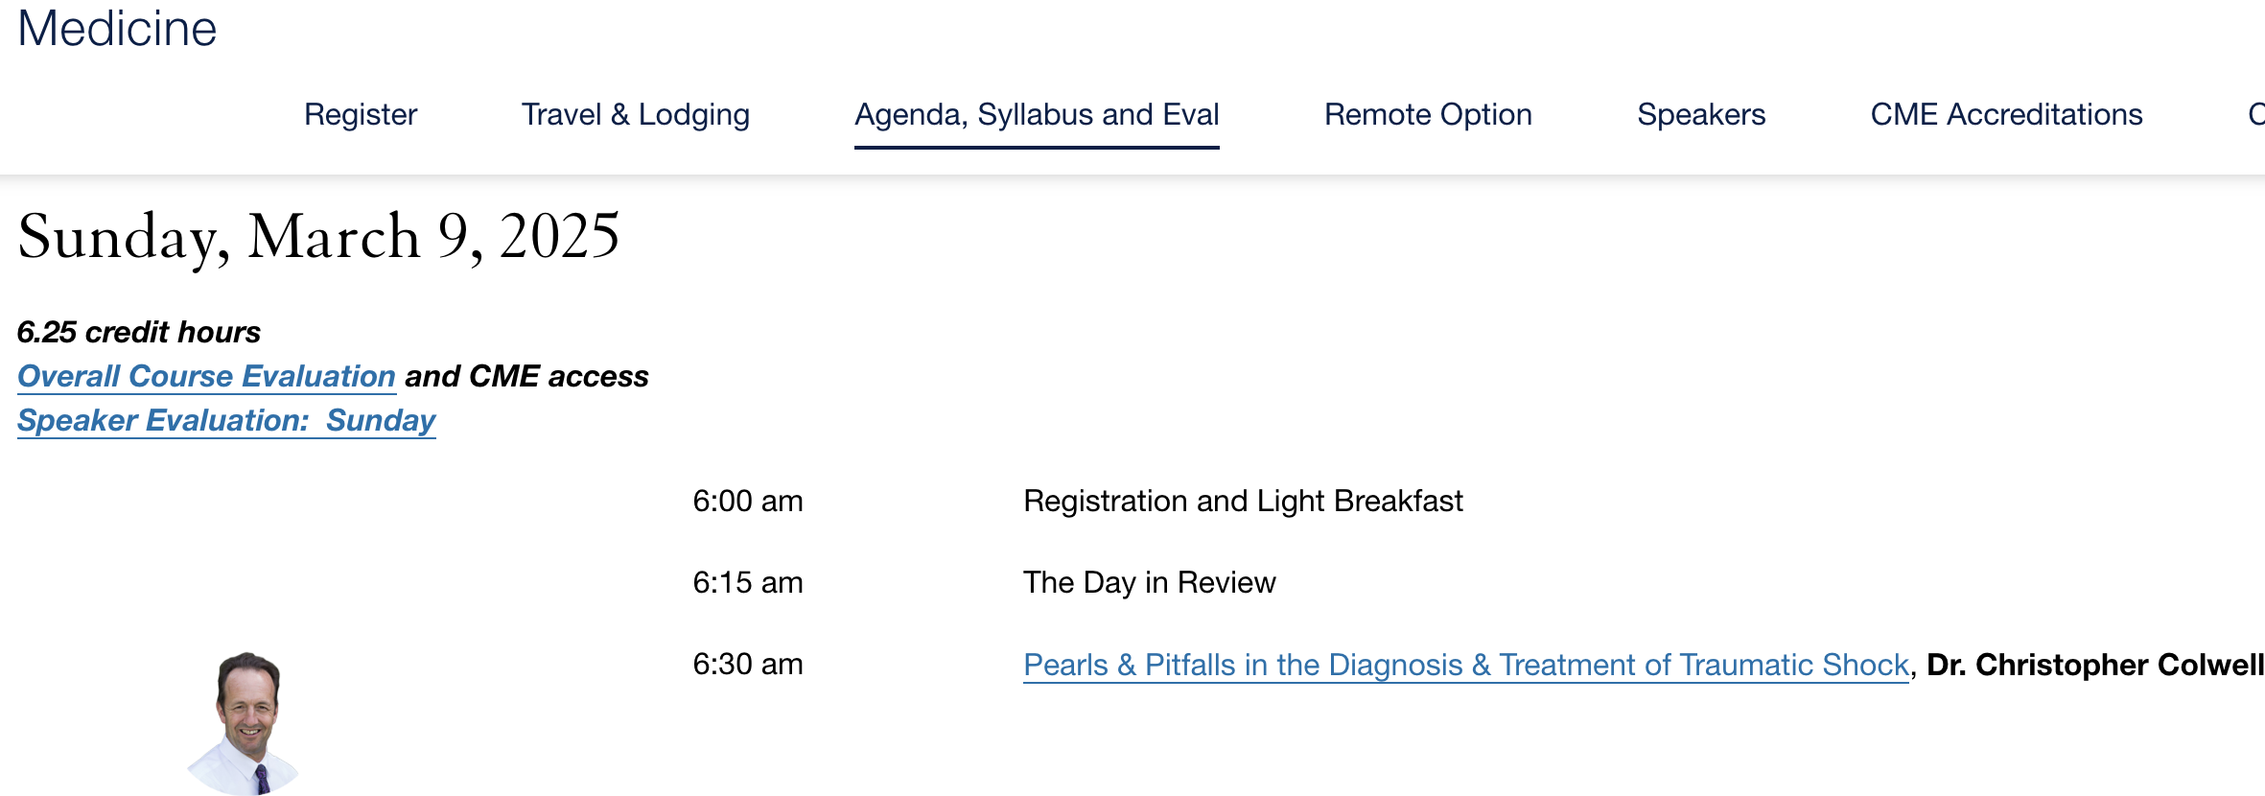
Course Slides Available at highriskem.com

Slide 12
Evaluations, CME, and MOC 2
Daily speaker evaluations
- Complete at HighRiskEM.com under Agenda, Syllabus, and Eval
- For ABIM or ABP MOC 2 Credit, please see Erin
CME Certificates
Can be claimed on or after final course day

Slide 13
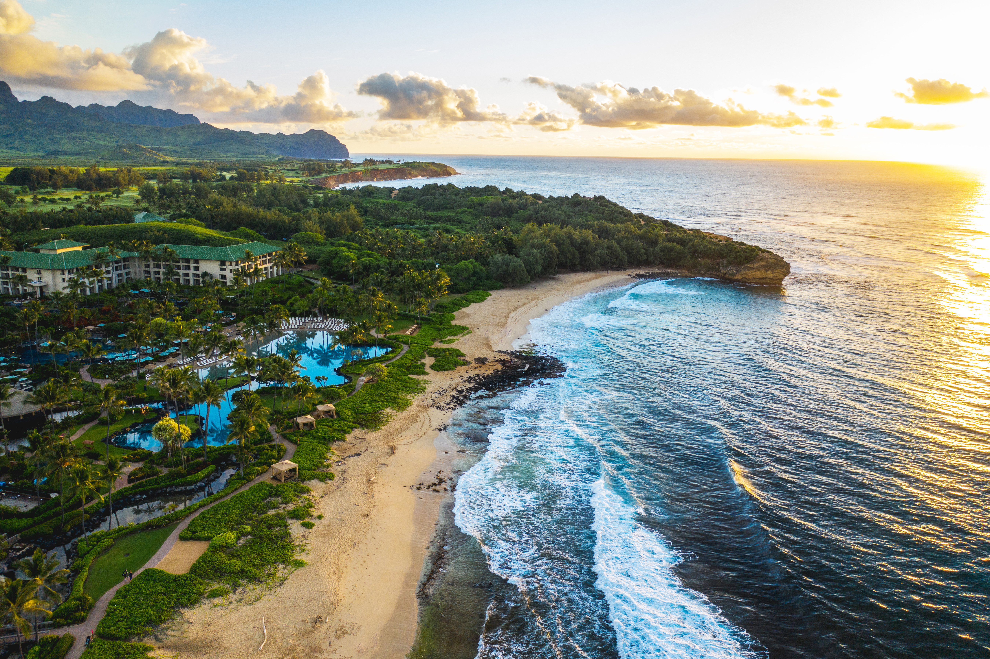
HIGH RISK EM HAWAII 2027
SAVE THE DATE:
March 15-19, 2027

Slide 14
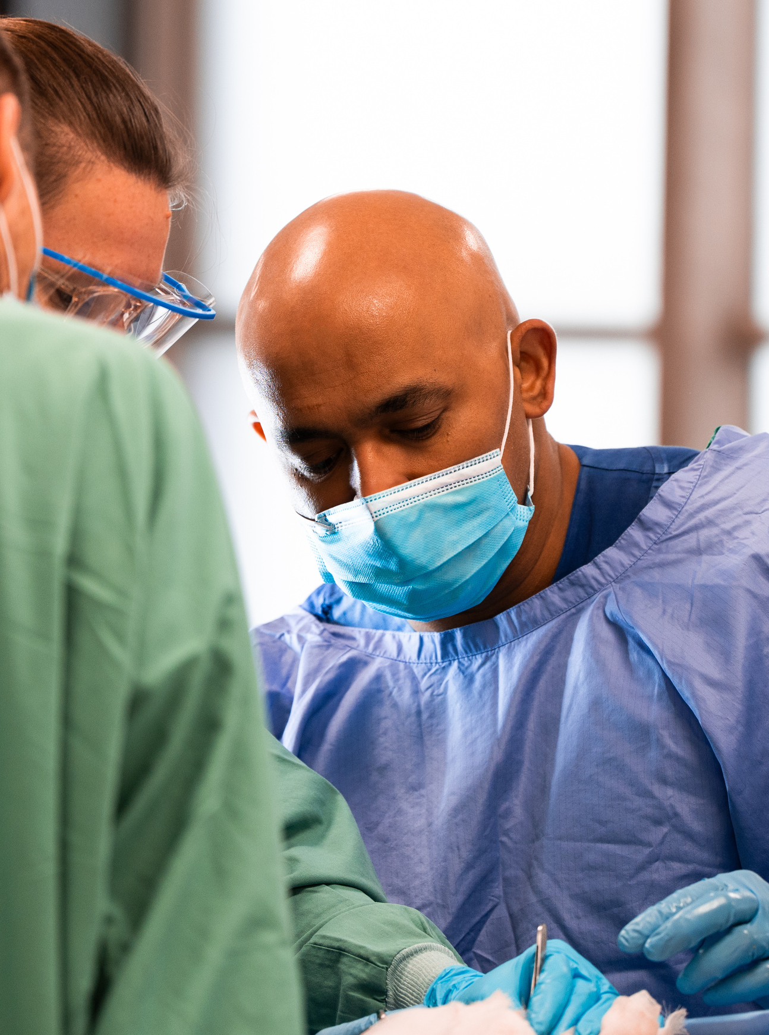


The Procedures Course Hawaii
March 12 & 13 , 2027
in Honolulu
An immersive cadaveric course focusing on life, limb and sight saving resuscitative procedures.

Slide 15
Thank you!

