Slide 1
Deadly Errors in the Well-Appearing Baby
Dina Wallin, MD
March 13, 2026
Notes:
Hello! It’s me again. On Tuesday, we talked about the critically ill infant and how to get them stabilized and OUT of your ED. We talked about

Slide 2
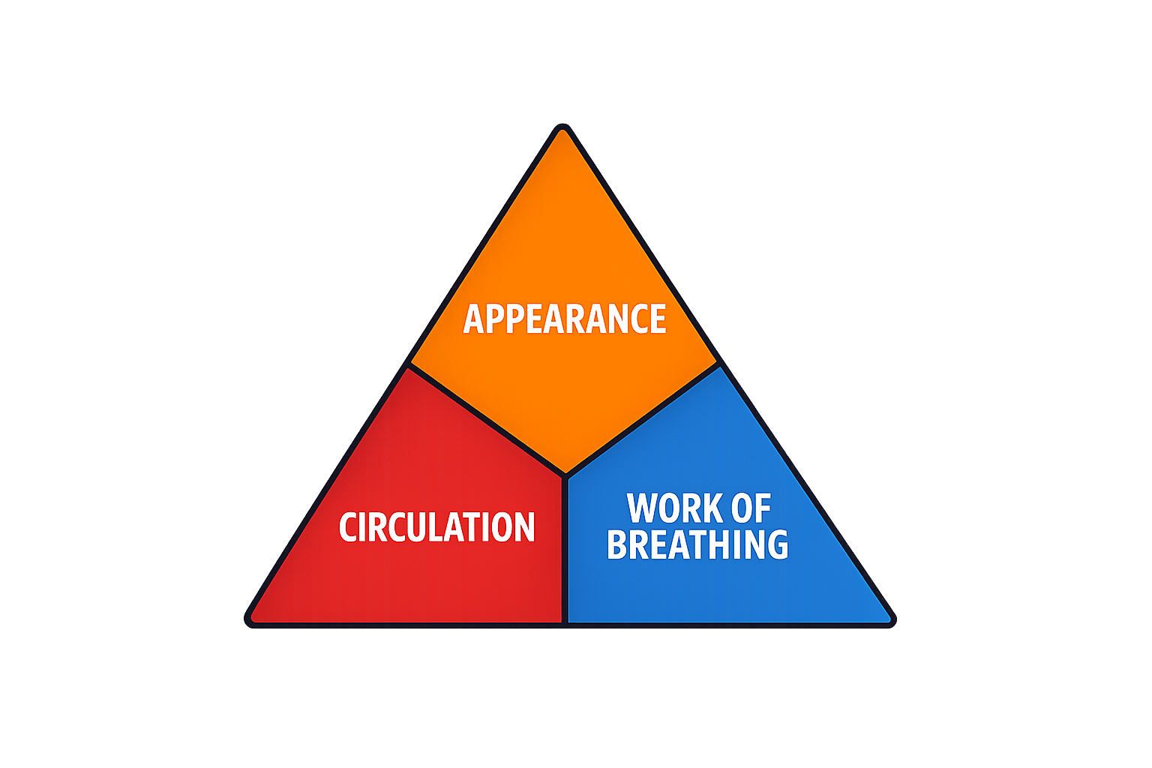
Notes:
The pediatric assessment triangle as a rapid way to assess sick or not sick,

Slide 3

ABCDE
Notes:
Followed by our typical ABCDE, remembering that bad is bad regardless of age, hypoglycemia can manifest all sorts of ways, and a specific diagnosis isn’t necessary to resuscitate the baby. It’s easy to recognize that you have do get AGGRESSIVE when your patient looks SICK. But what if your patient looks like this? If you don’t take care of many infants, or even if you do– HOW DO WE MAKE SURE WE DON’T MISS SOMETHING IN THE WELL-APPEARING INFANT? Everything we need to know about successfully caring for our sneaky infant patients can be boiled down into three take-away points:

Slide 4
Take-away points
The history and physical exam are your most powerful detective tools.
Vital signs are vital for a reason.
Babies love to eat– vomiting and poor feeding are always concerning.
Notes:
This is totally different from our adult patients, where we're usually going to be getting a slew of labs, imaging, and other testing to help us sort through their presentation. When an exam is otherwise benign, subtle alterations in VS can clue us in to an underlying sinister situation. So, our whole reason for being here, our

Slide 5
Goal
To strengthen clinicians’ ability to recognize and manage life-threatening conditions in well-appearing infants
Notes:
We’ll accomplish this via the following objectives:

Slide 6
Objectives
After attending this session, learners will be able to:
Describe subtle high-risk features in the history, vital signs, and physical examination of well-appearing infants
List key life-threatening diagnoses that may present with deceptively normal initial examinations
Apply a structured approach to the evaluation and risk stratification of the well-appearing infant.

Slide 7


1
Possible Diagnoses
Notes:
Let’s start by discussing a diagnostic schema for critical illness in infants. We already explored this on Tuesday, and this will build upon that. We want to think of some BIG BUCKET categories that can present very subtly and that we just can't miss. First, we think of

Slide 8
Infections
🦠
Notes:
As we mentioned before not all babies with life-threatening infections will have focal findings on exam (how does an 8-day-old communicate dysuria?) or a fever. Many will even have hypothermia, as we discussed. Because many of these infections can lead to death or permanent disability, we need to make sure we're not missing them. Another important category is

Slide 9
Vomiting
🤮
Notes:
Vomiting is a really common chief concern in the pediatric ED, and it's one we might be tempted to overlook in a well-appearing infant, chalking it up to a virus. Vomiting is much more likely to represent a structural or sinister cause in infants! We’ll see some important questions to ask to make sure we don’t miss anything.

Slide 10
Altered mental status
😵‍💫
Notes:
A baby doesn’t need to be comatose or losing their minds to be altered-- altered for an infant can be slightly off baseline. Although it can feel daunting to evaluate the mental status of a nonverbal patient who doesn’t do much other than eat, cry, pee, poop, and sleep– we’re lucky to have a secret weapon– caregivers! We’re going to see that enlisting the caregiver is critical to our approach. To that end– what IS our approach?

Slide 11
2
Framework
Notes:
a framework for the history and physical to make sure we get all the info we need to catch subtle dangerous diagnoses in our tiniest patients.

Slide 12
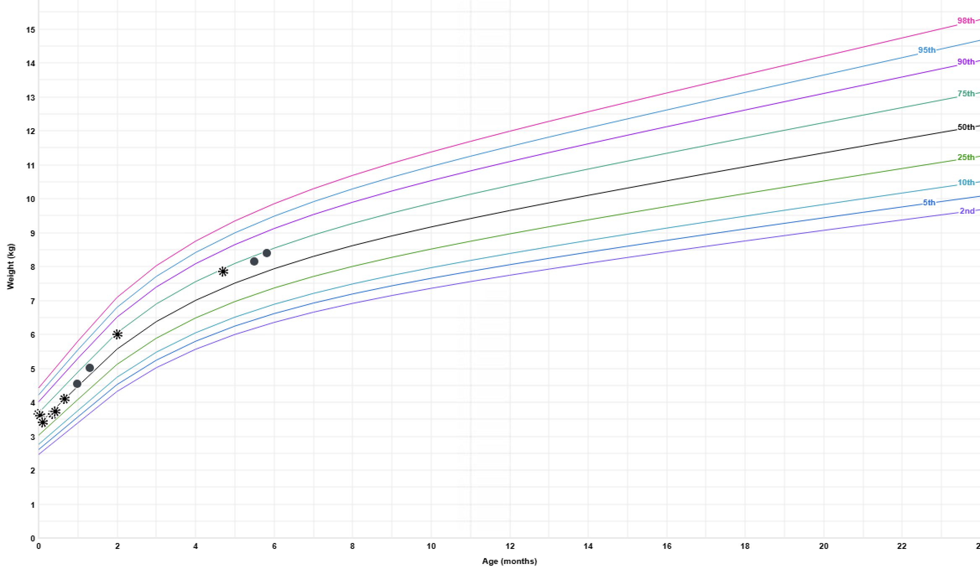
Vital signs
First step: full set of vital signs!
Rectal temp
Know normal vital signs.
Expanded vital signs:
  Current and birth weight
  Plot on growth curve
Notes:
With a rectal temp AND a BP. NO BED WEIGHT! You need an infant scale. This might make us feel like general pediatricians, but this is really important, and, yay, is built in to many EMRs. If we’ve got a kid chugging along here in the 75th percentile, and when his caregiver brings him in for vomiting, we’re here, THAT IS A PROBLEM. This already brings us to one of our take-away points:

Slide 13
Vital signs are vital for a reason.
Notes:
They set us up for a successful, thorough, accurate visit. Now we move on to our history. So, remembering the very few things that infants do to pass their time, let’s start with feeding.

Slide 14
History: feeding
Sweating, cyanosis, or fatigue during feeds?
Not waking up to feed?
Vomiting?
  Bilious? Blood? Projectile?
  After every feed?
  Diarrhea? URI symptoms? Fever? Sick contacts?
Notes:
now, on to another favorite pasttime of babies,

Slide 15
History: elimination 😳
Number of wet diapers in past 24 hours
Number, color, and consistency of stools in past 24 hours
How does this compare to normal?
Notes:
on to another important activity, one required for sustenance of life--

Slide 16
History: breathing
Apnea?
Increased work of breathing?
Abnormal breath sounds? Positional?
Cyanosis?
Notes:
We discussed on Tuesday that apnea is a symptom! Remember that different ethnicities will show cyanosis differently. Can look on mucosal membranes, and trust the caregiver (are you sensing a theme?). Then, onto more baby-specific questions,

Slide 17
History: overall
Behavior / mental status
  Extra fussy? Do they console with typical interventions?
  Extra sleepy?
  Abnormal or new movements?
Detailed review of systems
What are you most concerned about?
Notes:
Especially rhythmic movements– of any kind of any part of the body. I cannot over emphasize this point. We might feel scared to open Pandora’s box with this question, but this is critically important. For our American attendees, this is also important when we think of malpractice. Unfortunately, bad things sometimes happen no matter how amazing of a clinician we are, and people are more likely to sue not based on outcome, but based on how they felt. Feeling dismissed, ignored, or unheard can lead to major downstream legal problems… plus, none of us entered this field to dismiss our worried patients. OK, moving on to the exam…

Slide 18
Physical exam
Undress the infant completely.
Examine the entire body
Normal vital signs and exam ≠ nothing wrong
Serial exams increase sensitivity
Ask for photos or videos
Notes:
It’s not that hard to get the baby out of all their clothing (though getting the onesie BACK on is a bit challenging). Behind ears, in skin folds, diaper area. We talked about this on Tuesday too. You might be catching them between episodes, or what seems within the range of normal to YOU may be grossly ABnormal for this specific infant. This brings us to two other take-away points:

Slide 19
Babies like to eat.

Slide 20
The history & physical are your most powerful detective tools.
🔍
Notes:
This is VERY different from adults, where we often rely on data from testing to support our decisionmaking. OK, so, we have an idea of big buckets of scary diagnoses (infections, vomiting, altered mental status), and important components of our H&P. Let’s practice applying this to some real infants

Slide 21
3
Specific diagnoses
Notes:
And dive into some specific diagnoses.

Slide 22
Serious bacterial infection / sepsis
A 3-week-old presents with sleeping through several feeds over the past day. Looks overall well; rectal temp of 36.1; falls asleep immediately after exam.
Why we miss it:
  Might be afebrile or well-appearing
Pearls:
  Hypothermia, poor feeding, apnea, or mild tachypnea may be only symptoms
  Normal vitals don’t rule it out
  Trust caregiver concern
🦠
😵‍💫
Notes:
Several red flags here, right? Remember, babies like to eat! Vital signs are vital! We can’t write off that temperature. So, this could be… We mentioned this on Tuesday, too-- sepsis can present VERY subtly. These are important signs and symptoms to notice and respect. we see here, infection and AMS-- and if either is left unexplored/unaddressed, we need to keep going to be sure we don't miss something.

Slide 23
Inborn error of metabolism
A 6-day-old presents with lethargy and vomiting in the peak of viral season; mildly tachycardic; well-appearing though sleeping.
Why we miss it:
  Vomiting is SO common in other age groups!
  May appear well initially
Pearls:
  History of lethargy & vomiting + normal exam = metabolic until proven otherwise
  Worsening after feeds is a red flag
🤮
😵‍💫

Slide 24
Intussusception
A 10-week-old presents with vomiting and fussiness; mild tachycardia; otherwise normal exam, in your eyes and caregiver’s. Just before discharge, has episode of inconsolability and vomits.
Why we miss it:
  Can be smiling and playful between episodes
  Typically won’t have blood in stool until late
Pearls:
  Younger kids are more likely to have lethargy
  Consider ultrasound even if exam is benign
🤮
😵‍💫
Notes:
I guarantee you, you give this case to PEM docs, and we're thinking intuss, general EM, not s much. Up to 50% of cases will have lethargy as a presenting symptom, and it's more common in younger infants.

Slide 25
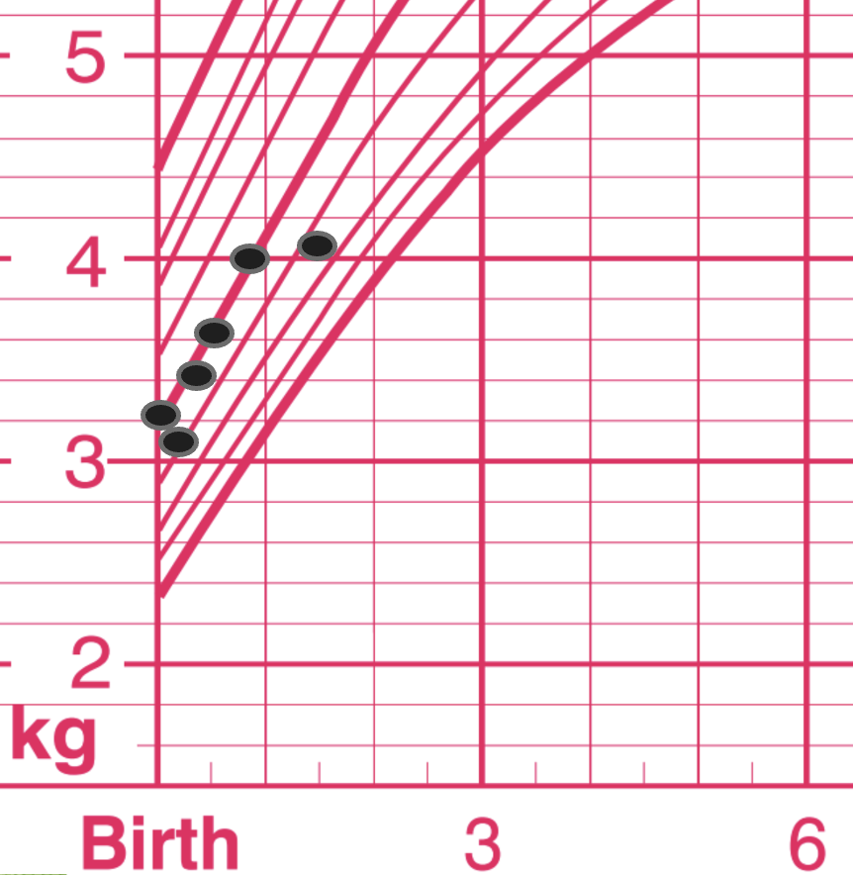
Pyloric stenosis
A 35-day-old presents with vomiting; normal vital signs; alert and rooting with normal exam. Breastfeeds vigorously in ED → non-bloody, non-bilious emesis of milk.
Why we miss it:
  Babies spit up!
  Infant looks well, hungry, no discomfort
  You’re never gonna see the olive
Pearls:
  “Projectile” aspect is subtle early
  Electrolyte abnormalities may precede visible dehydration → check labs and ultrasound
🤮
Notes:
You also remember to consult the infant’s growth chart and see this: Zofran trial and home? More common in first time parents and teen parents– easy to write them off

Slide 26
Meningitis
A 6-week-old presents with poor feeding; normal vital signs and normal exam, other than appearing slightly uncomfortable and fidgety; caregiver informs you this is not typical.
Why we miss it:
  Might not have fever, neck stiffness, AMS, or risk factors
  Fontanelle is typically normal early
Pearls:
  Irritability or poor feeding may be the only sign
  Paradoxical irritability
  Low threshold to LP infants
🦠
😵‍💫
Notes:
How can you have meningismus when you don't even have successful head control? How many folx have cared for an infant w meningitis?

Slide 27
Seizures
An 8-week-old presents with abnormal movements. Caregiver reports several episodes of bilateral arm stiffness and rapid blinking; completely normal exam; tolerates full feed in ED.
Why we miss it:
  Rarely appear like GTCs– often MUCH more subtle
  Babies make weird movements at baseline!
Pearls:
  Low threshold to contact pediatric neurology or transfer for EEG
  Early diagnosis minimizes impact on development → this matters
😵‍💫
Notes:
really! We admit these infants for video EEG happily.

Slide 28
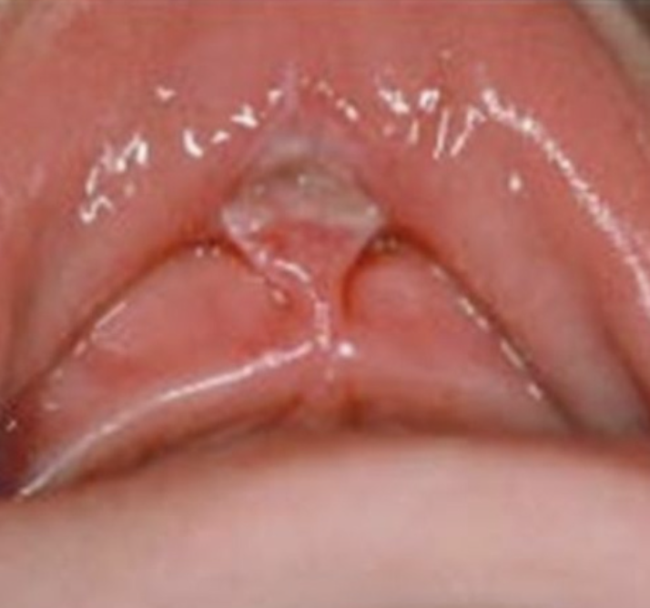
Non-accidental trauma
A 5-week-old presents with vomiting and fussiness; caregiver reports the infant has been inconsolable for days; normal vital signs; normal exam; tolerates feed in ED. She is discharged, and returns in cardiac arrest 1 week later.
Why we miss it:
  Often have normal physical exam
Pearls:
  Full and detailed physical exam
    Any bruising or burns, patterned lesions, frenulum tear
  Trust your spidey sense, while being aware of unconscious bias.
  Check in with caregivers of infants labeled as “fussy” and offer support
🤮
😵‍💫
Frenulum tear photo from https://ismilekids.com/frenum-tear/
Notes:
So, this is a downer case, and it's not meant to scare you. It's meant to normalize that this is common and WE MISS THIS. WE MISS THIS.

Slide 29
4
Recap
Notes:
Ending on that downer… let’s recap the primary themes of what we’ve learned. We know that babies are likely to be FINE– they’re strong and resilient and have been surviving for millennia. However, we have seen that life-threatening conditions can present VERY subtly, and if we apply a systematic framework every single time, we are MUCH less likely to miss these.

Slide 30
Approach
Detailed history:
  Feeds, peeing/pooping, breathing, behavior
  ROS
  What are you most worried about?
Detailed exam:
  Full set of vital signs, including rectal temp
  Measure weight, plot on growth chart
  Fully undress and examine head to toe
  Serial exams / observation

Slide 31
Options
Discharge with 12-24h follow-up
  Pediatrician conversation?
Admit for observation
Go fishing
  Glucose
  Basic metabolic panel
  Procalcitonin
  Urinalysis
  Consider abdominal ultrasound if emesis
Notes:
… and once we’re here, we’ve either elicited all the info from the H&P, obsed the kid, and found absolutely NOTHING, and everyone feels good going home, OR at some point along the way, in history, physical, obs time the baby has done SOMETHING that makes us curious to know more. CAN admit for observation in many settings– how many folx think that would work in their shop? Now, I’d love to hear from folx, what might be the fishing we’d do? There’s no correct answer here, and of course every infant will be different. BMP can give an impression of overall milieu– renal function, bicarb, electrolytes themselves. PCT– be ready to do something about it if it comes back elevated. UA can also give an idea of hydration status. But I would say NO on viral testing, EKG (so hard to interpret, varies widely by WEEKS of development what really are you looking for?), CXR, CBC/ESR/CRP, belly XR, or head imaging. And then, here we are– we’ve either found something, in which case, go us, or…

Slide 32
Options
Discharge with 12-24h follow-up
  Pediatrician conversation?
Admit for observation
Go fishing
  Glucose
  Basic metabolic panel
  Procalcitonin
  Urinalysis
  Consider abdominal ultrasound if emesis
Notes:
And really, although, yes, we can’t predict the future, and sometimes we’re unlucky enough to be involved in the 1 in 1 million case with the worst, rarest outcome… at this point, we’ve given the infant the best possible chance and we’ve really met standard of care. This is where we need to lean in to our emergency medicine mindset and embrace uncertainty– communicate clearly and kindly with caregivers, share our thought processes and any data to support them, communicate clear return precautions and follow-up plan, and… good bye.
So, again, one final sweep to be sure we don’t miss anything--

Slide 33
Top pearls
Normal vital signs and exam ≠ nothing wrong
Major can’t miss categories: infection, vomiting, altered mental status
Trust caregiver concern
Notes:
And, of course, our take-away points:

Slide 34
Take-away points
The history and physical exam are your most powerful detective tools.
Vital signs are vital for a reason.
Babies love to eat– vomiting and poor feeding are always concerning.
Notes:
We reviewed high yield components of each, and if you’re systematic about it, you won’t miss the red flags. Vital signs, including weight, are CRITICAL. And babies love to eat! Respect feeding challenges as both a symptom and a problem on its own. So, hopefully now

Slide 35
Objectives
After attending this session, learners are able to:
Describe subtle high-risk features in the history, vital signs, and physical examination of well-appearing infants
List key life-threatening diagnoses that may present with deceptively normal initial examinations
Apply a structured approach to the evaluation and risk stratification of the well-appearing infant.
Notes:
All with the

Slide 36
Goal
To strengthen clinicians’ ability to recognize and manage life-threatening conditions in well-appearing infants
Notes:
Thanks so much for listening! I look forward to questions at the panel.

Slide 37
Thank you!

Slide 38
Specific conditions
Serious bacterial infection / Sepsis
  Infections, AMS
Congenital heart disease
  Vomiting, congenital stuff, AMS
Inborn errors of metabolism
  Vomiting, congenital stuff, AMS
Intussusception
  Vomiting, AMS
Pyloric stenosis
  Vomiting, congenital stuff

Slide 39
Specific conditions
Meningitis
  Infections, vomiting, AMS
Omphalitis
  Infections
Seizures
  Congenital stuff, AMS
Anatomic airway lesions
  Congenital stuff
Non-accidental trauma
  Vomiting, AMS
Notes:
So, we see that if we make sure to consider each of these categories and think, what could I be missing? , we WON’T miss it.

Slide 40
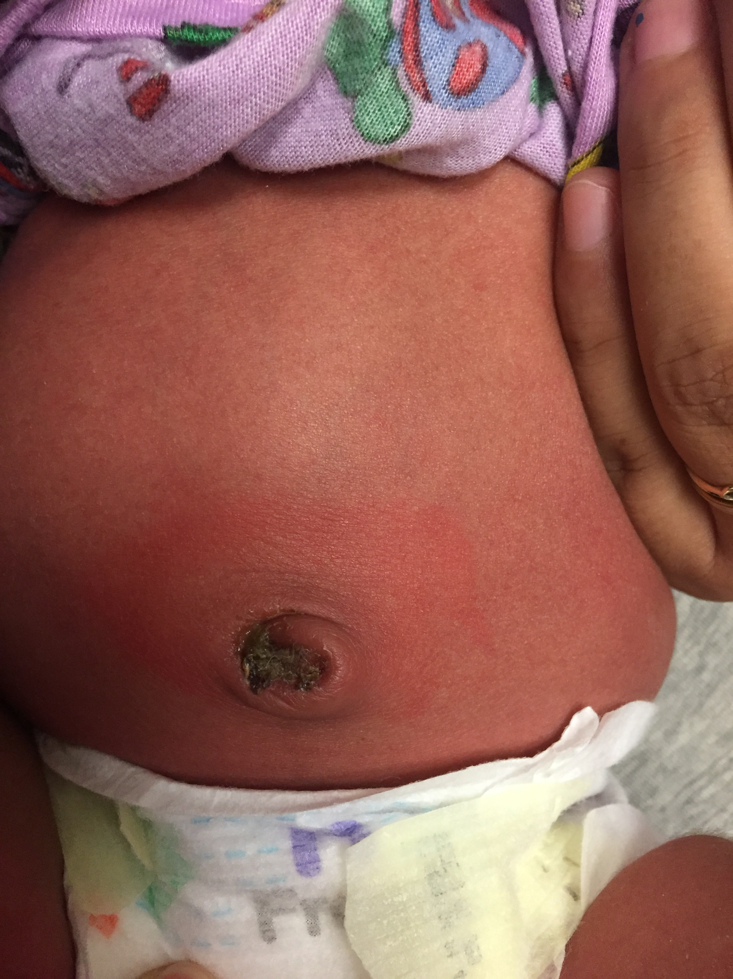
Omphalitis
A 9-day-old presents with redness around umbilical stump; feeding well, no fevers or purulent drainage; normal vital signs and normal exam, other than:
Why we miss it:
  Typically afebrile and well-appearing
  Might dismiss as normal or mild irritant dermatitis
Pearls:
  Requires full sepsis workup, IV antimicrobials, admission
🦠
Notes:
What is this? Why is it dangerous? Can lead to sepsis, yes, and also can lead to portal venous thrombosis, liver abscess, and cirrhosis! 7–15% mortality rate

