Slide 1
Gut Punch: Pediatric blunt abdominal trauma
Dina Wallin, MD
February 19, 2024
UCSF-San Francisco General Hospital
Notes:
Good morning, and I hope everyone had an awesome weekend. My name… and I’m here to speak with you about blunt abdominal trauma, something we see not uncommomonly yes, at our trauma center, and also everywhere that kids show up. How many people here work in a trauma center, of any level? How many people care for traumatically injured kids at their site? Everything we’re going to discuss today can be boiled down to 3 takeaway points.

Slide 2
Take-aways
Rules rule!
Not so FAST– optimal use of the FAST is in flux.
If you don’t quit your bellyachin’… I’ll have to admit you.
Notes:
Let’s meet a few kids to kick things off.

Slide 3
Cases
Kai: 8yo restrained passenger in rollover MVC with totaled vehicle. Scared-appearing with normal vital signs, no symptoms, no abdominal TTP.
Riley: 4yo restrained passenger in rollover MVC with totaled vehicle. Crying, mild tachycardia for age, scattered abrasions, mild abd TTP without R/G.
Taylor: 6yo restrained passenger in rollover MVC with totaled vehicle. Crying, mild tachycardia for age, bruising across abd with TTP and R/G.
Notes:
OK, so, we’ve got an ED full of crying kids with belly pain. What do we do now? This is exactly our goal for being here:

Slide 4
Goal
To improve and streamline evaluation and management of pediatric blunt abdominal trauma, balancing avoidance of unnecessary testing with detection of clinically significant injury
Notes:
We’ll accomplish that via the following objectives:

Slide 5
Objectives
After attending this session, learners will be able to:
Apply the PECARN clinical decision instrument for pediatric blunt torso trauma to the acutely injured child.
Describe the utility of the FAST exam in pediatric patients with blunt abdominal trauma.
Discuss potential next steps for the evaluation and management of the child with suspected intra-abdominal injury.
Notes:
again, these objectives boil down to our three take-aways:

Slide 6
Take-aways
Rules rule!
Not so FAST– optimal use of the FAST is in flux.
If you don’t quit your bellyachin’… I’ll have to admit you.

Slide 7
No commercial or financial interests to disclose.
Notes:
All righty, let’s jump into things.

Slide 8
Intra-abdominal injury
Leading cause of morbidity
Kids more likely to sustain than adults…
but are less likely to receive intervention.
Adolescents cared for by pedi team less likely to receive IR/angio for confirmed splenic injury
IAI vs IAI-I… ai yi yi!
Notes:
Hepatic surgery c high M/M rtal in kids, splenic assoc c sepsis which has higher fatal in kids; 27/74 adult ones got angio (23 c embolization) and 0/59 peds did. So what we’re REALLY talking about is IAI-I: death caused by the intra-abdominal injury, a therapeutic intervention at laparotomy, angiographic embolization to treat bleeding from the intra-abdominal injury, blood transfusion for anemia as a result of hemorrhage from the intra-abdominal injury, or administration of intravenous fluids for 2 or more nights in patients with pancreatic or gastrointestinal injuries . We’re most worried about liver, spleen, and bowel.

Slide 9
Intra-abdominal injury
Longer LOS
Higher cost
Poking a kid isn’t nothing!
Incidentalomas a tad less relevant
Radiation
Notes:
SO, why don’t we just lab and CT everyone? What are some drawbacks to working up every kid? LOS more impactful for a child + fam, not to mention multiple pokes. And that’s the real one. Kids inherently more susceptible to radiation than adults and we really do need to be thoughtgul– breast, gonad, kidneys, lymph/heme all getting thoroughly irradiated. SO, because of this, there’s been significant interest in figuring out a way to safely risk-stratify kids.

Slide 10
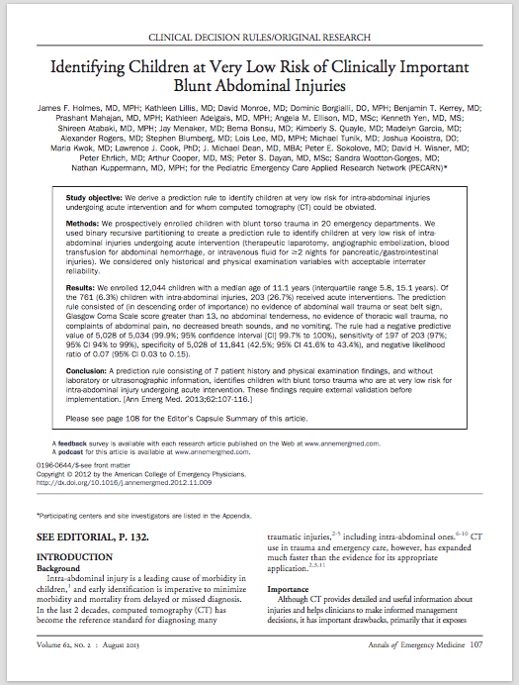
Notes:
Published 2013, prospective, 12,044 children, median age 11.1. Looks for IAII. They ask seven sequential questions to determine who can safely avoid further workup:

Slide 11
Seven questions:
Abdominal wall trauma/seatbelt sign?
GCS < 14?
Abdominal tenderness?
Thoracic wall trauma?
Abdominal pain?
Absent or decreased breath sounds?
Vomiting?
0.1% chance of IAI-I
Sensitivity 97%, specificity 43%
Notes:
This rule is awesome! But, looking at our specificity, this brings up a super important point:

Slide 12
1. If a patient cannot be ruled out by the decision instrument, this does not mean that the patient needs a scan.
Notes:
This is not a bidirectional decision instrument! It was derived to identify kids who are LOW risk, not those who are high risk.

Slide 13
1. If a patient cannot be ruled out by the decision instrument, this does not mean that the patient needs a scan. 2. This decision rule is not intended for non-accidental trauma.
Notes:
Neither is PECARN head, BTW.

Slide 14
Take-aways
Rules rule!
Notes:
Rules absolutely RULE. The PECARN abdomen rule is immensely helpful in supporting us to avoid unnecessary radiation, while ensuring we’re picking up clinically significant injuries. But what about kids who we can’t screen out with the rule? How can we find clinically significant injuries without irradiating every child? Let’s start with

Slide 15
LABS
Notes:
Labs! We love getting labs. There’s nothing more fun than poking a screaming child who’s just been through one of the most stressful events of their young lives. Let’s start with pee, since that’s relatively non-invasive…

Slide 16
Hematuria
Microscopic (> 5 RBC/hpf): OR 4.8 for IAI
Gross: OR 5.8
Microscopic hematuria with otherwise normal exam likely does not need imaging.
Notes:
CITATIONS PER TRAUMA LECT. Marker not only for GU inj but also other intraabd inj. But no kids with asymptomatic hematuria, regardless of grade of hematuria or GCS, had abnl CT. This is wild because in an adult, we would definitely be worried. Do need to have f/u UAs to be sure hematuria clears. OK, so this needs to be in combination with exam. What about blood tests

Slide 17
Liver function tests
AST > 200 U/L or ALT > 125 U/L independently associated with IAI
Most effective in combination with other tests
Notes:
This is different from adults! LFTs aren’t helpful in adults. Such as…

Slide 18
Lipase
No pancreatic injury detected on elevated lipase alone
Useful if clinical suspicion
Notes:
OK, so labs on their own aren’t super helpful, but do contribute to the exam… what about the FAST?

Slide 19
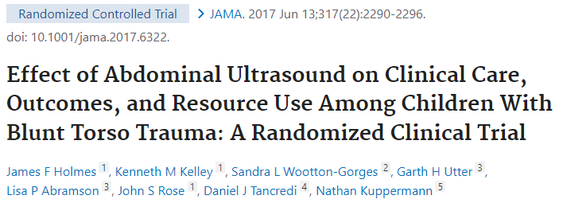
FAST
Various reports of test characteristics:
Pooled meta-analysis: sens 35%, spec 96%
Earth-shattering news for POCUS enthusiasts:
Notes:
How many people routinely FAST their kids? So, somewhere around 50% sensitive and 90s specific. Sensitivity and specificity both increase with increasing experience, and ALSO increase with repeat FAST exams. This supports how the FAST is now commonly used in children– while in adults, the FAST is used for its positive predictive value (a positive FAST with hypotension goes straight to OR), in children, it’s useful for its negative predictive value– when used correctly, it may be helpful to avoid unnecessary CTs. But THEN-- How many people remember when this came out?

Slide 20
FAST
FAST as part of initial evaluation:
No change: CT rate, missed injury, ED LOS, charges, hospital admission
“These findings do not support the routine use of FAST in [hemodynamically stable children treated in an ED following blunt torso trauma].”
Not so fast!!
Notes:
The authors concluded that FAST did not impact rates of CT use
However, what they did find was that an additional 68 children (nearly 20%) had a post-test probability for injury of less than 1% - meaning, the clinician’s suspicion of IAI was reduced in a substantial proportion of patients in the FAST group. it may be that the decrease in clinician suspicion without corresponding decrease in CT is a result of clinicians lacking confidence in their FAST skills. Again, we know that the FAST performs better with increasing operator experience. Clearly, clinician suspicion is also heavily influenced by the physical exam– how do the exam and FAST work together?

Slide 21
FAST + exam
Notes:
AST > 200, ALT > 125. in this study by my colleague Dr. Aaron Kornblith and his team, only FAST and physical exam emerged as significant predictors. Fast-enhanced physical exam, or ex-FAST:

Slide 22
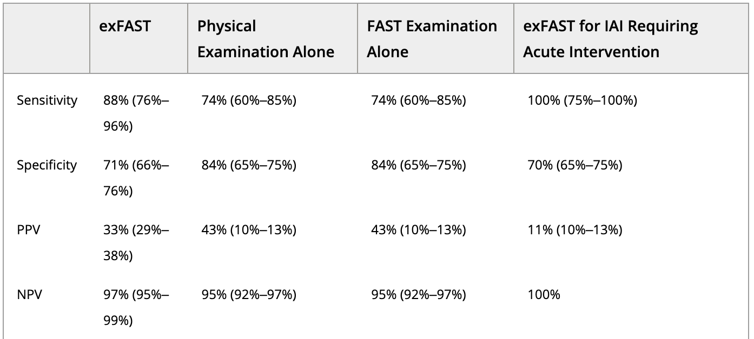
FAST + exam
Notes:
I want to call your attention to: 100% sensitivity for IAI-I, with a 100% negative predictive value! Pretty frickin’ good! SO, putting it all together, FAST is not super sensitive, IS super specific, and its impact on clinical practice, such as obtaining a CT or not, relies on the operator’s confidence in their performance. What’s on the horizon for FAST? Controversial for sure! To share more work by my colleague Dr. Kornblith and his team,

Slide 23
Seven questions:
Abdominal wall trauma/seatbelt sign?
GCS < 14?
Abdominal tenderness?
Thoracic wall trauma?
Abdominal pain?
Absent or decreased breath sounds?
Vomiting?
Notes:
They just performeda recent analysis of the PECARN rules and, we found that the final 4 of the 7 PECARN rule predictor variables, had poor stability this means they lacked generalizability when retrospectively evaluated on 16 other sites
Therefore, when we consider sensitivity-specificity tradeoff, these 4 unstable predictor variables decrease specificity of the PECARN IAI rule without a clear gain in sensitivity.
These are the variables that if replaced, could potentially improve specificity
Our early work shows that FAST may improve specificity without decreasing sensitivity
Currently, we are working on several studies related to these findings, including (1) a multicenter PECARN study and (2) novel methods using artificial intelligence to enhance the acquisition, interpretation and confidence of our pediatric FAST examinations. Super cool stuff coming down the pike!

Slide 24
Seven questions:
Abdominal wall trauma/seatbelt sign?
GCS < 14?
Abdominal tenderness?
Thoracic wall trauma?
Abdominal pain?
Absent or decreased breath sounds?
Vomiting?
Notes:
They just performeda recent analysis of the PECARN rules and, we found that the final 4 of the 7 PECARN rule predictor variables, had poor stability this means they lacked generalizability when retrospectively evaluated on 16 other sites
Therefore, when we consider sensitivity-specificity tradeoff, these 4 unstable predictor variables decrease specificity of the PECARN IAI rule without a clear gain in sensitivity.
These are the variables that if replaced, could potentially improve specificity
Our early work shows that FAST may improve specificity without decreasing sensitivity
Currently, we are working on several studies related to these findings, including (1) a multicenter PECARN study and (2) novel methods using artificial intelligence to enhance the acquisition, interpretation and confidence of our pediatric FAST examinations. Super cool stuff coming down the pike! This brings us to our second take-away point:

Slide 25
Take-aways
Rules rule!
Not so FAST– optimal use of the FAST is in flux.
Notes:
It likely does help, in combination with our exam, and is more useful as WE are more confident. SO… keep doing those FASTs! Get better, get more confident, and keep an eye out for new data. OK, so, we’ve discussed a clinical decision instrument to identify very low risk patients; and also discussed utility of labs and FAST to risk stratify those remaining. Now, let’s take some time to

Slide 26
Put it all together.

Slide 27
Three questions:
Abd wall trauma/seatbelt sign?
GCS < 14?
Abd tenderness?
AND
FAST
Notes:
This is how I’m thinking about things in the HEMODYNAMICALLY NORMAL kid. If any of these, I’m going to give analgesia, obtain labs, and perform serial exams. Adding in the FAST– if IT is positive or indeterminate, I’m also going to give analgesia, obtain labs, and perfrm serial exams.

Slide 28
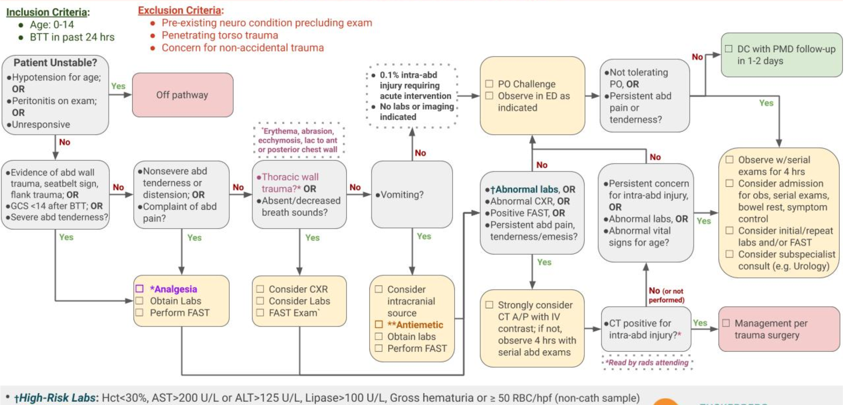
Notes:
This is an algorithm I co-developed, incorporating the CDI, labs, and FAST. Let’s walk through it a bit. You can pull it up and follow along with the QR code here. So, the whole point of this is to improve care for real kids, right? So let’s go back to our

Slide 29
Cases
Kai: 8yo restrained passenger in rollover MVC with totaled vehicle. Scared-appearing with normal vital signs, no symptoms, no abdominal TTP.
Riley: 4yo restrained passenger in rollover MVC with totaled vehicle. Crying, mild tachycardia for age, scattered abrasions, mild abd TTP without R/G.
Taylor: 6yo restrained passenger in rollover MVC with totaled vehicle. Crying, mild tachycardia for age, bruising across abd with TTP and R/G.

Slide 30
Cases
Kai: 8yo restrained passenger in rollover MVC with totaled vehicle. Scared-appearing with normal vital signs, no symptoms, no abdominal TTP.
Riley: 4yo restrained passenger in rollover MVC with totaled vehicle. Crying, mild tachycardia for age, scattered abrasions, mild abd TTP without R/G.
Taylor: 6yo restrained passenger in rollover MVC with totaled vehicle. Crying, mild tachycardia for age, bruising across abd with TTP and R/G.
Notes:
Let’s start with Kai. We see that we’re hemodynamically normal, so we apply our questions:

Slide 31
Three questions:
Abd wall trauma/seatbelt sign?
GCS < 14?
Abd tenderness?
AND
FAST
Notes:
No, no, no. We do a FAST and it’s normal. Now what?

Slide 32
Cases
Kai: 8yo restrained passenger in rollover MVC with totaled vehicle. Scared-appearing with normal vital signs, no symptoms, no abdominal TTP.
Emotional validation
+/- analgesia
PO challenge in ED
VERY supported to discharge without further testing!
Notes:
Great job! Let’s talk about Riley.

Slide 33
Cases
Kai: 8yo restrained passenger in rollover MVC with totaled vehicle. Scared-appearing with normal vital signs, no symptoms, no abdominal TTP.
Riley: 4yo restrained passenger in rollover MVC with totaled vehicle. Crying, mild tachycardia for age, scattered abrasions, mild abd TTP without R/G.
Taylor: 6yo restrained passenger in rollover MVC with totaled vehicle. Crying, mild tachycardia for age, bruising across abd with TTP and R/G.
Notes:
We see that, although we have tachycardia, our hemodynamics are OK. Let’s apply our questions:

Slide 34
Three questions:
Abd wall trauma/seatbelt sign?
GCS < 14?
Abd tenderness?
AND
FAST
Notes:
YES– we have belly TTP! So, we need to STOP and do need further workup! So, what should we do for Riley?

Slide 35
Cases
Riley: 4yo restrained passenger in rollover MVC with totaled vehicle. Crying, mild tachycardia for age, scattered abrasions, mild abd TTP without R/G.
Perform FAST
Analgesia
Acetaminophen IV/PO, ibuprofen PO
CBC, LFTs, +/- lipase, gross UA
LFTs are elevated?
Labs are normal; has persistent TTP?
Labs are normal; TTP resolved?
Notes:
I’d still do a FAST– increase my proficiency, possibly engage child/parent, and might find a true positive. So we do these things and have a negative FAST. What would we do if: high 100s. Awesome job! OK, let’s close with our final kiddo,

Slide 36
Cases
Kai: 8yo restrained passenger in rollover MVC with totaled vehicle. Scared-appearing with normal vital signs, no symptoms, no abdominal TTP.
Riley: 4yo restrained passenger in rollover MVC with totaled vehicle. Crying, mild tachycardia for age, scattered abrasions, mild abd TTP without R/G.
Taylor: 6yo restrained passenger in rollover MVC with totaled vehicle. Crying, mild tachycardia for age, bruising across abd with TTP and R/G.
Notes:
OK, so, we’re hemodynamically normal so can apply our questions…

Slide 37
Three questions:
Abd wall trauma/seatbelt sign?
GCS < 14?
Abd tenderness?
AND
FAST
Notes:
And we’re immediately off the algorithm. We have belly wall trauma and significant TTP, even peritonitis– so we really don’t need to overthink this.

Slide 38
Cases
Taylor: 6yo restrained passenger in rollover MVC with totaled vehicle. Crying, mild tachycardia for age, bruising across abd with TTP and R/G.
+/- FAST
Analgesia
Acetaminophen IV, fentanyl IV or IN
CT A/P with IV contrast!
CT positive for IAI?
CT negative and:
All symptoms have resolved?
Persistent TTP?
Notes:
Really, we don’t need to overthink this. With a peritoneal exam, there’s no piece of data we’re going to get that will prevent us from getting a CT. now, what would we do if… depends on your local system. The kid will likely need a night in the ICU for serial exams and labs– might be you or might be transfer. If hemodynamically normal, VERY unlikely to g to OR. But that’s easier, bc it’s not actually our decision! What about if: could consider PO chall and DC, though also very safe to admit for obs. If persistent TTP, you gotta admit. We worry about bowel inj, which doesn’t show up well on CT.

Slide 39
Blunt bowel injury
Less common than solid organ injury
Hematoma, perf, ileus
Perf: 0.3% incidence!
Vague presentation
Worse mortality with delayed diagnosis
Notes:
So, knowing this, you decide to admit Taylor for serial exams and bowel rest. They have persistent pain for about 24h, then gradually successfully advance their diet and are DCd on day 3. This gets us to our final take-away point:

Slide 40
Take-aways
Rules rule!
Not so FAST– optimal use of the FAST is in flux.
If you don’t quit your bellyachin’… I’ll have to admit you.
Notes:
WE can lean on evidence-based methods of evaluation and testing to safely avoid CT and to risk stratify other kids, but once the CT is done, it’s more freeform. If a kid still has tenderness or pain after blunt trauma, it’s a good idea to admit them given the concern for bowel injury. If there’s strong resistance, either on behalf of the family or the hospital, as long as the kid has nl VS, is tolerating Pos, and family has access to follow-up care, you could DC, but this is not standard. OK, team, we did it!

Slide 41
Objectives
Now that you’ve attended this session, you are able to:
Apply the PECARN clinical decision instrument for pediatric blunt torso trauma to the acutely injured child.
Abdominal wall trauma/seatbelt sign, GCS < 14, abdominal tenderness, thoracic wall trauma, abdominal pain, absent/decreased breath sounds, vomiting

Slide 42
Objectives
Now that you’ve attended this session, you are able to:
Apply the PECARN clinical decision instrument for pediatric blunt torso trauma to the acutely injured child.
Abdominal wall trauma/seatbelt sign, GCS < 14, abdominal tenderness, thoracic wall trauma, abdominal pain, absent/decreased breath sounds, vomiting
Notes:
And we know that these are the more predictive variables.

Slide 43
Objectives
Now that you’ve attended this session, you are able to:
Apply the PECARN clinical decision instrument for pediatric blunt torso trauma to the acutely injured child.
Describe the utility of the FAST exam in pediatric patients with blunt abdominal trauma.
90s% specific, 50s% sensitive, best with higher skill and confidence and in combination with other data
Notes:
So just keep doing those FASTs!

Slide 44
Objectives
Now that you’ve attended this session, you are able to:
Apply the PECARN clinical decision instrument for pediatric blunt torso trauma to the acutely injured child.
Describe the utility of the FAST exam in pediatric patients with blunt abdominal trauma.
Discuss potential next steps for the evaluation and management of the child with suspected intra-abdominal injury.
Analgesia, labs, FAST, sometimes CT, sometimes admission
Notes:
All of these objectives with a goal

Slide 45
Goal
To improve and streamline evaluation and management of pediatric blunt abdominal trauma, balancing avoidance of unnecessary testing with detection of clinically significant injury
Notes:
And finally, our three take-away points:

Slide 46
Take-aways
Rules rule!
Not so FAST– optimal use of the FAST is in flux.
If you don’t quit your bellyachin’… I’ll have to admit you.
Notes:
Let’s meet a few kids to kick things off.

Slide 47
Thank you!
dina.wallin@ucsf.edu

Slide 48
References
Lee LK, Fleisher G. An Approach to the Injured Child. In: Fleisher GR, Ludwig S, editors. Textbook of Pediatric Emergency Medicine, 6th ed. Philadephia: Lippincott Williams & Wilkins;2010. p. 1233-1243.
O’Connell KJ, Carter EA, Fritzeen JL, Waterhouse LJ, Burd RS. Effect of Family Presence on Advanced Trauma Life Support Task Performance During Pediatric Trauma Team Evaluation. Pediatr Emer Care 2017 May 8. doi: 10.1097/PEC.0000000000001164. [Epub ahead of print].
Oliver J, Avraham J, Frangos S, Tomita S, DiMaggio C. The epidemiology of inpatient pediatric trauma in United States hospitals 2000 to 2011. Jour Pediatr Surg 2017 Apr 30. pii: S0022-3468(17)30255-5. doi: 10.1016/j.jpedsurg.2017.04.014. [Epub ahead of print].
Waltzman ML, Mooney DP. Major Trauma. In: Fleisher GR, Ludwig S, editors. Textbook of Pediatric Emergency Medicine, 6th ed. Philadephia: Lippincott Williams & Wilkins;2010. p. 1244-1255.
American College of Surgeons Committee on Trauma. Advanced Trauma Life Support for Doctors Student Course Manual, 8th ed. American College of Surgeons: Chicago, IL. 2008.
Scaife ER, Rollins MD, Barnhart DC, Downey EC, Black RE, Meyers RL, et al. The role of focused abdominal sonography for trauma (FAST) in pediatric trauma evaluation. Jour Ped Surg 2013;48:1377-1383.
Fox JC, Boysen M, Gharahbaghuan L, Cusick D, Ahmed SS, Anderson CL, et al. Test Characteristics of Focused Assessment of Sonography for Trauma for Clinically Significant Abdominal Free Fluid in Pediatric Blunt Abdominal Trauma. Acad Emerg Med 2011;18:477-482.
Soudack M, Epelman M, Maor R, Hayari L, Shoshani G, Heyman-Reiss A, et al. Experience with Focused Abdominal Sonography for Trauma (FAST) in 313 Pediatric Patients. J Clin Ultrasound 2004;32:53-61.
Sola JE, Cheung MC, Yanf R, Koslow S, Lanuti E, Seaver C, et al. Pediatric FAST and Elevated Liver Transaminases: An Effective Screening Tool in Blunt Abdominal Trauma. J Surg Research 2009;157:103-107.
Kornblith AE, Newton C, Graff J, Jaffe DM. The Utility of the Focused Assessment with Sonography for Trauma (FAST) Enhanced Physical Examination in Children with Blunt Torso Trauma. Abstract presented at Pediatric Academic Societies annual meeting, May 2019.

