Slide 1
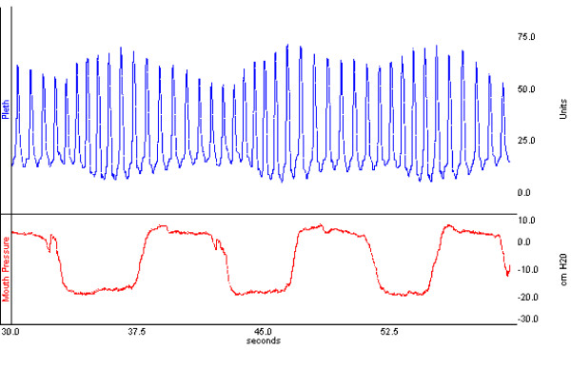
The Crashing Asthmatic Patient: Pearls and Pitfalls
Amal Mattu, MD, FAAEM, FACEP
Professor and Vice Chair
Department of Emergency Medicine
University of Maryland School of Medicine
Baltimore, Maryland
amalmattu@comcast.net

Slide 2
Case
47 yo large male (120 kg) BIBA for dyspnea
Field VS: HR 130, BP 150/90, RR 32
pox 79% on RA, 88% on 100% NRB
Nebulizer started
Placed on stretcher in ED, poor air movement and wheezes present bilaterally

Slide 3
Case
47 yo male BIBA for dyspnea
Sitting upright, RR 36, difficulty talking
Confused, agitated, refusing to sit still
Refusing to hold nebulizer or wear mask
NO IV access

Slide 4
Case
47 yo male BIBA for dyspnea
Worsening confusion, diaphoresis
Won’t wear pox, ripping off monitor leads and NRB/neb
“I gotta…get out of here…get off me!”
NO IV access

Slide 5
Case
47 yo male BIBA for dyspnea
Worsening confusion, diaphoresis
Won’t wear pox, ripping off monitor leads and NRB/neb
“I gotta…get out of here…get off me!”
NO IV access
What do you do?

Slide 6
Case
Choices:

Slide 7
Case
Choices:
a. Let him sign out AMA, go see the ankle sprain

Slide 8
Case
Choices:
a. Let him sign out AMA, go see the ankle sprain
b. Restrain patient until he stops breathing, then IO line and intubate

Slide 9
Case
Choices:
a. Let him sign out AMA, go see the ankle sprain
b. Restrain patient until he stops breathing, then IO line and intubate
c. Midazolam blowdart, then just as he codes you intubate

Slide 10
Case
Choices:
a. Let him sign out AMA, go see the ankle sprain
b. Restrain patient until he stops breathing, then IO line and intubate
c. Midazolam blowdart, then just as he codes you intubate
d. Pretend you never saw him, see the ankle sprain, let partner pick up chart

Slide 11
Outline
Background
Pathophysiology
Symptoms and signs
Differential diagnosis
Diagnostic testing
Treatment

Slide 12
Outline
Background
Pathophysiology
Symptoms and signs
Differential diagnosis
Diagnostic testing
Treatment

Slide 13
Outline
Not a comprehensive review
Focus on the sick patients
What to do when the nebs, steroids, Mg⁺⁺ are not working
Focus on pearls and pitfalls

Slide 14
Asthma
Background
Chronic inflammatory disorder
Increased responsiveness to many stimuli

Slide 15
Asthma
Background (US statistics)
Average asthmatic has…
15 days of restricted activity
5-6 days in bed
2 million ED visits
484,000 hospitalizations
> 4000 deaths per year

Slide 16
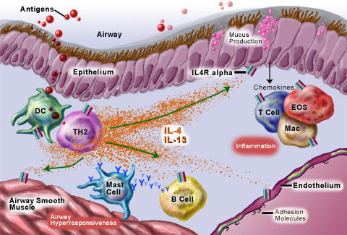
Asthma
Pathophysiology

Slide 17
Asthma
Pathophysiology: the essentials
Inflammation
Airway narrowing, bronchoconstriction
Bronchial smooth muscle contraction
Bronchial wall edema
Mucous production, plugging

Slide 18
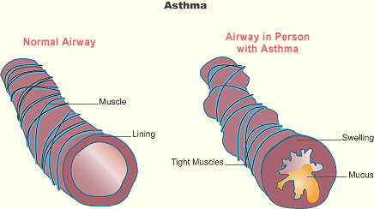
Asthma
Pathophysiology: the essentials

Slide 19
Asthma
Symptoms, exam, workup and basic DDx + treatment → we’ll mostly skip

Slide 20
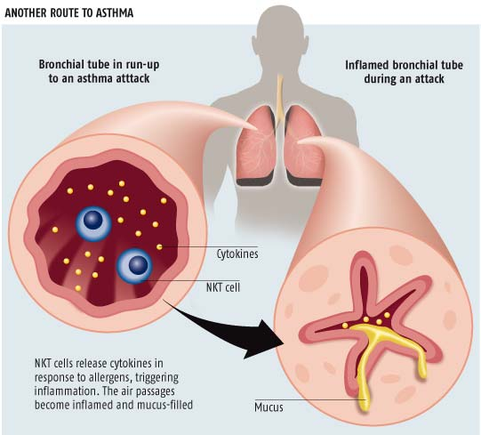
Asthma
Treatment
Beta₂ agonist administration
What if nebs not working?
Too dyspneic to take nebs
Prolonged symptoms → mucus plugging

Slide 21
Asthma
Treatment
Beta₂ agonist administration
Alternative → parenteral beta₂ agonists
Too dyspneic to take nebs
Prolonged symptoms → mucus plugging

Slide 22
Asthma
Treatment
Beta₂ agonist administration
Alternative to nebulizers → parenteral use
Too dyspneic to take nebs
Prolonged symptoms → mucus plugging

Slide 23
Asthma
Treatment
Beta₂ agonist administration
Alternative to nebulizers → parenteral use
EPI 0.3 mg (1:1000) SQ/IM every 20 min
Non-selective beta agonist
Terbutaline 0.25 mg SQ/IM every 30-60 min
Selective beta₂ agonist
Fewer cardiac side effects than EPI
More often used in kids

Slide 24
Asthma
Treatment
Beta₂ agonist administration
Alternative to nebulizers → IV use
Controversial
Increased side effects, uncertain benefit
IV terbutaline used in kids (?)

Slide 25
Asthma
Other treatments
IVF
Steroids (parenteral vs. po)
Atrovent, magnesium
Heliox
Mast cell modifiers (e.g. cromolyn)
Leukotriene modifiers
Inhaled steroids
Nebulized furosemide

Slide 26
Summary
Don’t hesitate to give parenteral EPI
Give IVF!!

Slide 28
Asthma
Treatment → mechanical ventilation
Non-invasive ventilation
Endotracheal intubation

Slide 29
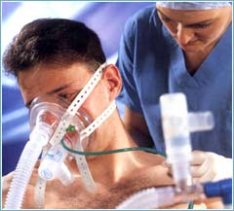
Asthma
Treatment → mechanical ventilation
Non-invasive ventilation

Slide 30
Asthma
Treatment → mechanical ventilation
Non-invasive ventilation
Data is limited
No clear evidence of reduced hospitalization, intubation rates
Consider, don’t dwell!

Slide 31
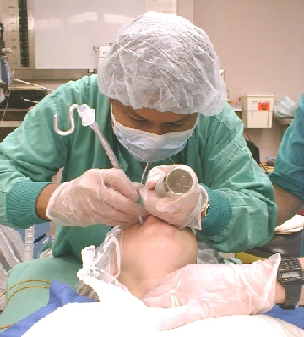
Asthma
Treatment → mechanical ventilation
Endotracheal intubation

Slide 32
Asthma
Treatment → mechanical ventilation
Endotracheal intubation → clinical decision

Slide 33
Asthma
Treatment → mechanical ventilation
Endotracheal intubation → clinical decision
Worsening Sx’s despite max treatment
Increasing fatigue
Worsening VS (HR, RR, pulse ox)
Increased use of accessory muscles
Diaphoresis
Increasing agitation (→ hypoxia)
Decreasing LOC (→ hypercarbia)

Slide 34
Asthma
Treatment → mechanical ventilation
Endotracheal intubation → clinical decision
Worsening Sx’s despite max treatment
Increasing fatigue
Worsening VS (HR, RR, pulse ox)
Increased use of accessory muscles
Diaphoresis
Increasing agitation (→ hypoxia)
Decreasing LOC (→ hypercarbia)

Slide 36
Asthma
Treatment → endotracheal intubation
Temporizing solution only!

Slide 37
Asthma
Treatment → endotracheal intubation
Temporizing solution only!
Does not solve the underlying problem
Laryngoscopy may trigger worsening bronchospasm, laryngospasm

Slide 38
Asthma
Pearls
Intubation by the most experience provider to minimize attempts and maximize speed
Use largest ETT possible (8-9 mm if possible)

Slide 39
Asthma
Treatment → endotracheal intubation
Sedation choices
Ketamine
Potentiates catecholamine release
Relaxes bronchiolar smooth muscle
Hemodynamically stable, may raise BP
Increases bronchial secretions (atropine or glycopyrrolate?)

Slide 40
Asthma
Treatment → endotracheal intubation
Sedation choices
Propofol
Bronchodilating properties
May cause hypotension, lactic acidosis

Slide 41
Asthma
Treatment → endotracheal intubation
Sedation choices
Etomidate
Hemodynamically stable
Adrenal suppression?

Slide 42
Asthma
Treatment → endotracheal intubation
Sedation choices
Benzodiazepines
Inhaled anesthetics

Slide 43
Asthma
Treatment → endotracheal intubation
Paralytic of choice: succinylcholine
Fastest onset, beneficial when pre-oxygenation not possible

Slide 44
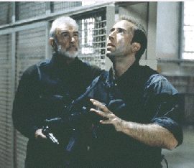
Asthma
Treatment → endotracheal intubation
Paralytic of choice: succinylcholine
Fastest onset, beneficial when pre-oxygenation not possible
Alternative: rocuronium

Slide 45
Asthma
Treatment → endotracheal intubation
Paralytic of choice: succinylcholine
Fastest onset, beneficial when pre-oxygenation not possible
If IM dose needed, use 3-4 mg/kg minimum

Slide 46
Summary
Manage the airway…if absolutely needed
ETI is best
Look for signs of worsening catecholamine output, agitation, fatigue

Slide 48
Asthma

Slide 49
Asthma

Slide 50
Asthma
Treatment → ventilator management
Barotrauma: major source of morbidity and mortality
Beware auto-PEEP!

Slide 51
Asthma
Treatment → ventilator management
The basics…
Volume controlled mode
Use low tidal volumes (6-8 cc/kg)
Ventilate at < 10 breaths/min
Must allow sufficient time for exhalation, decrease I:E ratio

Slide 52
Asthma
Pitfall → Use of increased respiratory rates to “blow off” CO₂.
Pearl → Patients need extra time to “blow off” CO₂, therefore lower the rate.

Slide 53
Asthma
Pearl → If auto-PEEP develops, disconnect vent and allow time to exhale (squeeze chest!).
Pearl → Reduce RR and TV even further.

Slide 54
Asthma
Pearl → Monitor plateau pressures closely…maintain < 30 mm Hg.

Slide 55
Asthma
Treatment → ventilator management
Monitor blood gas
Permissive hypercapnea: pH > 7.2, pCO₂ up to 70-80

Slide 56
Asthma
Treatment → ventilator management
Sedate well!
Adequate sedation preferred to repeated dosages of paralytics
Combination of paralytics with steroids can result in weaning difficulties, myopathy

Slide 57
Asthma
Treatment → ventilator management
If hypotension or hypoxia develops…

Slide 58
Asthma
Treatment → ventilator management
If hypotension or hypoxia develops, consider…
Incorrect tube placement
Obstruction of ETT
Ventilator malfunction
Tension pneumothorax
Decreased preload

Slide 59
Asthma
Pearl → Consider preload insufficiency if patient is hypotensive.

Slide 60
Asthma
Pearl → Consider preload insufficiency if patient is hypotensive.
Mechanical ventilation, esp. if excessive auto-PEEP, produces increased intrathoracic pressure

Slide 61
Asthma
Pearl → Consider preload insufficiency if patient is hypotensive.
Mechanical ventilation, esp. if excessive auto-PEEP, produces increased intrathoracic pressure
Results in decreased venous return → decreased cardiac output → decreased BP

Slide 62
Asthma
Pearl → Always give fluid bolus to sick asthmatics that may need intubation!
Almost all are hypovolemic

Slide 63
Asthma
Pearl → PEA arrest DDx?

Slide 64
Asthma
Pearl → PEA arrest DDx?
Think tension PTX
Extreme hypotension from decreased preload due to intrathoracic pressure

Slide 65
Summary
ETI → high risk of barotrauma
Low rate, low TV, low plateau pressure (keep < 30 mm Hg)
ETI → high risk of hypotension
Tension PTX
Incorrect tube placement
Hypovolemia

Slide 67
Takehome Points
Don’t hesitate to use parenteral EPI!
Give IVF early and aggressively
Non-invasive ventilation +
Intubation is a clinical decision
Fatigue, accessory muscle use, worsening diaphoresis, agitation, decreased LOC

