Slide 1

Debbie Yi Madhok, MD
Associate Professor of Clinical Emergency Medicine and Neurology, University of California San Francisco

Slide 2
Disclosures
Funded by Abbott Laboratories to advance development of Abbott’s TBI test for diagnosis and determination of severity of brain injury in adults and children

Slide 3
Agenda
Neuroanatomy for Brain Bleeds
Neurocritical Care in a Nutshell
Cases

Slide 4
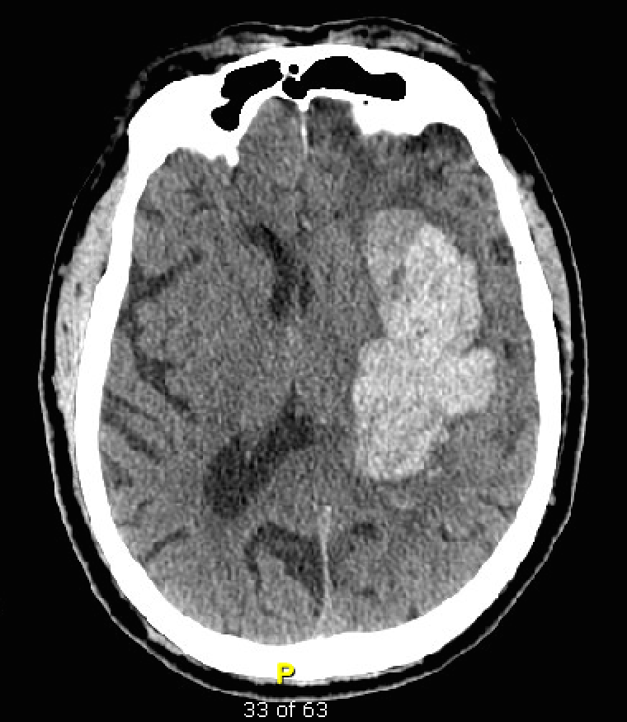
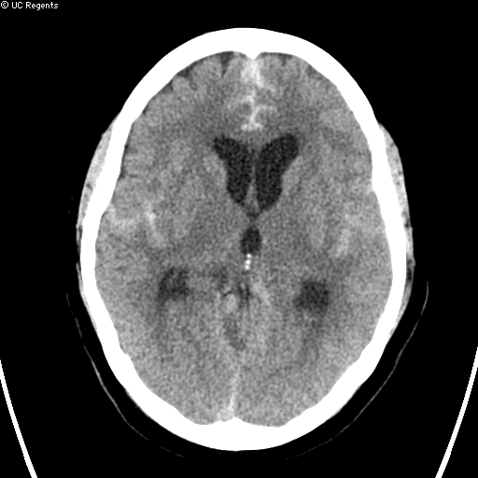

Slide 5
Neuroanatomy for Brain Bleeds

Slide 6
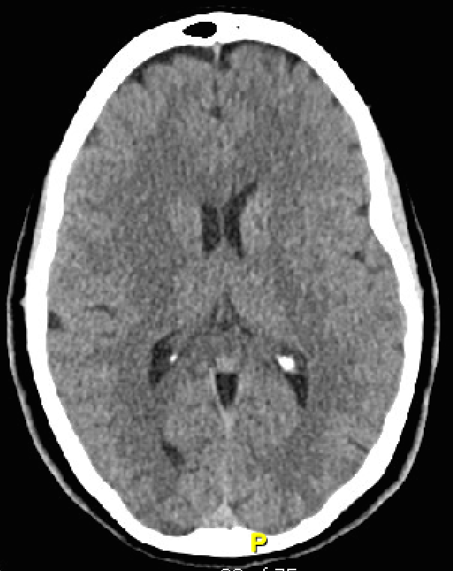
FALX CEREBRI
GYRI
SULCI
Notes:
This is

Slide 7
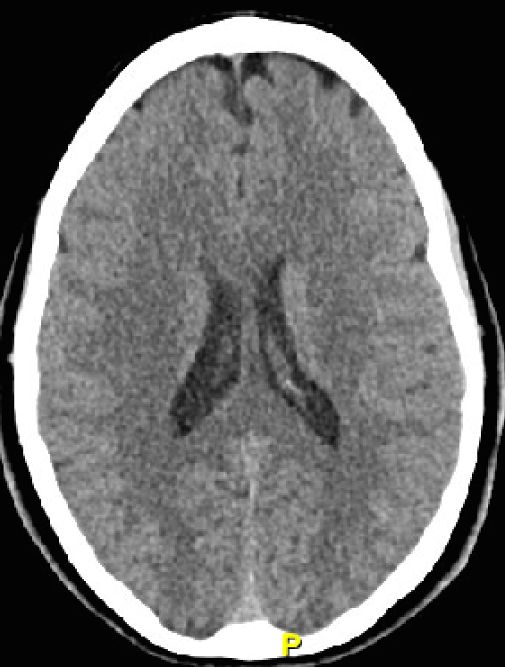
LATERAL VENTRICLES
Notes:
Lateral ventricles with no evidence of a 3rd ventricle
When blood gets stuck in the drains of the brain, such as the 3rd ventricle, this causes hydrocephalus

Slide 8
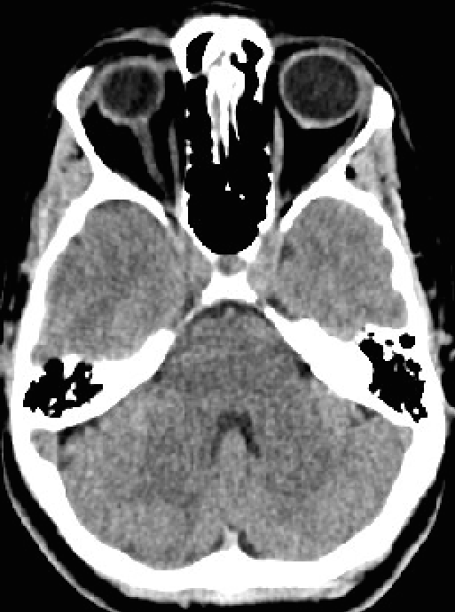

FOURTH VENTRICLE
Notes:
Darth Vader
Again, when blood gets trapped in the ventricles, this causes hydrocephalus. And hydrocephalus causes intracranial pressure to skyrocket because CSF cannot drain properly.

Slide 9
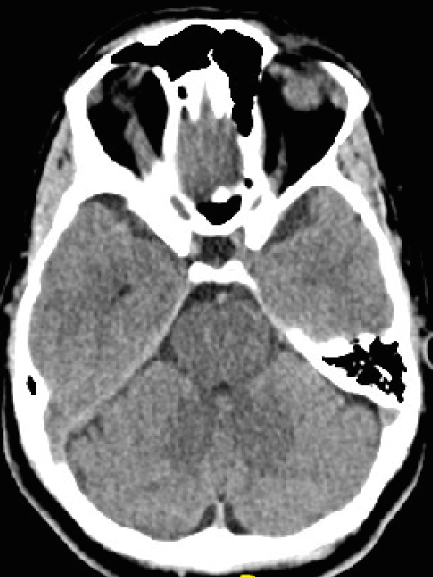
CISTERN
BRAIN
STEM
Notes:
Basal cistern

Slide 10
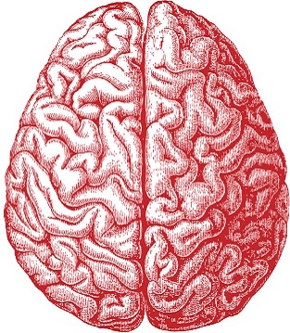
Neurocritical Care in a Nutshell
Notes:
Brain is housed in a rigid box called the skull. It does an excellent job protecting the brain.
There’s room for 3 things in here and not much else: the brain parenchyma, intracerebral blood, and CSF

Slide 11
Neurocritical Care in a Nutshell
Notes:
So, when something else comes around – whether it be a tumor or blood or swelling from a large stroke or hypoxic ischemic injury, there isn’t room for much more.
This doesn’t only have to be blood. This can be swelling from tissue that has infarcted (large strokes, hypoxic ischemic injury) or axons that have been severed (diffuse axonal injury)

Slide 12
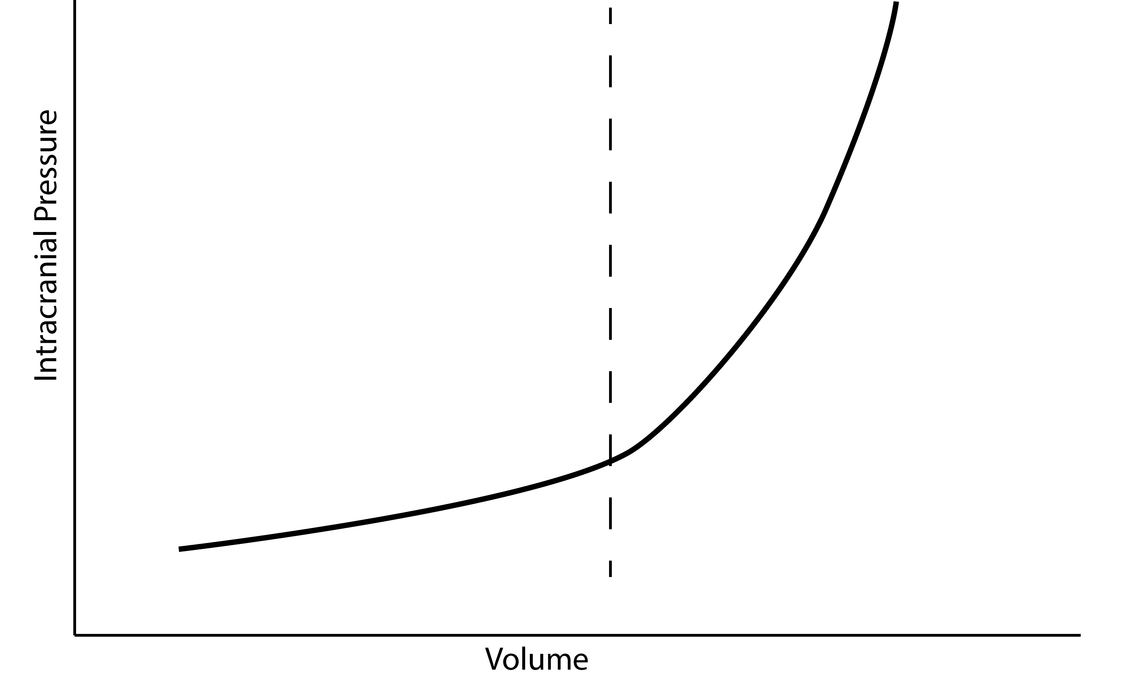
Neurocritical Care in a Nutshell
Notes:
ICP in the brain is determined by brain parenchyma, presence of any mass lesions, intracranial blood volume and intracranial CSF volume.
What’s terrible about the ICP going up is that the brain gets smooshed and you lose blood flow to the parts that get smooshed. That is called Mass Effect.
Hole in the bottom of the skull = herniation

Slide 13
Neurocritical Care in a Nutshell
CPP = MAP - ICP
Notes:
Low CPP = risk of ischemic injury
Autoregulation maintains constant CBF despite changes in CPP

Slide 14
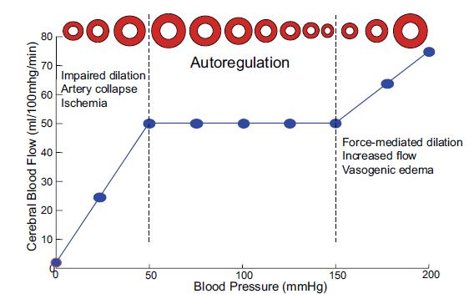
Neurocritical Care in a Nutshell
Pires PW, Dams Ramos CM, Matin N, Dorrance AM. The effects of hypertension on the cerebral circulation. Am J Physiol Heart Circ Physiol. 2013;304(12):H1598-H1614. doi:10.1152/ajpheart.00490.2012.
Notes:
Autoregulation maintains constant CBF despite changes in CPP
If autoregulation remains intact, a drop in SBP triggers an autoregulatory vasodilation in an attempt to maintain adequate brain perfusion. This results in increased cerebral blood volume, which in turn elevates intracranial pressure. If autoregulation is not intact, there is dependency on SBP to prevent cerebral ischemia, which has been ascribed to be the single most important secondary insult.
Autoregulation maintains constant CBF despite changes in CPP

Slide 15
How Bad Things Happen
3 H’s
Hydrocephalus
High ICP
Herniation
Notes:
Acute obstructive hydrocephalus causes rapid increases in ICP
Herniation = path of least resistance
High ICP

Slide 16
Case 1
54yo M h/o HTN, non-compliant with meds, in ED with L facial droop, L sided weakness, slurred speech
Afebrile, 90, 210/110, 18, 96% RA

Slide 18
SULCAL EFFACEMENT
VENTRICULAR EFFACEMENT
Notes:
First I’d like for you to recognize some things that have changed:

Slide 19
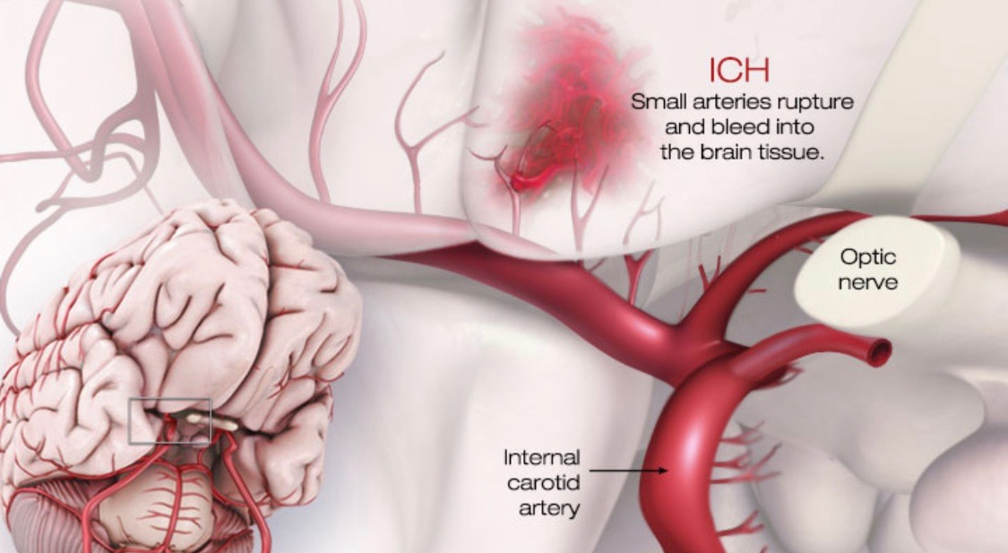
Primary Intracerebral Hemorrhage
American Heart Association, watchlearnlive.heart.org

Slide 20
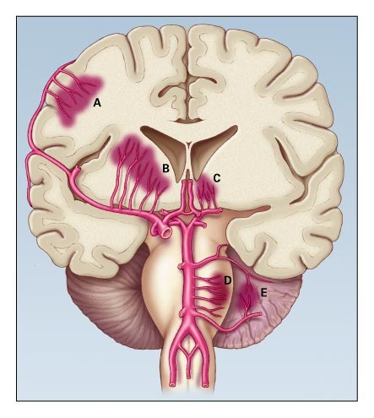
Qureshi AI, Tuhrim S, Broderick JP, Batjer HH, Hondo H, Hanley DF. Spontaneous intracerebral hemorrhage. N Engl J Med. 2001;344(19):1450-1460. doi:10.1056/NEJM200105103441907.
Notes:
These are the locations you will find a hypertensive ICH. Basal ganglia, thalamus, pons, and cerebellum. If it’s not one of these locations, second guess a diagnosis of a hypertensive hemorrhage.

Slide 21
Blood Pressure Goals
SBP < 130-150
Anderson CS, Heeley E, Huang Y, Wang J, Stapf C, Delcourt C, Lindley R, Robinson T, Lavados P, Neal B, et al; INTERACT2 Investigators. Rapid blood-pressure lowering in patients with acute intracerebral hemorrhage.N Engl J Med. 2013; 368:2355–2365. doi: 10.1056/NEJMoa1214609
Qureshi AI, Palesch YY, Barsan WG, Hanley DF, Hsu CY, Martin RL, Moy CS, Silbergleit R, Steiner T, Suarez JI, et al; ATACH-2 Trial Investigators and the Neurological Emergency Treatment Trials Network. Intensive blood-pressure lowering in patients with acute cerebral hemorrhage.N Engl J Med. 2016; 375:1033–1043. doi: 10.1056/NEJMoa1603460
American Heart Association, watchlearnlive.heart.org
Notes:
Remember: this is about small arteries bleeding
INTERACT2: intensive BP lowering to SBP < 140 in first 6 hours, patients had better functional recovery and reduction in death and disability when SBP between 150 and 220
ATACH2: BP < 140 and SBP < 180 pretty much the same
Nicardipine

Slide 22
NO SEIZURE PROPHYLAXIS
Notes:
16% of ICH patients have a seizure within 1st week
Most likely cortical ICH. Things closer to the cortex of the brain – outer edge – are most likely to cause seizures. And remember, from the prior picture, hypertensive ICH affects deep structures.
Number of studies showing increased death and disability when AED used in ICH. Other studies showed no difference when looking at patients who survived past 5 days.
Give it if the patient has a clinical seizure or AMS with seizures on EEG

Slide 23
NO PLATELETS
Notes:
PATCH trial: Odds of death or dependence at 3 months higher in platelet transfusion group

Slide 24
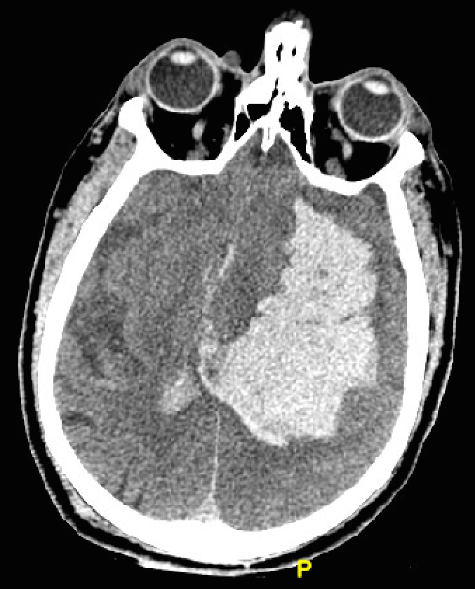
30% EXPAND WITHIN FIRST 3 HOURS
Notes:
30% of bleeds expand within first 3 hours

Slide 25
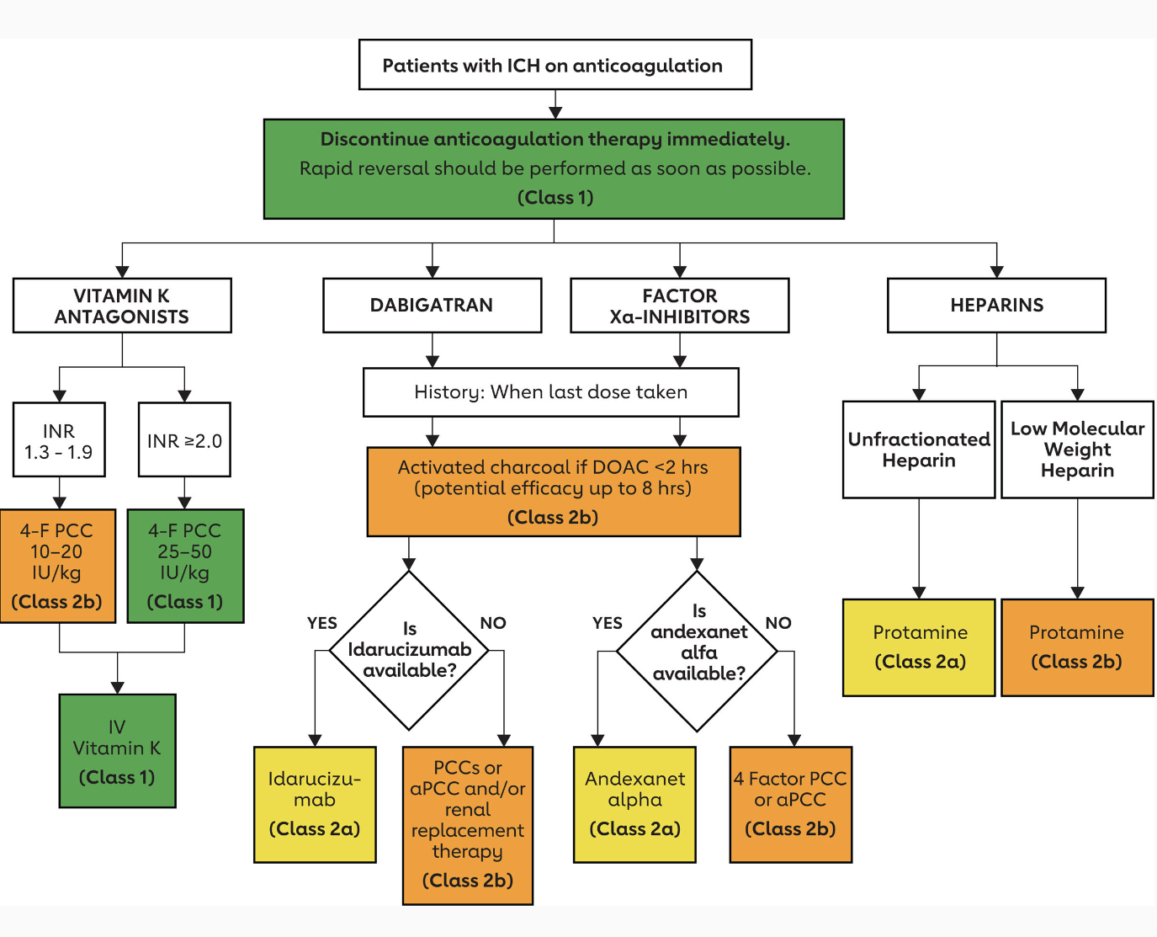
Anticoagulant Reversal
Greenberg et al. 2022 Guideline for the Management of Patients With Spontaneous Intracerebral Hemorrhage: A Guideline From the American Heart Association/American Stroke Association. 17 May 2022https://doi.org/10.1161/STR.0000000000000407Stroke. 2022;53:e282–e361
Notes:
If a patient has an acute intracranial hemorrhage on anti coagulation, this patient needs to be reversed unless there is a concomitant life-threatening thrombosis going on such as MI, PE. If the patient is on a Vitamin K antagonist, i.e. warfarin, I use INR >= 1.4 as my cut-off per the Neurocritical Care Society guidelines.
So, give 10mg IV vitamin K and then administer 4-factor PCC or 3-factor PCC, 4-factor being preferred. In case you haven’t done this before, this is weight-based on based on the INR.
For Factor XA inhibitors (Rivaroxaban/Apixaban): Activated Charcoal if last dose within 2 hours, KCentra (PCC)
For Direct Thrombin inhibitors ie Dabigatran: Activated charcoal 50gm PO if patient intubated and last dose within 2 hours + Idarucizumab 2.5gm x 2 vials IV PUSH over 5 minutes separated by less than 15 min

Slide 26
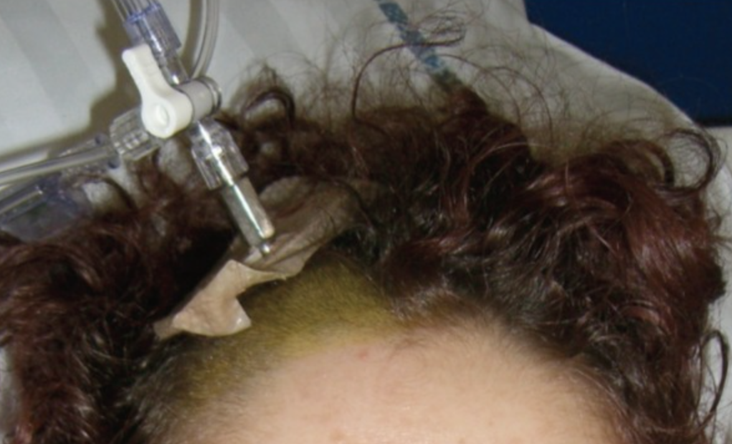
EVD FOR GCS ≤ 8, AMS with Hydrocephalus
Notes:
ICP in the brain is determined by brain parenchyma, presence of any mass lesions, intracranial blood volume and intracranial CSF volume. The best way to know the pressure is to insert a pressure monitor. As a result, the ways to lower ICP include shrinking the volume of the brain (mannitol), removing mass lesions (surgery), decreasing intracranial blood volume (hyperventilation) and decreasing intracranial CSF volume (drainage). Or, you can let the pressure be and remove the rigid box it sits in (decompressive craniectomy).

Slide 27
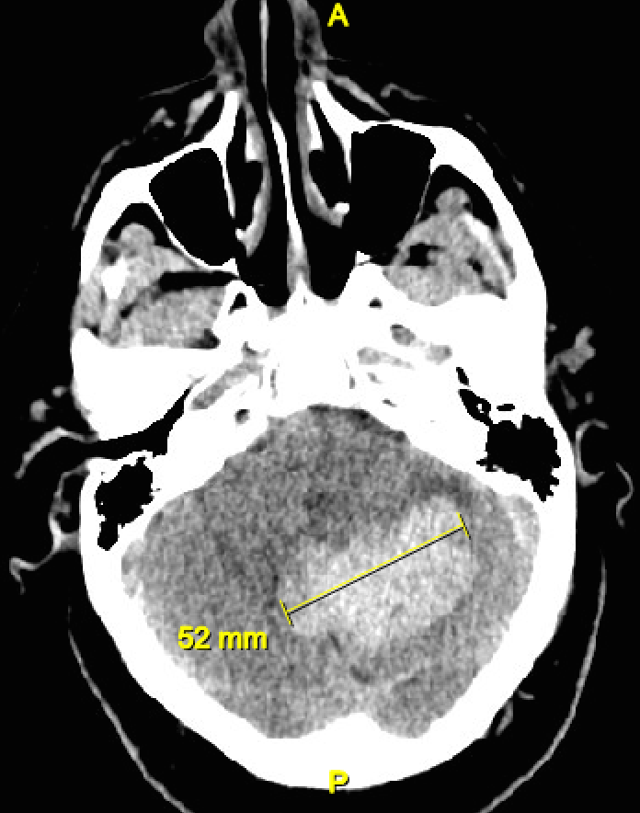
Surgery
Cerebellar ICH > 3cm
GCS < 8 with large bleeds, MLS or ICP not improved with medical/EVD management
Notes:
STITCH II: no benefit hematoma evacuation in lobar hemorrhages but might be benefit in GCS < 8 with large bleeds, midline shift or ICP not improved with medical management
Cerebellar ICH: > 3cm or e/o brainstem compression or HCP → DC

Slide 28
BLOOD IN FOURTH VENTRICLE = HYDROCEPHALUS

Slide 29
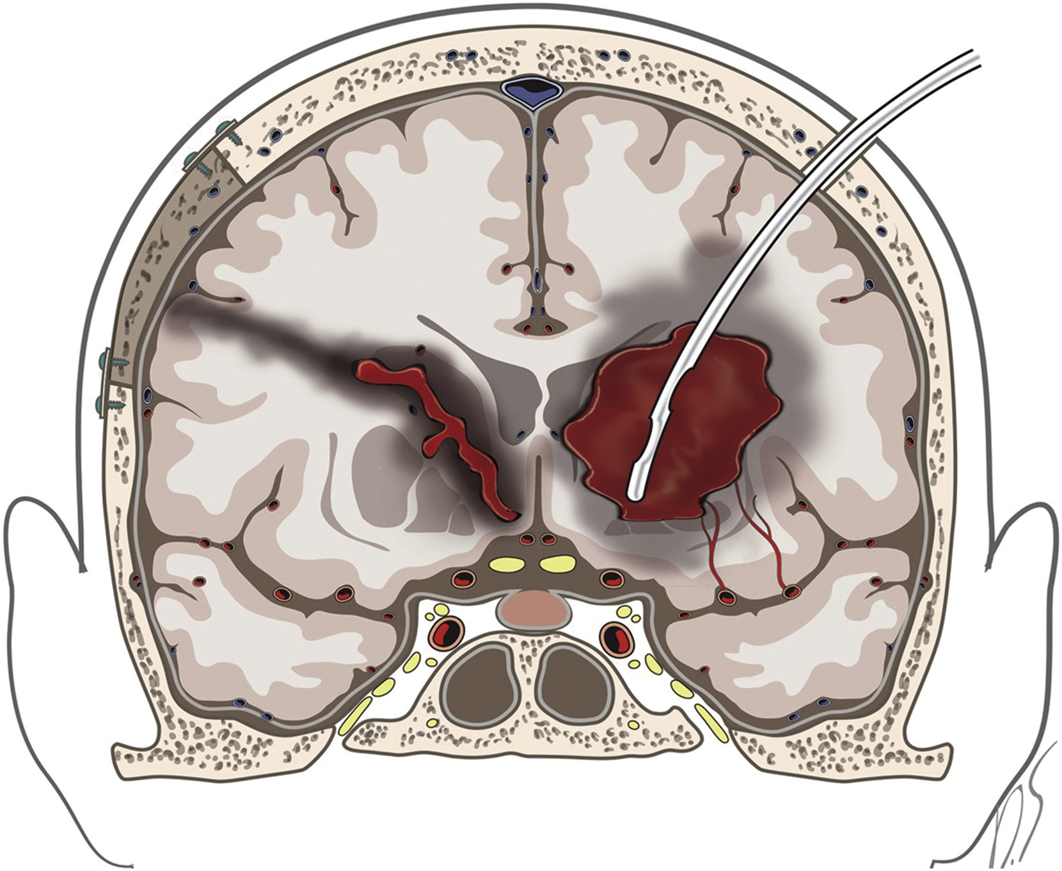
What’s Here Now
Kim H, Edwards NJ, Choi HA, Chang TR, Jo KW, Lee K. Treatment Strategies to Attenuate Perihematomal Edema in Patients With Intracerebral Hemorrhage. World Neurosurg. 2016;94:32-41. doi:10.1016/j.wneu.2016.06.093.
Notes:
MISTIE III: hematoma aspiration with a catheter and rtPA

Slide 30
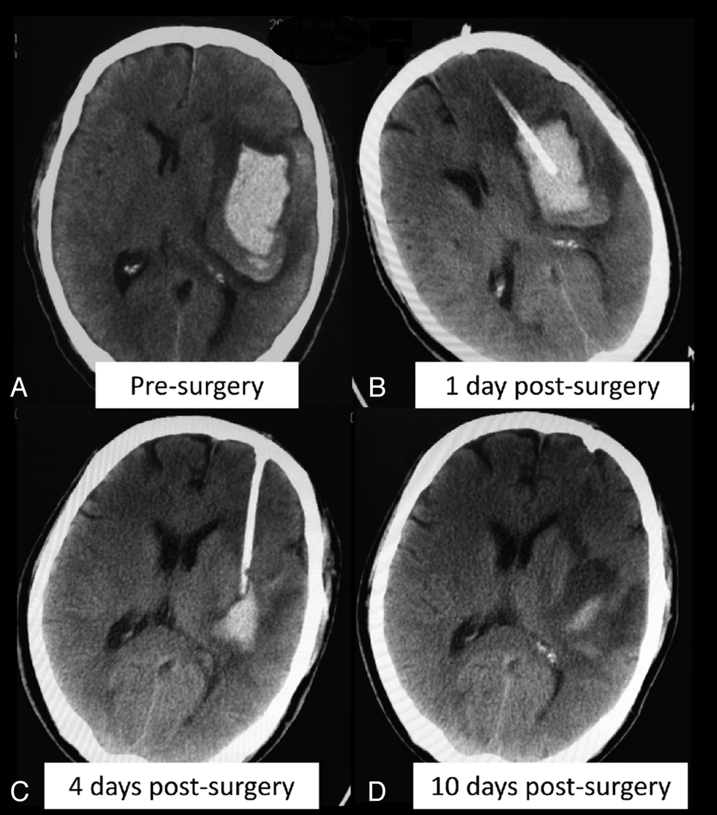
What’s Here Now
Yang Z, Hong B, Jia Z, et al. Treatment of supratentorial spontaneous intracerebral hemorrhage using image-guided minimally invasive surgery: Initial experiences of a flat detector CT-based puncture planning and navigation system in the angiographic suite. AJNR Am J Neuroradiol. 2014;35(11):2170-2175. doi:10.3174/ajnr.A4009.
Notes:
MISTIE III: hematoma aspiration with a catheter and rtPA

Slide 31
Case 2
54yo F smoker, no other PMHx, in ED with severe headache
Afebrile, 90, 210/110, 18, 96% RA

Slide 32
Notes:
Do you know what this is?
Subarachnoid hemorrhage
From a ruptured cerebral aneurysm
Most centers will obtain a CT angiogram after the NCHCT to visualize the aneurysm. If you are not at a center which manages cerebral aneurysms, this is when you need to transfer your patient

Slide 33
SULCAL EFFACEMENT
Notes:
Do you know what this is?
Subarachnoid hemorrhage
From a ruptured cerebral aneurysm
Most centers will obtain a CT angiogram after the NCHCT to visualize the aneurysm. If you are not at a center which manages cerebral aneurysms, this is when you need to transfer your patient

Slide 34
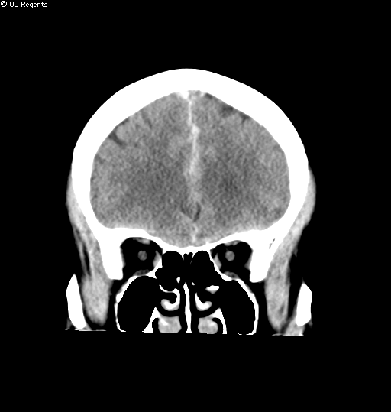
SBP < 160
Connolly ES, Rabinstein AA, Carhuapoma JR, Derdeyn CP, Dion J, Higashida RT, Hoh BL, Kirkness CJ, Naidech AM, Ogilvy CS, et al; American Heart Association Stroke Council; Council on Cardiovascular Radiology and Intervention; Council on Cardiovascular Nursing; Council on Cardiovascular Surgery and Anesthesia; Council on Clinical Cardiology. Guidelines for the management of aneurysmal subarachnoid hemorrhage: a guideline for healthcare professionals from the American Heart Association/american Stroke Association.Stroke. 2012; 43:1711–1737.
Notes:
This is a fragile artery with a clot sitting there covering the hole that just bled. There’s a 5-10% chance of rebleeding within the first 72 hours. Use nicardipine.

Slide 35
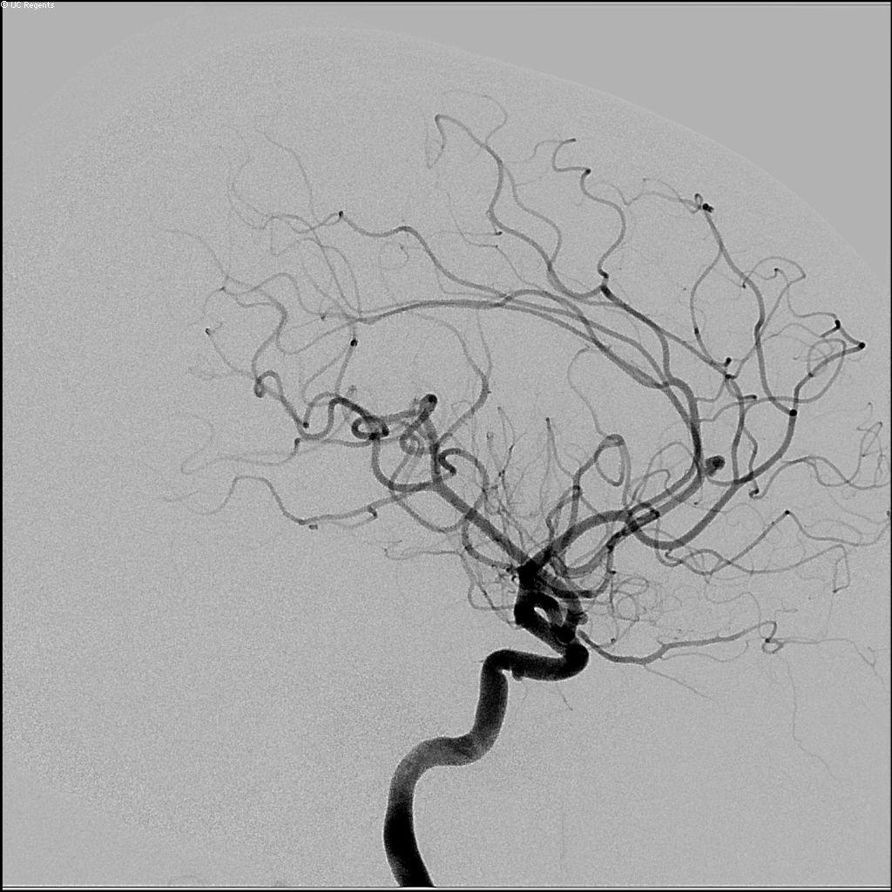
Notes:
But this patient needs a cerebral angiogram which is both diagnostic and therapeutic

Slide 36
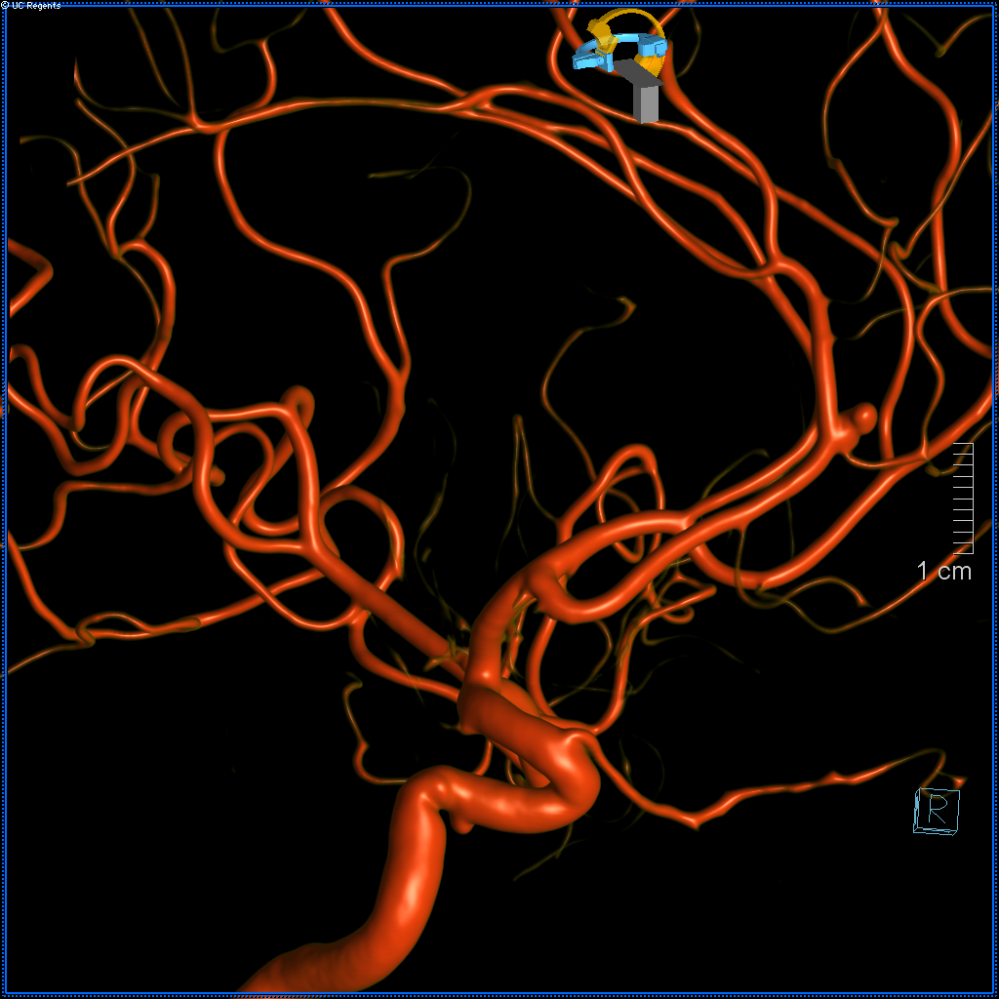
NO SEIZURE PROPHYLAXIS
Notes:
Seizure prophylaxis in SAH has been associated with increased risk of neurological deterioration, vasospasm, and elevated temperature.

Slide 37
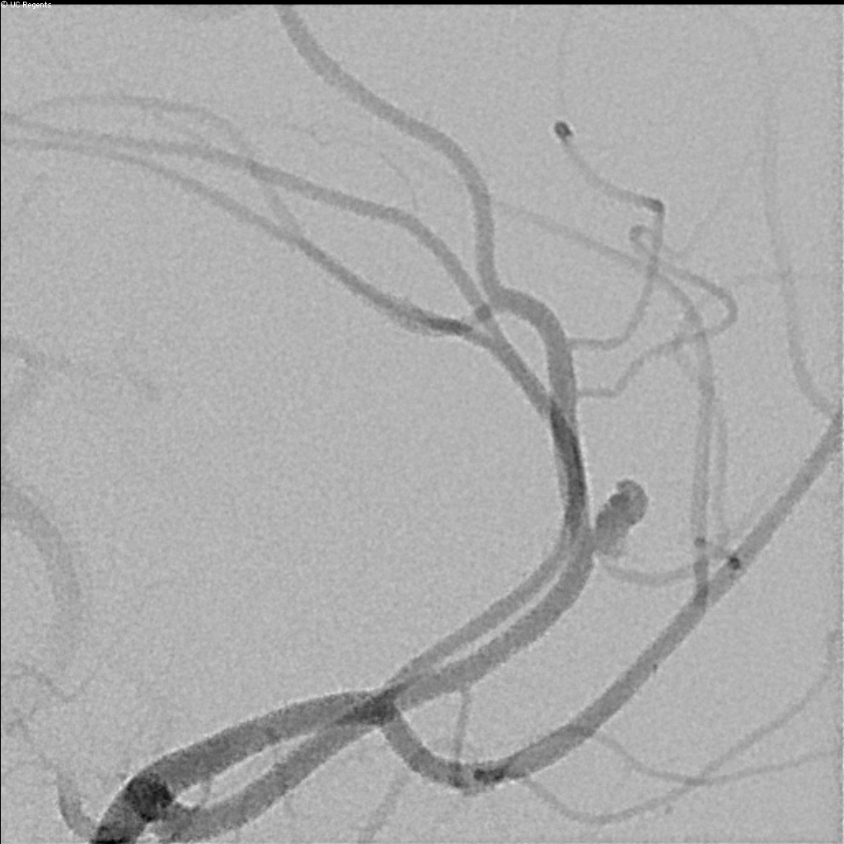
COIL VS. CLIP?
Notes:
The right answer: Depends on location of aneurysm and morphology of aneurysm
The true answer: depends on what your hospital system is comfortable with

Slide 38
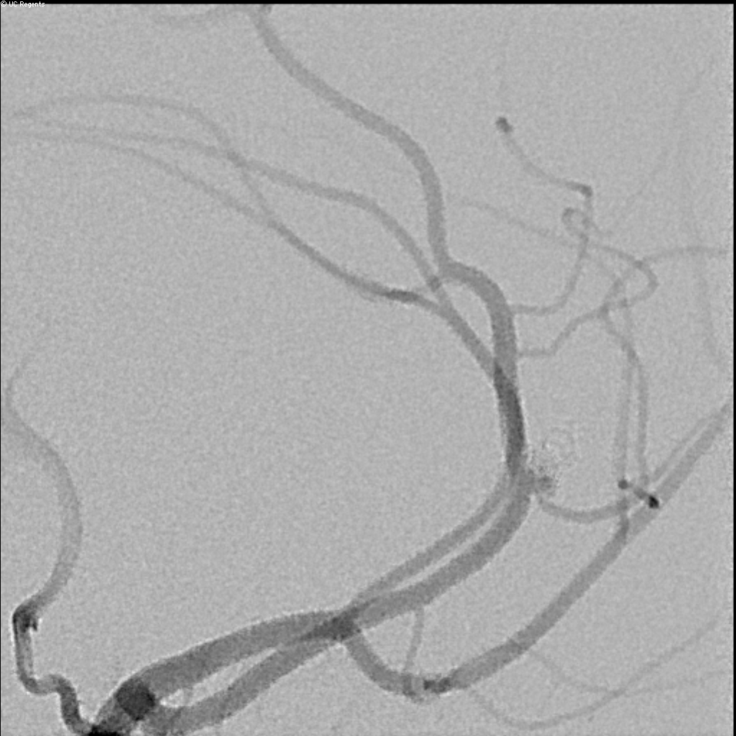
COILED ANEURYSM

Slide 39
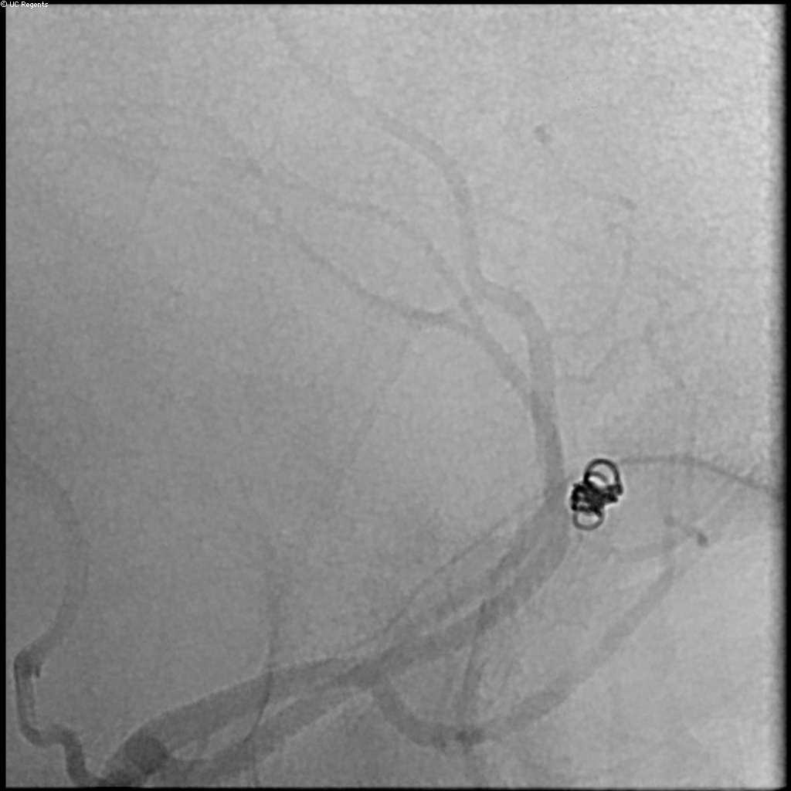
$3K-$150K WORTH OF COILS

Slide 40
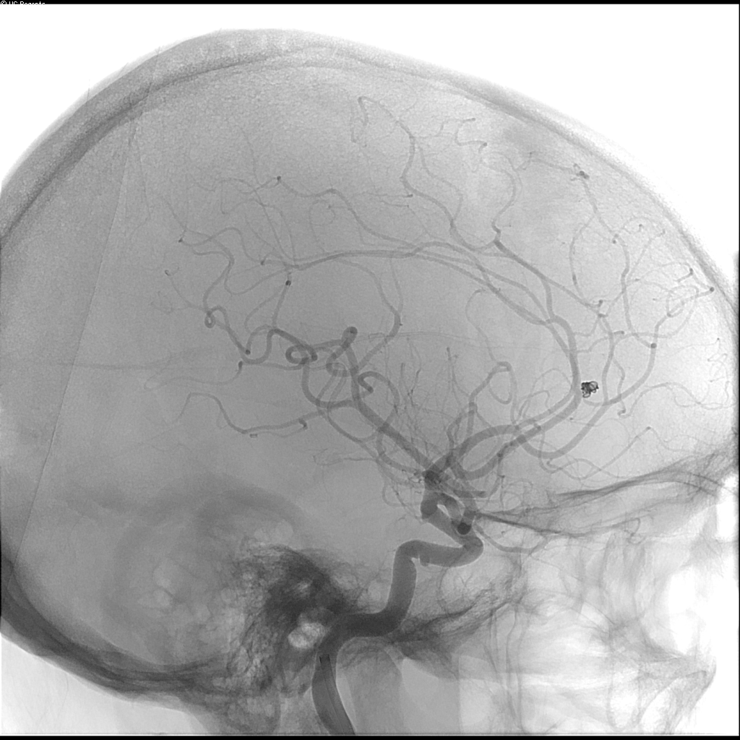
NOW, LIBERALIZE SBP

Slide 41
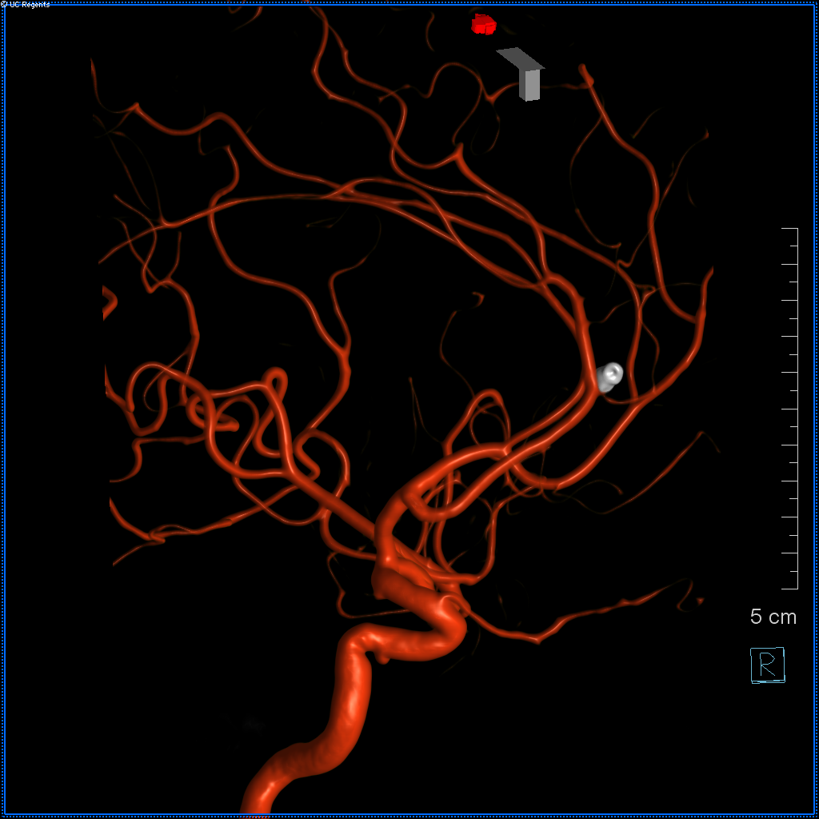
TO NEURO ICU

Slide 42
Case 3
54yo M h/o ETOH abuse in ED after fall down 5 steps with +LOC.
Afebrile, 90, 210/110, 18, 96% RA

Slide 43
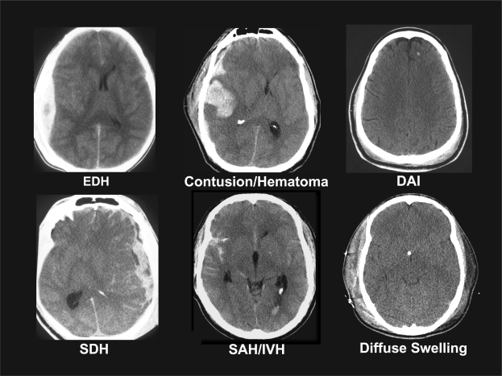
Traumatic Brain Injury
Saatman KE, Duhaime A-C, Bullock R, et al. Classification of traumatic brain injury for targeted therapies. In: Vol 25. Mary Ann Liebert, Inc. 140 Huguenot Street, 3rd Floor New Rochelle, NY 10801 USA; 2008:719-738. doi:10.1089/neu.2008.0586.
Notes:
Catch-all phrase for very different entities

Slide 44
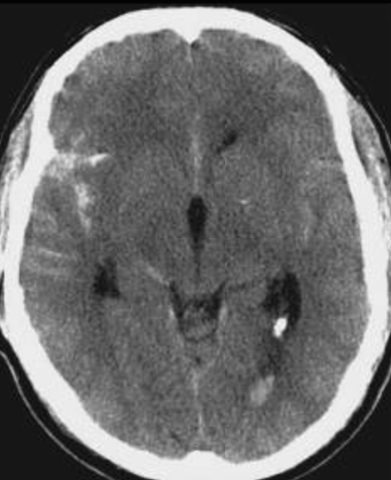
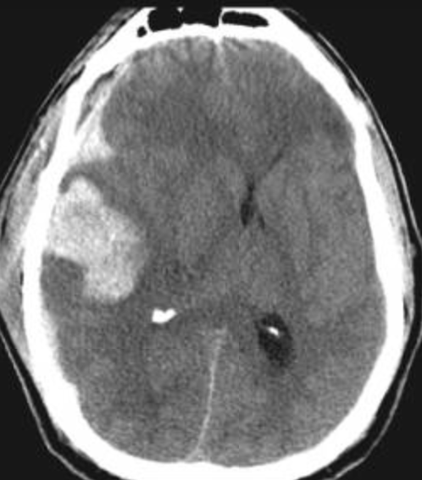
Saatman KE, Duhaime A-C, Bullock R, et al. Classification of traumatic brain injury for targeted therapies. In: Vol 25. Mary Ann Liebert, Inc. 140 Huguenot Street, 3rd Floor New Rochelle, NY 10801 USA; 2008:719-738. doi:10.1089/neu.2008.0586.

Slide 45
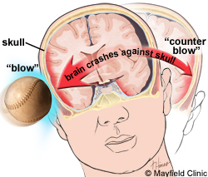
PRIMARY INJURY
SECONDARY INJURY
SECONDS
MINUTES
HOURS
DAYS
mayfieldclinic.com
Notes:
Primary injury: determines survival
Secondary injury: determines morbidity and mortality (think: amino acid (glutamate) release, free radical production, calcium influx into neurons,
Banana analogy
What can we do to prevent secondary injury? First of all, make sure the patient is never hypoxic. Not in the ambulance, not in the ED, not while we are intubating the patient.

Slide 46
CPP = MAP - ICP
Notes:
What can we do to prevent secondary injury?
Don’t forget: cerebral perfusion is determined by MAP and intracranial pressure.

Slide 47
Pires PW, Dams Ramos CM, Matin N, Dorrance AM. The effects of hypertension on the cerebral circulation. Am J Physiol Heart Circ Physiol. 2013;304(12):H1598-H1614. doi:10.1152/ajpheart.00490.2012.
Notes:
But remember autoregulation? Autoregulation maintains constant CBF despite changes in CPP
Dips in blood pressure shouldn’t really matter. However, here’s the quandary:
If autoregulation remains intact, a drop in SBP triggers an autoregulatory vasodilation in an attempt to maintain adequate brain perfusion. This results in increased cerebral blood volume, which in turn elevates intracranial pressure.
In many traumatic brain injury patients, autoregulation is not intact and there is dependency on SBP to prevent cerebral ischemia, which has been ascribed to be the single most important secondary insult.

Slide 48
SBP ≥ 100 for patients 50-69
SBP ≥ 110 for patients 15-49 and > 70
Brain Trauma Foundation, “Guidelines for the Management of Severe Traumatic Brain Injury,” 2016.
Notes:
Brain Trauma Foundation recommendation:
SBP ≥ 100 for patients 50-69
≥ 110 for patients for patients 15-49 or > 70
The only Class 2 study was Berry et al’s in Injury in 2012 which looked at about 15K isolated blunt moderate-severe TBI patients, with a wide age range and with admission systolic blood pressures < 60 and then looked at sequential increasing admission systolic BPs. There was an increased odds of mortality with SBP < 110 on admission.
(Brenner et al’s study in 2012 where 60 severe TBI patients were prospectively enrolled and vital signs were closely followed. Polytrauma patients were excluded. Hypotension in the first 48 hours was associated with mortality and worse outcomes.)

Slide 49
Seizure Prophylaxis
Depressed skull fracture
Acute SDH or EDH
Hemorrhagic contusion
Penetrating head trauma
Seizure within first 24 hours
GCS ≤ 10 (use phenytoin)
Brain Trauma Foundation, “Guidelines for the Management of Severe Traumatic Brain Injury,” 2016.
Notes:
Severe TBI: rate of seizures is up to 12%, higher rate of subclinical seizures
The injury with TBI is from the outside – higher chance of “cortical” injury – therefore, higher chance of seizures
1990 Temkin et al RCT in NEJM showing reduction in early post traumatic seizures with phenytoin vs. placebo.
In 2013, Inaba et al showed no difference in rate of post traumatic seizures between leveteracetam vs. phenytoin BUT the study included moderate and severe TBI patients, did not have a placebo arm

Slide 50
Traumatic Brain Injury
Saatman KE, Duhaime A-C, Bullock R, et al. Classification of traumatic brain injury for targeted therapies. In: Vol 25. Mary Ann Liebert, Inc. 140 Huguenot Street, 3rd Floor New Rochelle, NY 10801 USA; 2008:719-738. doi:10.1089/neu.2008.0586.
Notes:
Do you know what this is?

Slide 51
Acute Epidural Hematoma
VENTRICULAR EFFACEMENT
MIDLINE SHIFT
SULCAL EFFACEMENT
Saatman KE, Duhaime A-C, Bullock R, et al. Classification of traumatic brain injury for targeted therapies. In: Vol 25. Mary Ann Liebert, Inc. 140 Huguenot Street, 3rd Floor New Rochelle, NY 10801 USA; 2008:719-738. doi:10.1089/neu.2008.0586.
Notes:
Surgery: most patients with focal neurologic signs/symptoms attributable to acute head bleeds require urgent surgery.

Slide 52
Acute Epidural Hematoma
Saatman KE, Duhaime A-C, Bullock R, et al. Classification of traumatic brain injury for targeted therapies. In: Vol 25. Mary Ann Liebert, Inc. 140 Huguenot Street, 3rd Floor New Rochelle, NY 10801 USA; 2008:719-738. doi:10.1089/neu.2008.0586.
Notes:
Surgery: most patients with focal neurologic signs/symptoms attributable to acute head bleeds require urgent surgery.
Guidelines recommend surgery for all adults with EDH volume > 30cc or GCS < 9

Slide 53
Traumatic Brain Injury
Saatman KE, Duhaime A-C, Bullock R, et al. Classification of traumatic brain injury for targeted therapies. In: Vol 25. Mary Ann Liebert, Inc. 140 Huguenot Street, 3rd Floor New Rochelle, NY 10801 USA; 2008:719-738. doi:10.1089/neu.2008.0586.
Notes:
Surgery: most patients with focal neurologic signs/symptoms attributable to acute head bleeds require urgent surgery.
For acute subdural hematomas: clot thickness > 10mm or MLS >= 5mm = surgery regardless of GCS. Or GCS < 9 or decreased by >=2 from time of injury = surgery.

Slide 54
Acute Subdural Hematoma
MIDLINE SHIFT
VENTRICULAR EFFACEMENT
SULCAL EFFACEMENT
Saatman KE, Duhaime A-C, Bullock R, et al. Classification of traumatic brain injury for targeted therapies. In: Vol 25. Mary Ann Liebert, Inc. 140 Huguenot Street, 3rd Floor New Rochelle, NY 10801 USA; 2008:719-738. doi:10.1089/neu.2008.0586.

Slide 55
Acute Subdural Hematoma
Saatman KE, Duhaime A-C, Bullock R, et al. Classification of traumatic brain injury for targeted therapies. In: Vol 25. Mary Ann Liebert, Inc. 140 Huguenot Street, 3rd Floor New Rochelle, NY 10801 USA; 2008:719-738. doi:10.1089/neu.2008.0586.
Notes:
Surgery: most patients with focal neurologic signs/symptoms attributable to acute head bleeds require urgent surgery.
For acute subdural hematomas: clot thickness > 10mm or MLS >= 5mm = surgery regardless of GCS. Or GCS < 9 or decreased by >=2 from time of injury = surgery.

Slide 56
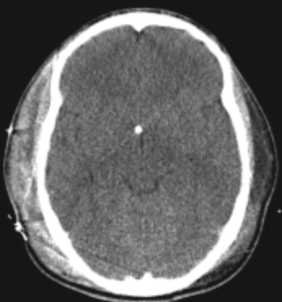
Traumatic Brain Injury
Saatman KE, Duhaime A-C, Bullock R, et al. Classification of traumatic brain injury for targeted therapies. In: Vol 25. Mary Ann Liebert, Inc. 140 Huguenot Street, 3rd Floor New Rochelle, NY 10801 USA; 2008:719-738. doi:10.1089/neu.2008.0586.

Slide 57
Diffuse Swelling
EFFACEMENT OF CISTERN
SULCAL EFFACEMENT
Saatman KE, Duhaime A-C, Bullock R, et al. Classification of traumatic brain injury for targeted therapies. In: Vol 25. Mary Ann Liebert, Inc. 140 Huguenot Street, 3rd Floor New Rochelle, NY 10801 USA; 2008:719-738. doi:10.1089/neu.2008.0586.
Notes:
Where am I in the brain moment?

Slide 58
Key Points
Intracerebral hemorrhage (ICH):
SBP < 130-150
NO Seizure Prophylaxis
No Platelets
Reverse Anticoagulation
Large Cerebellar ICH need immediate surgery

Slide 59
Key Points
Subarachnoid Hemorrhage (SAH):
SBP < 140-160 until secured
NO Seizure Prophylaxis
Reverse Anticoagulation

Slide 60
Key Points
Traumatic Brain Injury (TBI):
SBP ≥ 110
Seizure Prophylaxis for
  Depressed skull fracture
  Acute SDH or EDH
  Hemorrhagic contusion
  Penetrating head trauma
  Seizure within first 24 hours
  GCS ≤ 10 (use phenytoin)
Reverse Anticoagulation

Slide 61
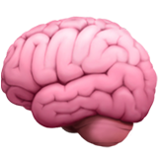

Thank you!
Questions?
Debbie.Madhok@ucsf.edu

