Slide 1
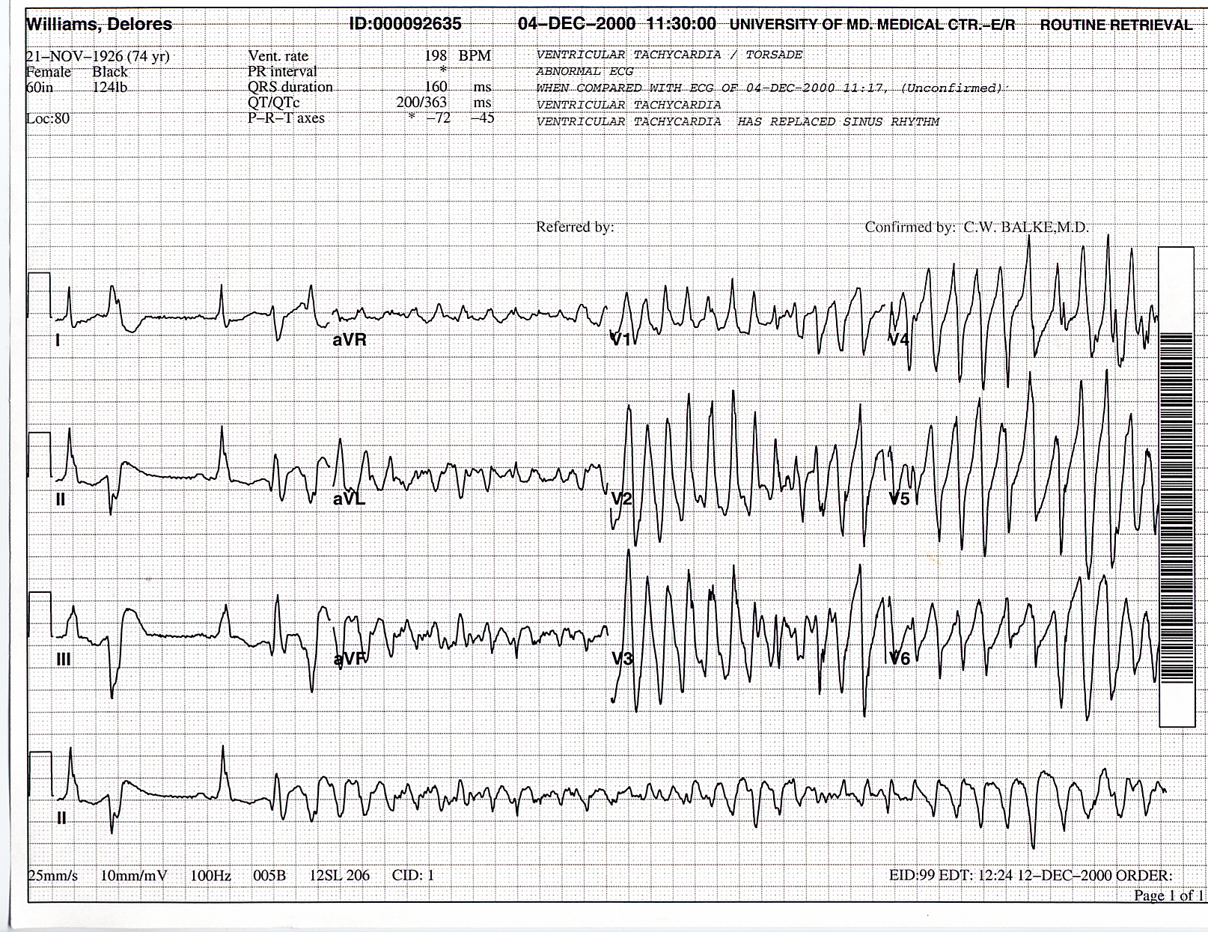
Peri-arrest Pearls and Pitfalls
Amal Mattu, MD, FAAEM, FACEP
Professor and Vice Chair of Academic Affairs
Department of Emergency Medicine
University of Maryland School of Medicine
Baltimore, Maryland

Slide 2


Slide 3


Slide 4


Slide 6
Classic/Common Pitfalls in Managing Shock

Slide 7
Classic/Common Pitfalls in Managing Shock
1. Failure to consider the DDx for hypotension/shock

Slide 8
What is your DDx for hypotension/shock?

Slide 9
What is your DDx for hypotension/shock?
Hypovolemic
Obstructive
Distributive

Slide 10
Causes of Shock
S
H
O
C
K

Slide 11
Causes of Shock
Septic, spinal
H
O
C
K

Slide 12
Causes of Shock
Septic, spinal
Hypovolemic, hemorrhagic
O
C
K

Slide 13
Causes of Shock
Septic, spinal
Hypovolemic, hemorrhagic
Obstructive (tamponade, massive PE)
C
K

Slide 14
Causes of Shock
Septic, spinal
Hypovolemic, hemorrhagic
Obstructive (tamponade, massive PE)
Cardiogenic, compartment synd. (abd)
K

Slide 15
Causes of Shock
Septic, spinal
Hypovolemic, hemorrhagic
Obstructive (tamponade, massive PE)
Cardiogenic, compartment synd. (abd)
K: endoKrine, anaphylaKtic

Slide 16
Causes of Shock
Septic, spinal
Hypovolemic, hemorrhagic
Obstructive (tamponade, massive PE)
Cardiogenic, compartment synd. (abd)
K: endoKrine, anaphylaKtic
SHOCK’d

Slide 17
Causes of Shock
Septic, spinal
Hypovolemic, hemorrhagic
Obstructive (tamponade, massive PE)
Cardiogenic, compartment synd. (abd)
K: endoKrine, anaphylaKtic
SHOCK’d (d = drugs)

Slide 18
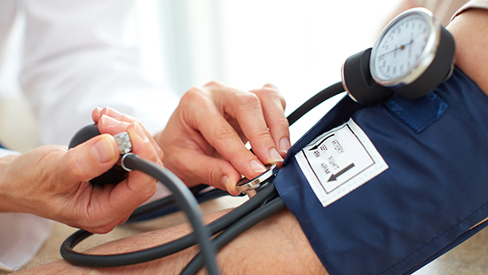
Classic/Common Pitfalls
2. Over-reliance on SBP rather than MAP

Slide 19
Classic/Common Pitfalls
2. Over-reliance on SBP rather than MAP
MAP = (SBP + DBP + DBP) / 3

Slide 20
Classic/Common Pitfalls
2. Over-reliance on SBP rather than MAP
MAP = (SBP + DBP + DBP) / 3
Who is perfusing better?
Patient A: BP 110/40
Patient B: BP 90/60

Slide 21
Classic/Common Pitfalls
2. Over-reliance on SBP rather than MAP
MAP = (SBP + DBP + DBP) / 3
Who is perfusing better?
Patient A: BP 110/40 → MAP 63
Patient B: BP 90/60 → MAP 70

Slide 22
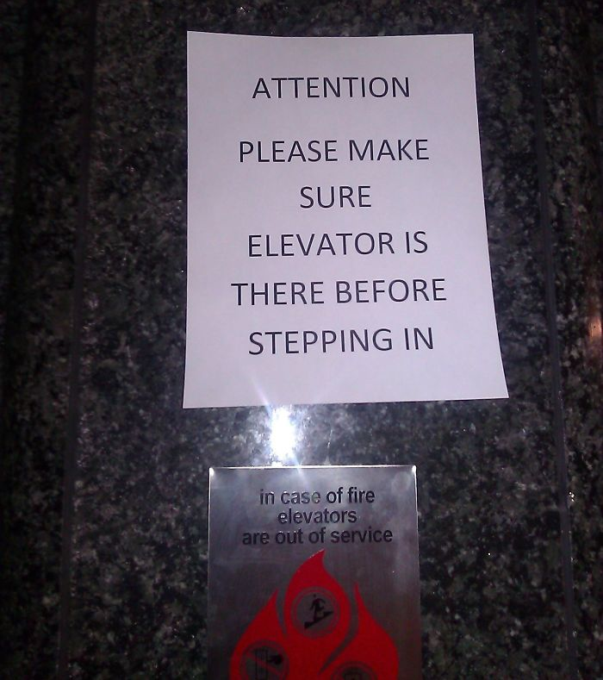

Slide 24

Classic/Common Pitfalls
3. Lackadaisical approach to treating shock

Slide 25
Classic/Common Pitfalls
3. Lackadaisical approach to treating shock
Current guidelines recommend 30 cc/kg IVF bolus (unless there’s a good reason not to)
The longer a patient maintains MAP < 60, the higher the M & M
Hypotension duration increases the risk of cardiac, cerebral, mesenteric, and renal injury

Slide 26
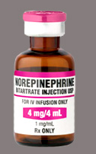
Classic/Common Pitfalls
3. Lackadaisical approach to treating shock → when should you start pressors?

Slide 27
Classic/Common Pitfalls
3. Lackadaisical approach to treating shock → when should you start pressors?
Bai, et al. Crit Care 2014
  For every hour of delay in initiating vasopressors in the first 6 hrs of septic shock, the mortality increased 5.3%

Slide 28
Classic/Common Pitfalls
3. Lackadaisical approach to treating shock → when should you start pressors?
Bai, et al. Crit Care 2014
  When NE started within 2 hours of dx of septic shock → improved lactate clearance, resolution of hypotension, shorter duration of need for pressors

Slide 29
Classic/Common Pitfalls
3. Lackadaisical approach to treating shock → when should you start pressors?
Early administration of NE is associated with reduced risk of renal and pulmonary injury

Slide 30
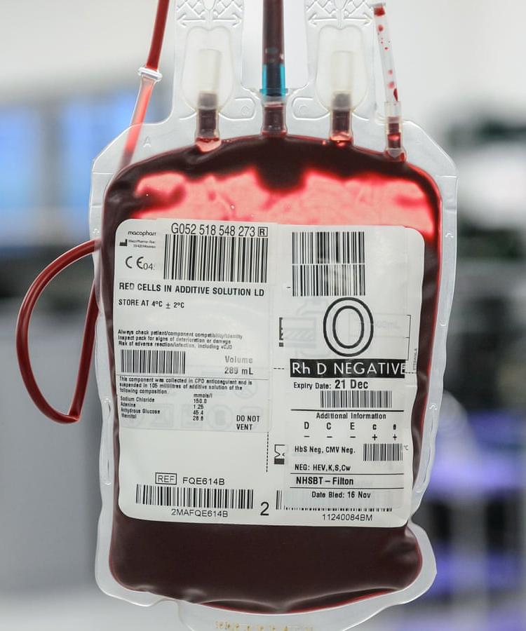
Classic/Common Pitfalls
3. Lackadaisical approach to treating shock → transfusions
Replace blood with blood!

Slide 31
Classic/Common Pitfalls
3. Lackadaisical approach to treating shock → transfusions
Replace blood with blood!
The more rapidly you need to give a transfusion, the longer it will take the blood bank to send the blood!

Slide 32
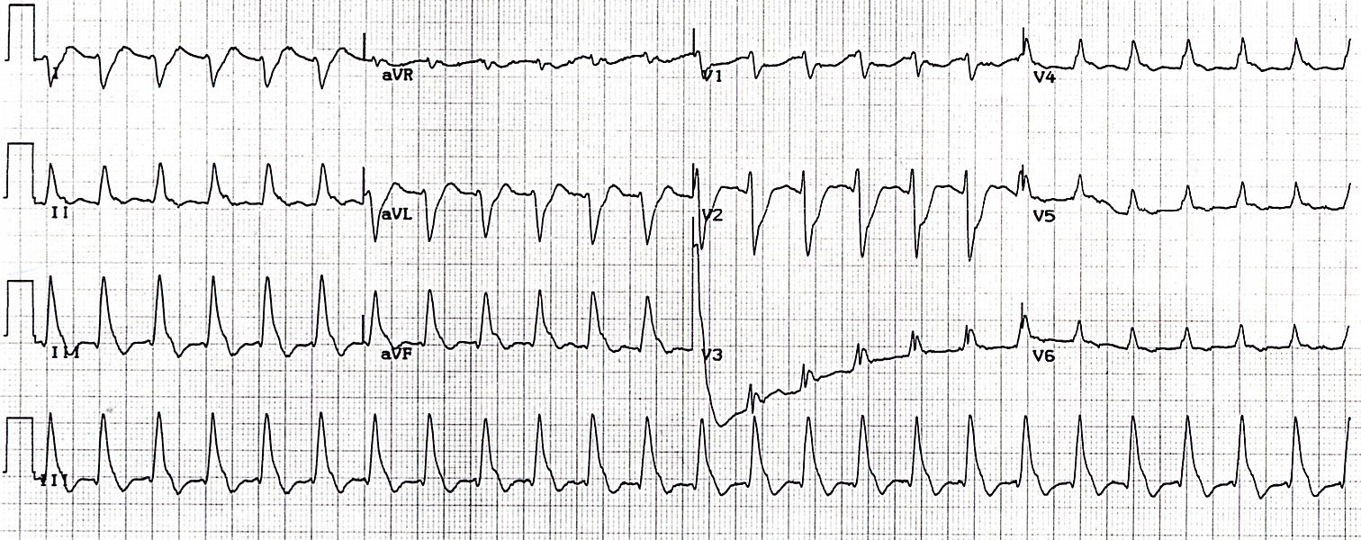
Classic/Common Pitfalls
3. Lackadaisical approach to treating shock → fear of cardioversion of (unstable) tachydysrhythmias

Slide 33
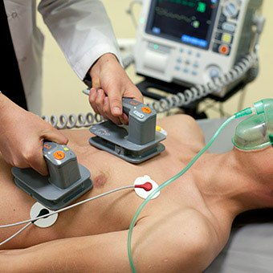
Classic/Common Pitfalls
3. Lackadaisical approach to treating shock → fear of cardioversion of (unstable) tachydysrhythmias
Don’t be afraid to sedate and shock! (but be ready to shock again!)

Slide 34


Slide 35

Classic/Common Pitfalls
4. Overzealous fluid administration

Slide 36
Classic/Common Pitfalls
4. Overzealous fluid administration
Not everyone benefits from IVF!
  Patients with acute blood loss → give blood products!
  Patients with right heart dysfunction
  Patients that are not hypovolemic

Slide 37
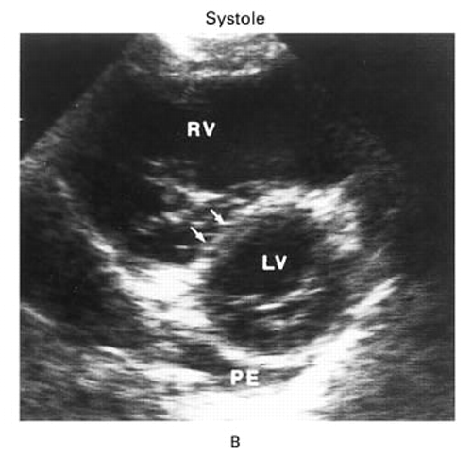
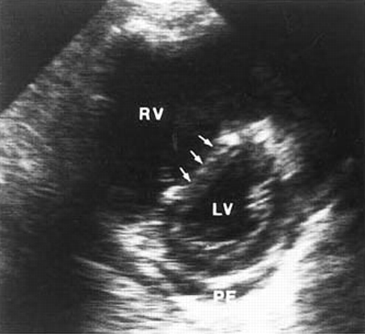
Massive Pulmonary Embolus
Systole
Diastole

Slide 38
Classic/Common Pitfalls
Passive leg raise can be helpful to assess fluid responsiveness
JAMA 2016

Slide 39
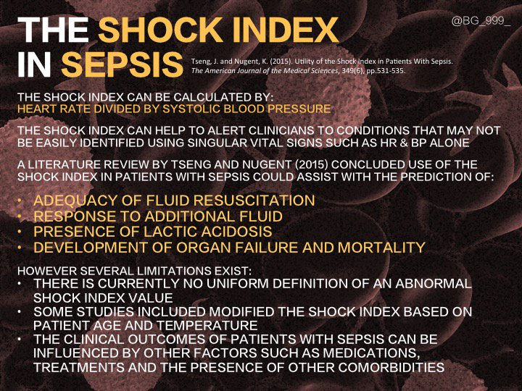
Classic/Common Pitfalls
5. Failure to appreciate the Shock Index

Slide 40
Classic/Common Pitfalls
5. Failure to appreciate the Shock Index
HR / SBP → normal < 0.7

Slide 41
Classic/Common Pitfalls
SI > 0.7 → as good as SIRS
SI > 1.0 → most specific predictor of hyperlactemia, 28-day mortality
WJEM 2013

Slide 42
Classic/Common Pitfalls
Shock index in sepsis can help predict
  Adequacy of fluid resuscitation
  Response to additional fluid
  Presence of lactic acidosis
  Development of organ failure and mortality

Slide 43
Classic/Common Pitfalls
Pre-RSI Shock Index > 0.8 predicts post-intubation crash

Slide 44


Slide 45
Summary
Always consider the DDx of shock!
MAP is more important than SBP
  Respect the DBP!
Be aggressive about reversing shock
Fluids are good...but not for everyone
  Passive leg raise
Keep Shock Index in mind
  Especially before intubation

Slide 46

Thank You! amalmattu@comcast.net

