Slide 1
2024 Emergency Cardiology Update:
Amal Mattu, MD, FAAEM, FACEP
Professor and Vice Chair
Co-Director, Emergency Cardiology Fellowship
University of Maryland School of Medicine
Baltimore, Maryland, USA
amalmattu@comcast.net

Slide 2
Disclosure
No financial relationships with drug or device-manufacturing companies

Slide 3
For This Lecture…
Assorted topics in emergency cardiology
Some new info, some not as new…but there’s more literature to discuss
No animal or basic science studies
NOT a journal club!
Cases...

Slide 4
Case 1
58 yo M presents with intermittent episodes of palpitations
History of cardiomyopathy, EF 30%
Associated with lightheadedness, near- syncope
4 episodes today

Slide 5
Case 1
58 yo M presents with intermittent episodes of palpitations
History of cardiomyopathy, EF 30%
Associated with lightheadedness, near- syncope
4 episodes today
On arrival he is currently having an episode
ECG...

Slide 6
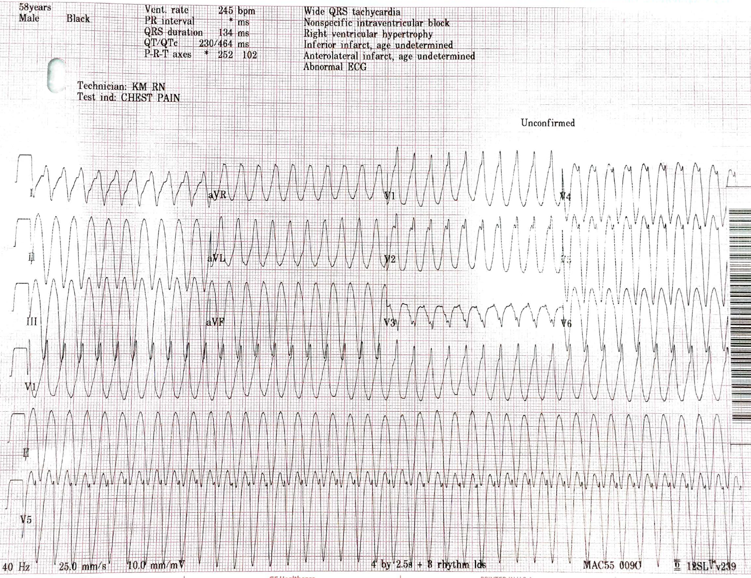
Case 1

Slide 9
Case 1

Slide 10
Recurrent Ventricular Tachycardia

Slide 11
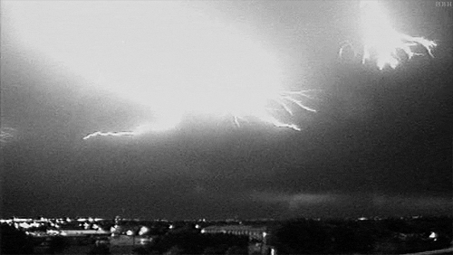
”Electrical Storm”

Slide 12
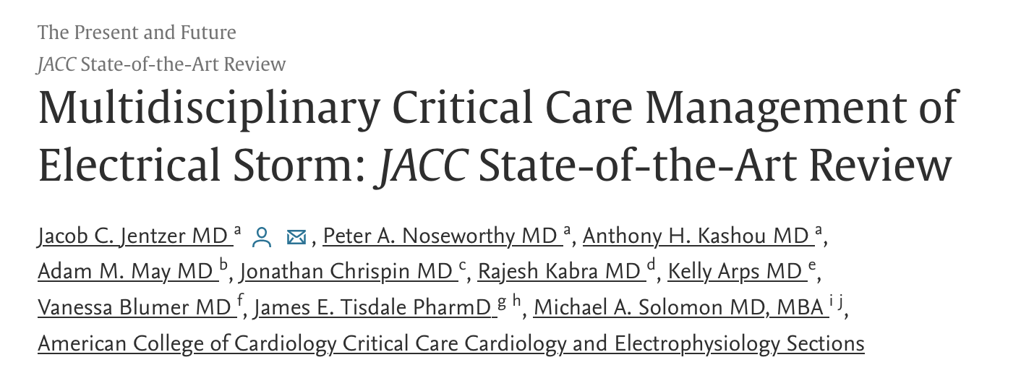
”Electrical Storm”
J Am Coll Cardiol
June 2023

Slide 13
”Electrical Storm”
> 3 episodes of sustained VT, VF, or receipt of appropriate shocks from an ICD within 24 hours
May include incessant VF

Slide 14
”Electrical Storm”
> 3 episodes of sustained VT, VF, or receipt of appropriate shocks from an ICD within 24 hours
May include incessant VF
Often occurs in patients with sick hearts
CMPY, low EF, prior MIs, patients with ICDs

Slide 15
”Electrical Storm”
Common precipitants
Electrolyte abnormalities (hypoK, hypoMg)
Binge drinking
Acute infections
Acute cardiac ischemia, heart failure
Thyrotoxicosis
Drug toxicities
Antiarrhythmic medications (esp. Type IA)

Slide 16
”Electrical Storm”
Elevated sympathetic tone is common

Slide 17
”Electrical Storm”
Elevated sympathetic tone is common
tachycardia
emotional distress
pain from shocks

Slide 18
”Electrical Storm”
Elevated sympathetic tone is common
tachycardia
emotional distress
pain from shocks

Slide 19
”Electrical Storm”
Treatment

Slide 20
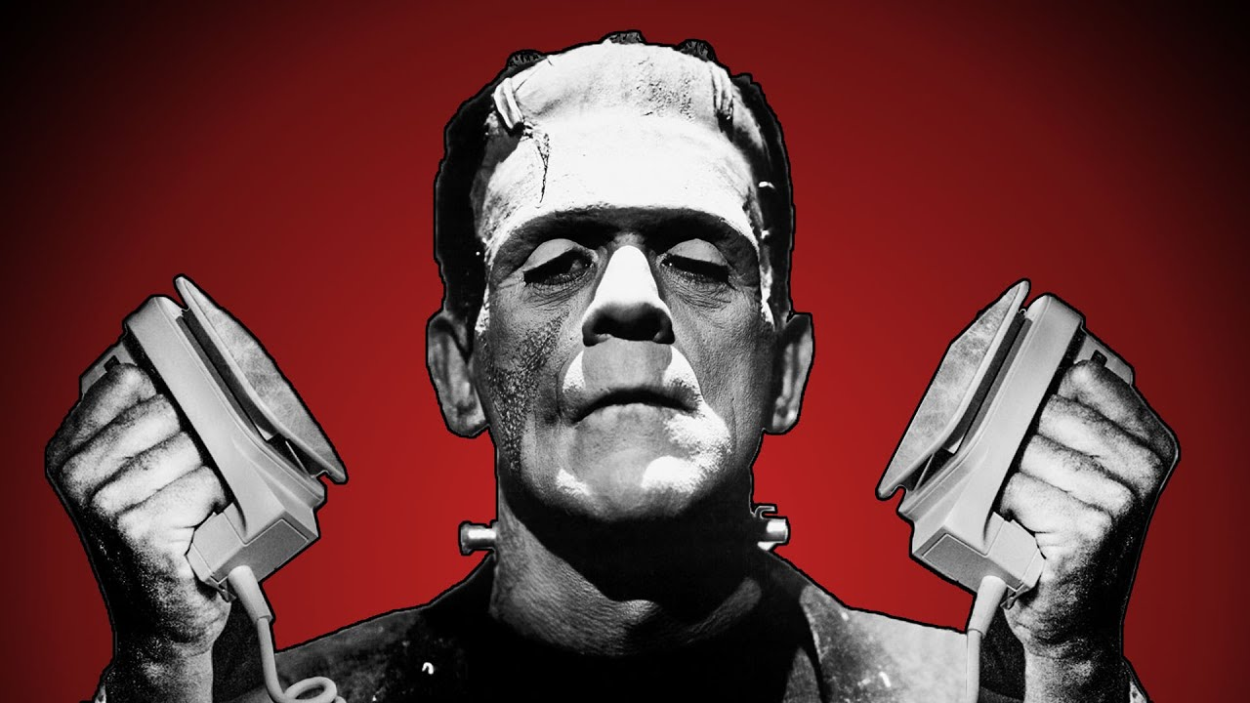
”Electrical Storm”
Treatment
If unstable and ongoing → shock!

Slide 21
”Electrical Storm”
Treatment
If stable and ongoing/intermittent...meds...
Polymorphic VT → Look for underlying cause and treat aggressively, based on QTc

Slide 22
”Electrical Storm”
Treatment
If stable and ongoing/intermittent...meds...
Polymorphic VT → Look for underlying cause and treat aggressively, based on QTc
Normal QTc → cardiac ischemia, Brugada

Slide 23
”Electrical Storm”
Treatment
If stable and ongoing/intermittent...meds...
Polymorphic VT → Look for underlying cause and treat aggressively, based on QTc
Long QTc → electrolytes, meds, etc.
Mg⁺⁺, overdrive pacing, etc.

Slide 24
”Electrical Storm”
Treatment
If stable and ongoing/intermittent...meds...
Monomorphic VT
Procainamide – Class IIa, but not rec’d in CMPY, AHF, HD unstable, etc.
Amiodarone – Class IIb, has βB effects
Lidocaine – less effective but produces less hypotension

Slide 25
”Electrical Storm”
Treatment
If stable and ongoing/intermittent...meds...
Monomorphic VT → amiodarone > lidocaine
βBs help with sympathetic tone

Slide 26
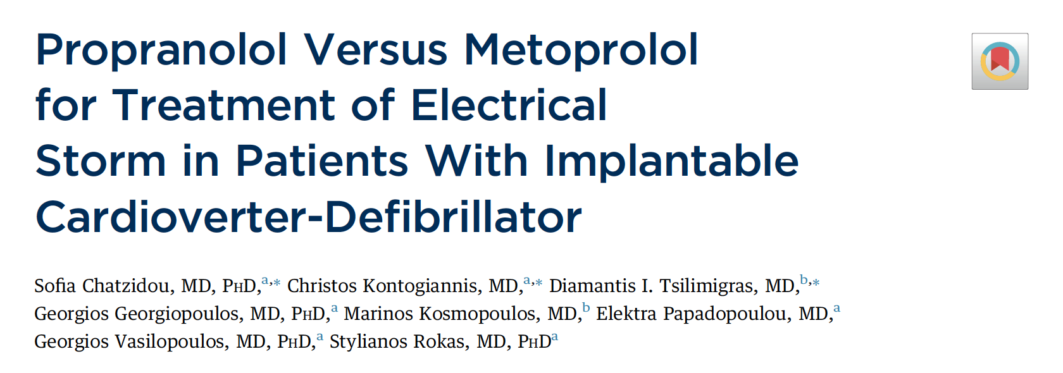
”Electrical Storm”
Treatment
If stable and ongoing/intermittent...meds...
Monomorphic VT → amiodarone > lidocaine
βBs help with sympathetic tone
JACC 2018

Slide 27
”Electrical Storm”
Treatment
If stable and ongoing/intermittent...meds...
Monomorphic VT → amiodarone > lidocaine
Non-selective βBs → better CNS penetration
Sedation, e.g. benzodiazepines, dexmedetomidine (anti-adrenergic effects), propofol if intubated

Slide 28
”Electrical Storm”
If patient converts to sinus rhythm...
Sedation
Look for and treat underlying cause
Monomorphic? → empiric amiodarone
PVT with normal QTc? → tx ACS, Brugada, etc.
PVT with long QTc? → empiric Mg⁺⁺
Admit for further workup and tx!!

Slide 29
Case 1
Unfortunately...

Slide 30
Case 1
Unfortunately...

Slide 31
”Electrical Storm”
What if...repeat defibs aren’t working!

Slide 32
”Electrical Storm”
Incessant/intractable VF

Slide 33
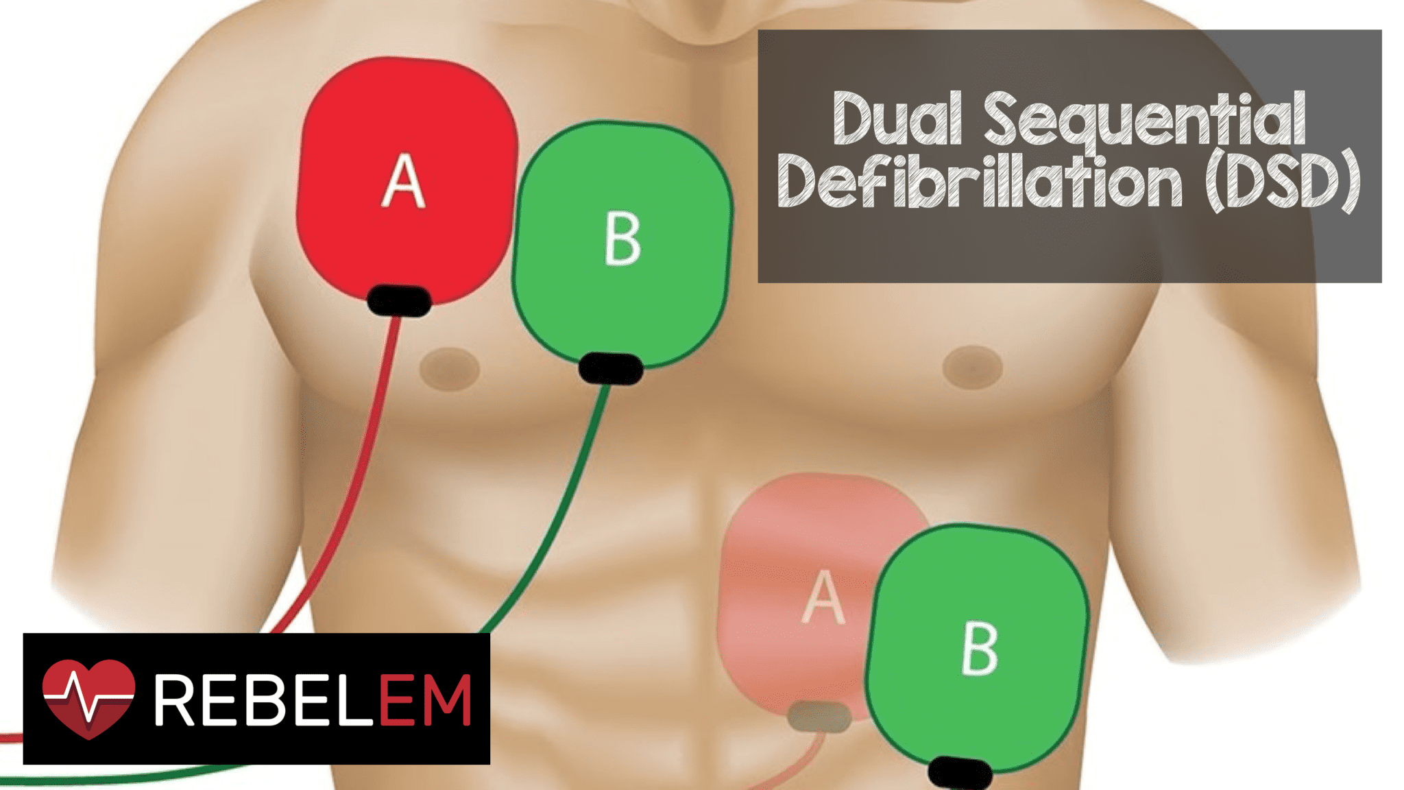
”Electrical Storm”
Incessant/intractable VF
Double sequential defibrillation?

Slide 34
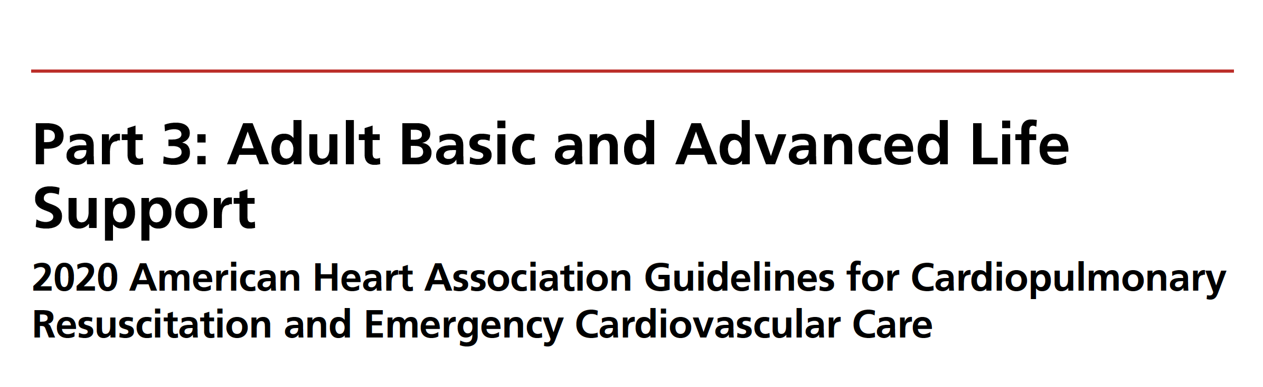
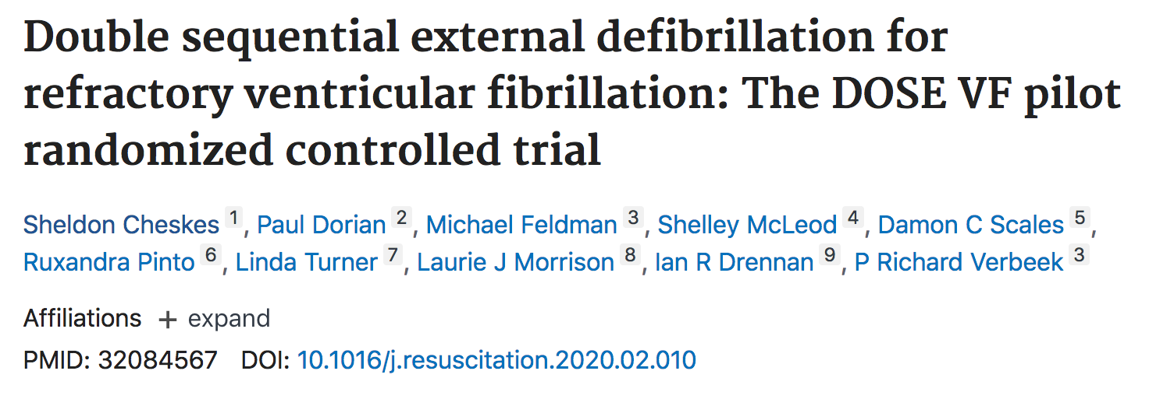
”Electrical Storm”
Incessant/intractable VF
Double sequential defibrillation?
Circulation 2020
Resuscitation 2020
AJEM 2020
AJEM 2020
Resuscitation 2020
AJEM 2020

Slide 35
”Electrical Storm”
Incessant/intractable VF
Double sequential defibrillation?
Appears promising when used early (after 3rd shock) and with A-P pad placement
Resuscitation 2020

Slide 36
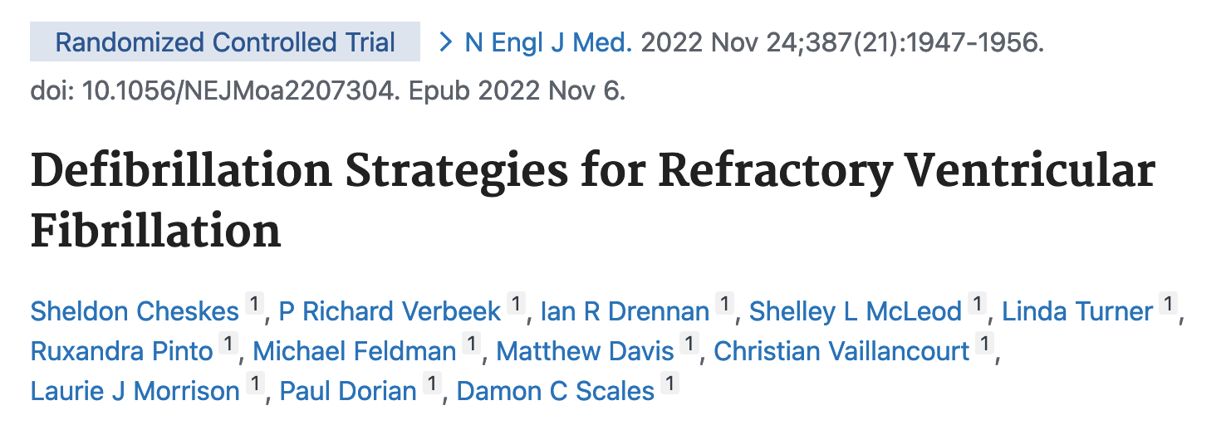
”Electrical Storm”
Incessant/intractable VF
Double sequential defibrillation?
Appears promising when used early (after 3rd shock) and with A-P pad placement
N Engl J Med 2022

Slide 37
”Electrical Storm”
Incessant/intractable VF
Double sequential defibrillation?
Increased survival and neurologic outcome
N Engl J Med 2022

Slide 38
”Electrical Storm”
Incessant/intractable VF
β-blockade?

Slide 39
”Electrical Storm”
Ann Emerg Med 2020
Resuscitation 2020

Slide 40
”Electrical Storm”
Incessant/intractable VF
β-blockade → low level evidence suggesting improved rates of ROSC and survival with favorable neurologic outcome

Slide 41
Case 1
58 yo M presents with intermittent episodes of palpitations

Slide 42
Case 1
58 yo M presents with intermittent episodes of palpitations
Monomorphic VT
Amiodarone
Shocked x 2 (midazolam sedation)

Slide 43
Case 1
58 yo M presents with intermittent episodes of palpitations
VF
Defib x 2, then DSD
Propranolol, propofol, RSI
DSD again

Slide 44
Case 1
58 yo M presents with intermittent episodes of palpitations
VF
Defib x 2, then DSD
Propranolol, propofol, RSI
DSD again → converted

Slide 45
Case 1
58 yo M presents with intermittent episodes of palpitations
Received an ICD
Good neurologic outcome, discharged 1 week later

Slide 46
Key Points

Slide 47
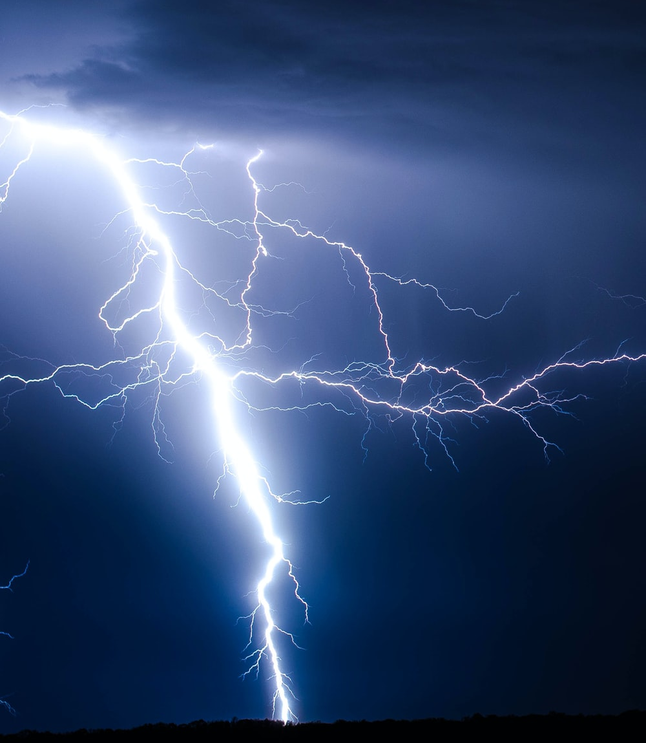
Key Points
Electrical storm
For monomorphic VT
Amiodarone
Suppress catecholamines → βBs, sedation
Shock when needed

Slide 48
Key Points
Electrical storm
For incessant VF
Consider DSD after 3rd shock, A-P pad position
Give βBs

Slide 49
Key Points
Electrical storm
For incessant VF
Consider DSD after 3rd shock, A-P pad position
Give βBs
Look for and treat the underlying cause

Slide 50
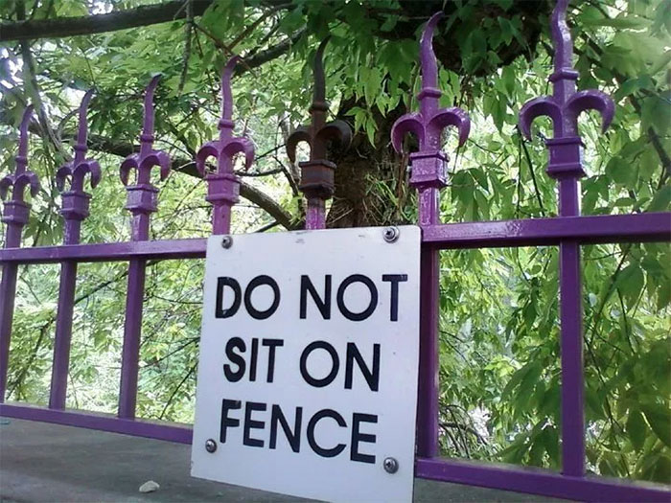

Slide 51
Case 2
55 yo M brought to the ED in cardiac arrest

Slide 52
Case 2

Slide 54
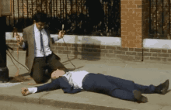

Slide 55
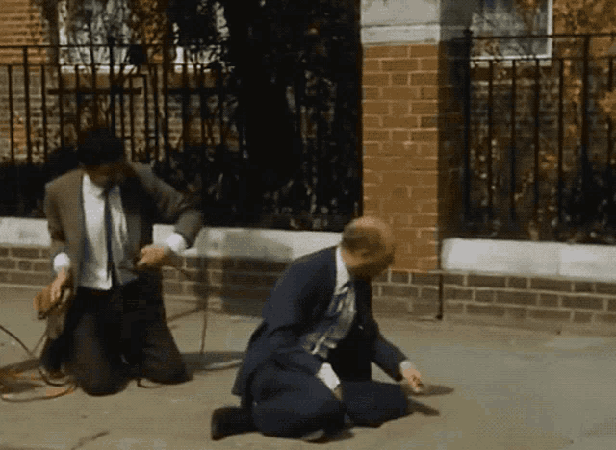

Slide 56
Case 2
Patient gets high-quality CPR, defibrillations, a few doses of EPI…

Slide 57
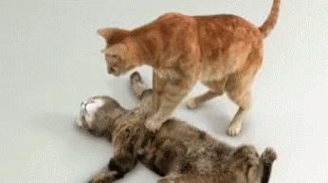
Case 2
Patient gets high-quality CPR, defibrillations, a few doses of EPI… ROSC!

Slide 58
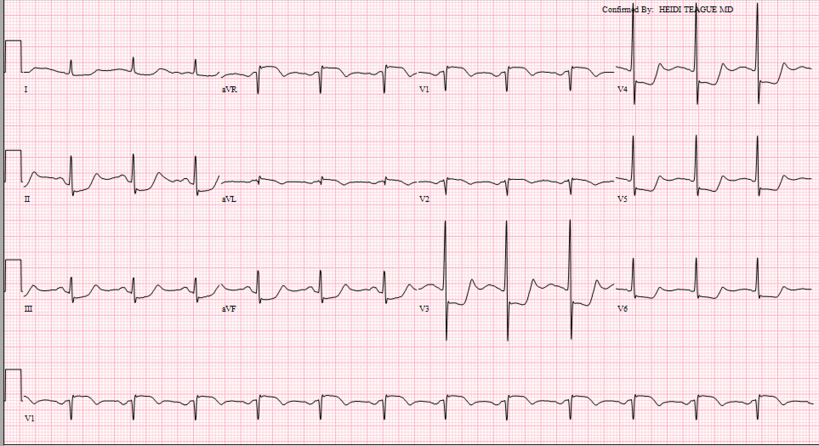
ECG < 10 min Post-ROSC

Slide 59
Cath lab activation?

Slide 60
Post-arrest ECG
JAMA Network Open Jan 2021
Resuscitation Dec 2021

Slide 61
Post-arrest ECG
Resuscitation 2023

Slide 62
Post-arrest ECG
The immediate post-ROSC ECG frequently overestimates the amount of underlying coronary disease c/w subsequent ECGs
Often caused by resuscitation interventions (e.g. EPI, shocks, etc.)

Slide 63
Post-arrest ECG
The immediate post-ROSC ECG frequently overestimates the amount of underlying coronary disease c/w subsequent ECGs
Often caused by resuscitation interventions (e.g. EPI, shocks, etc.)
Repeat ECG at least 8 minutes (?) after ROSC → better indicator of actual disease

Slide 64
ECG < 10 min Post-ROSC

Slide 65
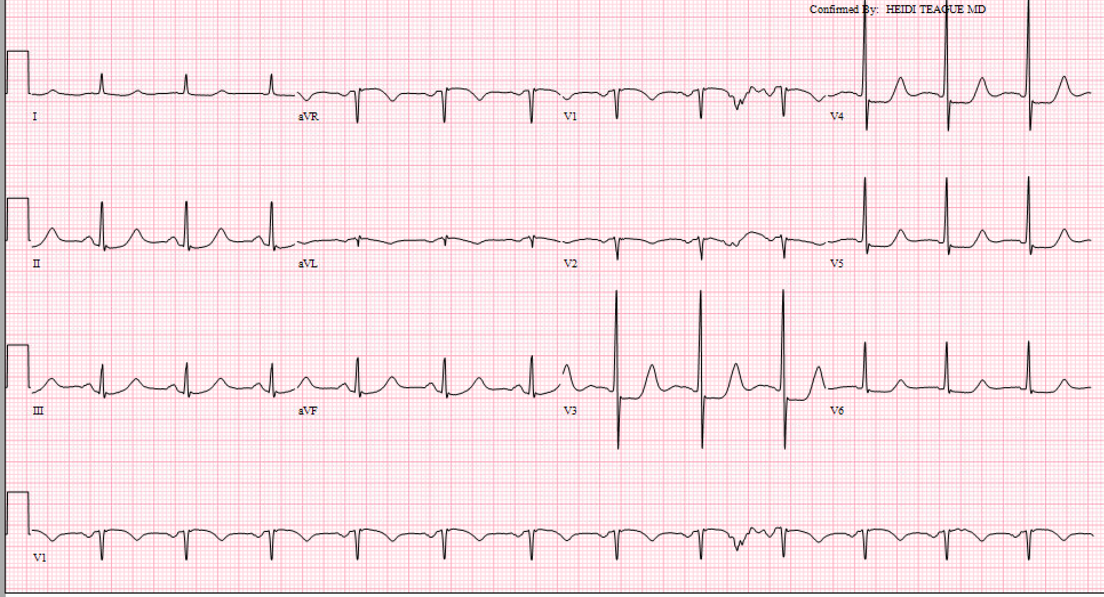
ECG #2 (after 15 min)

Slide 66
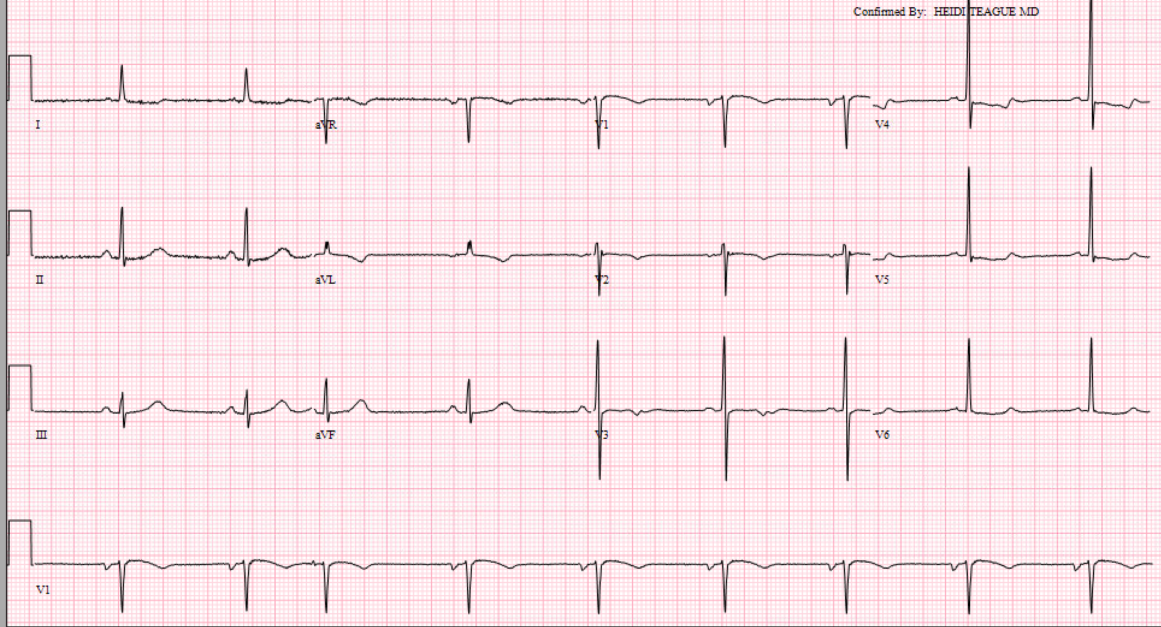
ECG #3 (after 30 min)

Slide 67
Key Points

Slide 68
Key Points
The post-arrest ECG frequently over-estimates ischemia
Consider repeating the ECG after a short period of time to better assess the true evidence of ischemia

Slide 69
Takehome Points
Electrical storm
Shock, reverse the underlying cause
Decrease the adrenergic tone → beta blockers
Immediate post-arrest ECGs can be unreliable
Consider using the 10-20 min ECG for decision-making

Slide 70
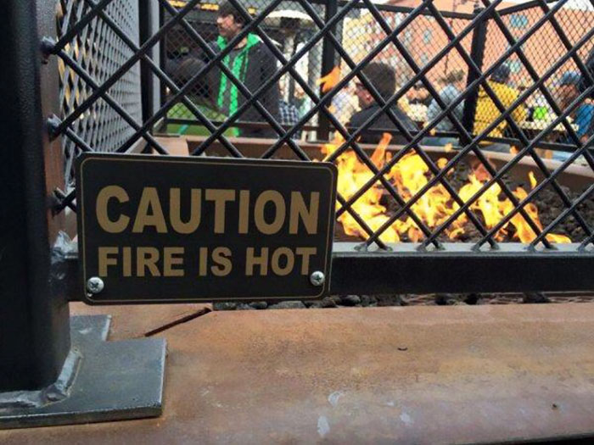

Slide 71
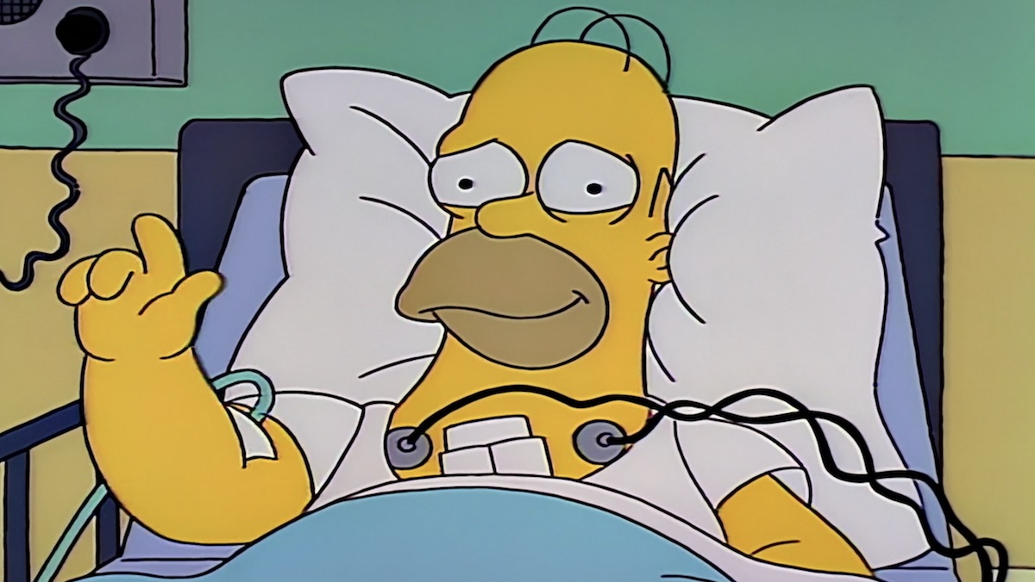
Back to the case...

Slide 72
Who should go for post-arrest cath?

Slide 73
Cath all post-arrest survivors!
Reynolds, J Int Care Med 2009
Ewy, JACC 2009
Dumas, Circ Cardiovasc Interv 2010
Radsel, Am J Cardiol 2011
Aurore, Eur J Emerg Med 2011
Larsen, Resuscitation 2012
Zanuttini, Am J Cardiol 2012
Chelly, Resuscitation 2012

Slide 74
Cath all post-arrest survivors!
Hollenbeck, Resuscitation 2014
Kim, Resuscitation 2015
Redfors, Resuscitation 2015
Choudry, Eur Heart J Acute Cardiovasc Care 2015
Salam, Eur Heart J Acute Cardiovasc Care 2016
Millin, Resuscitation 2016

Slide 75
Cath all post-arrest survivors!
You don’t even need to look at the ECG!!

Slide 76
Cath all post-arrest survivors!
Urgent/immediate invasive strategy (within 2 hours) is indicated for NSTE-ACS patients that develop hemodynamic or electrical instability, e.g. VT or VF
(Class I, level of evidence A)
Circulation 2014

Slide 77
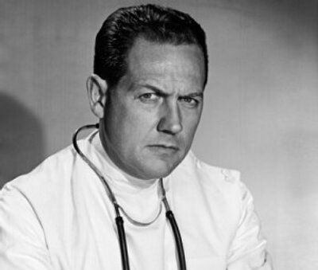
Cath all post-arrest survivors!
Urgent/immediate invasive strategy (within 2 hours) is indicated for NSTE-ACS patients that develop hemodynamic or electrical instability, e.g. VT or VF
(Class I, level of evidence A)
Circulation 2014

Slide 78
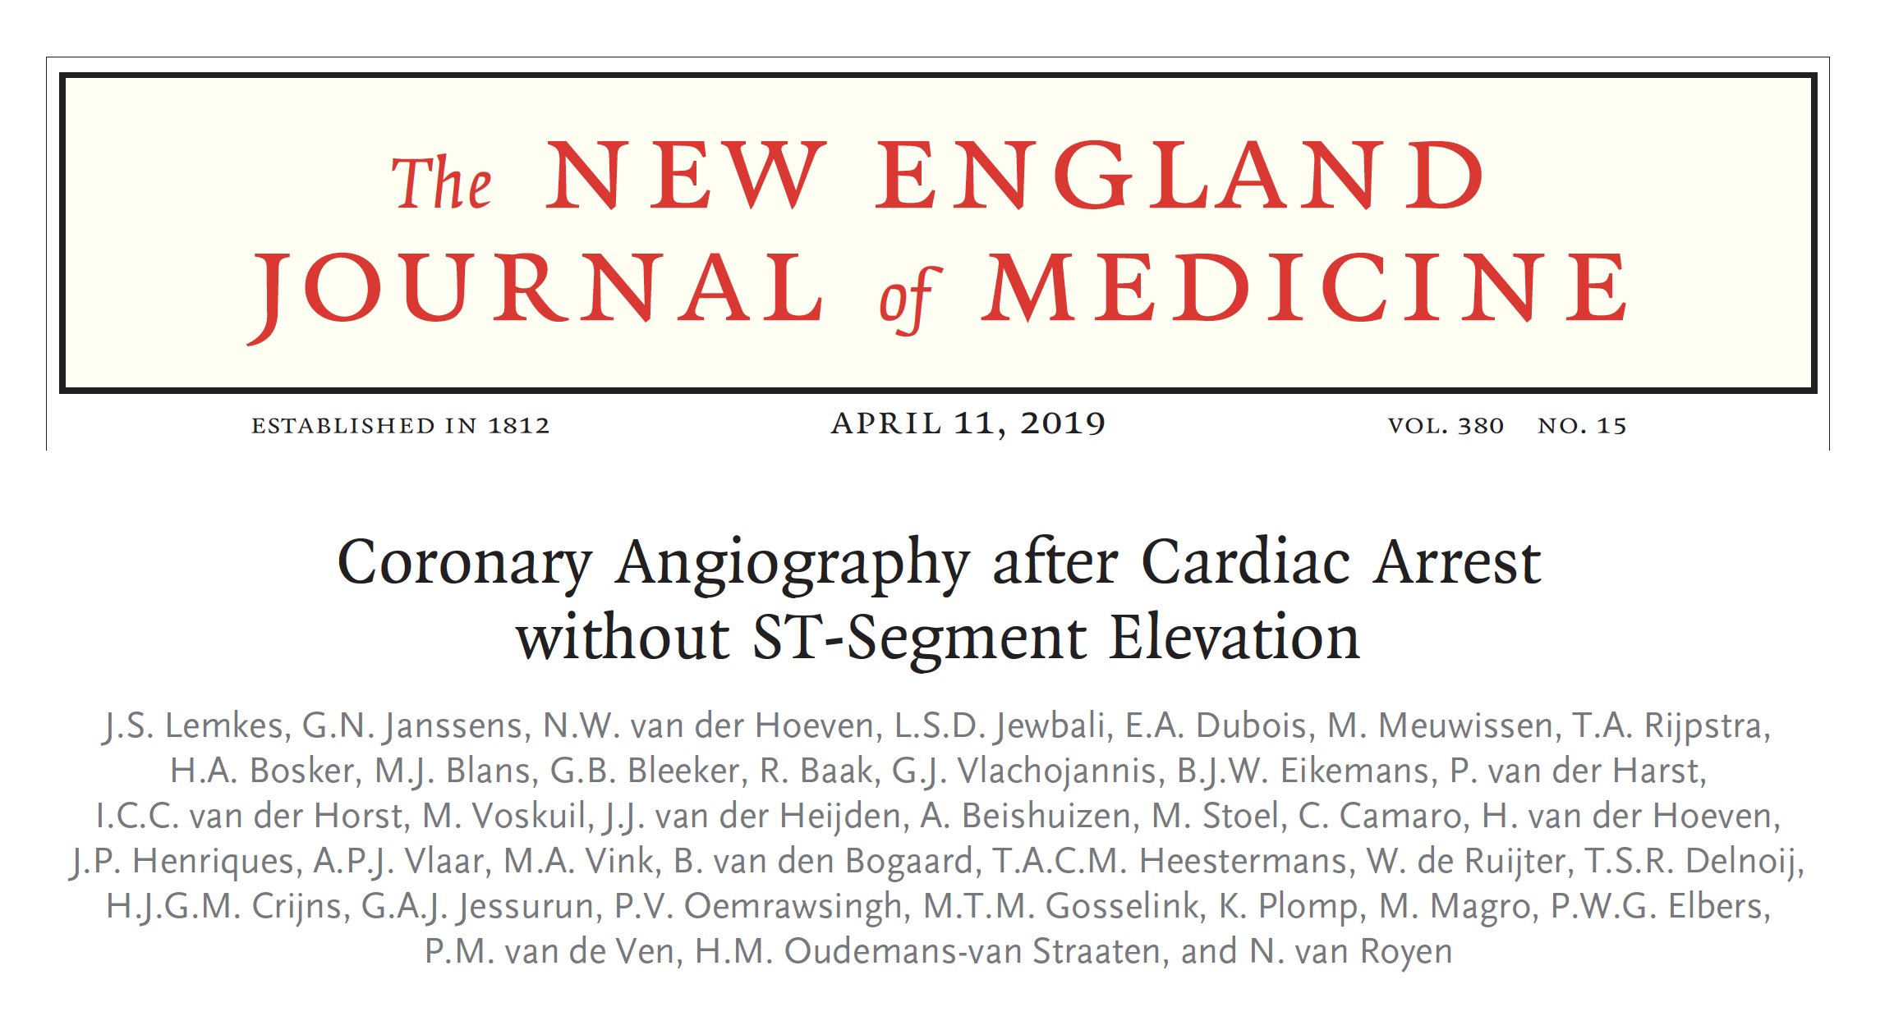
Cath all post-arrest survivors?

Slide 79
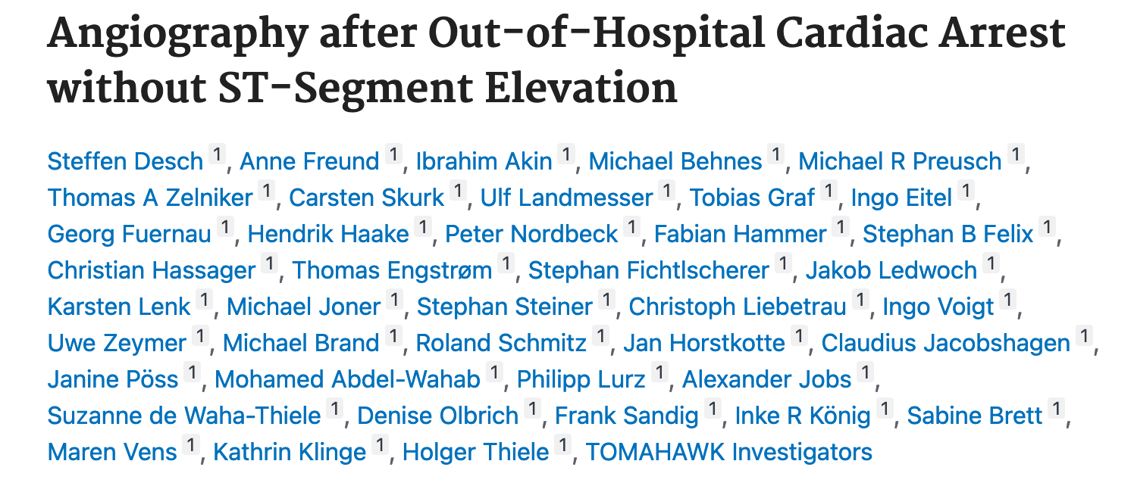
Cath all post-arrest survivors?
NEJM Dec 2021
Notes:
So we do NOT need to activate the cath lab

Slide 80
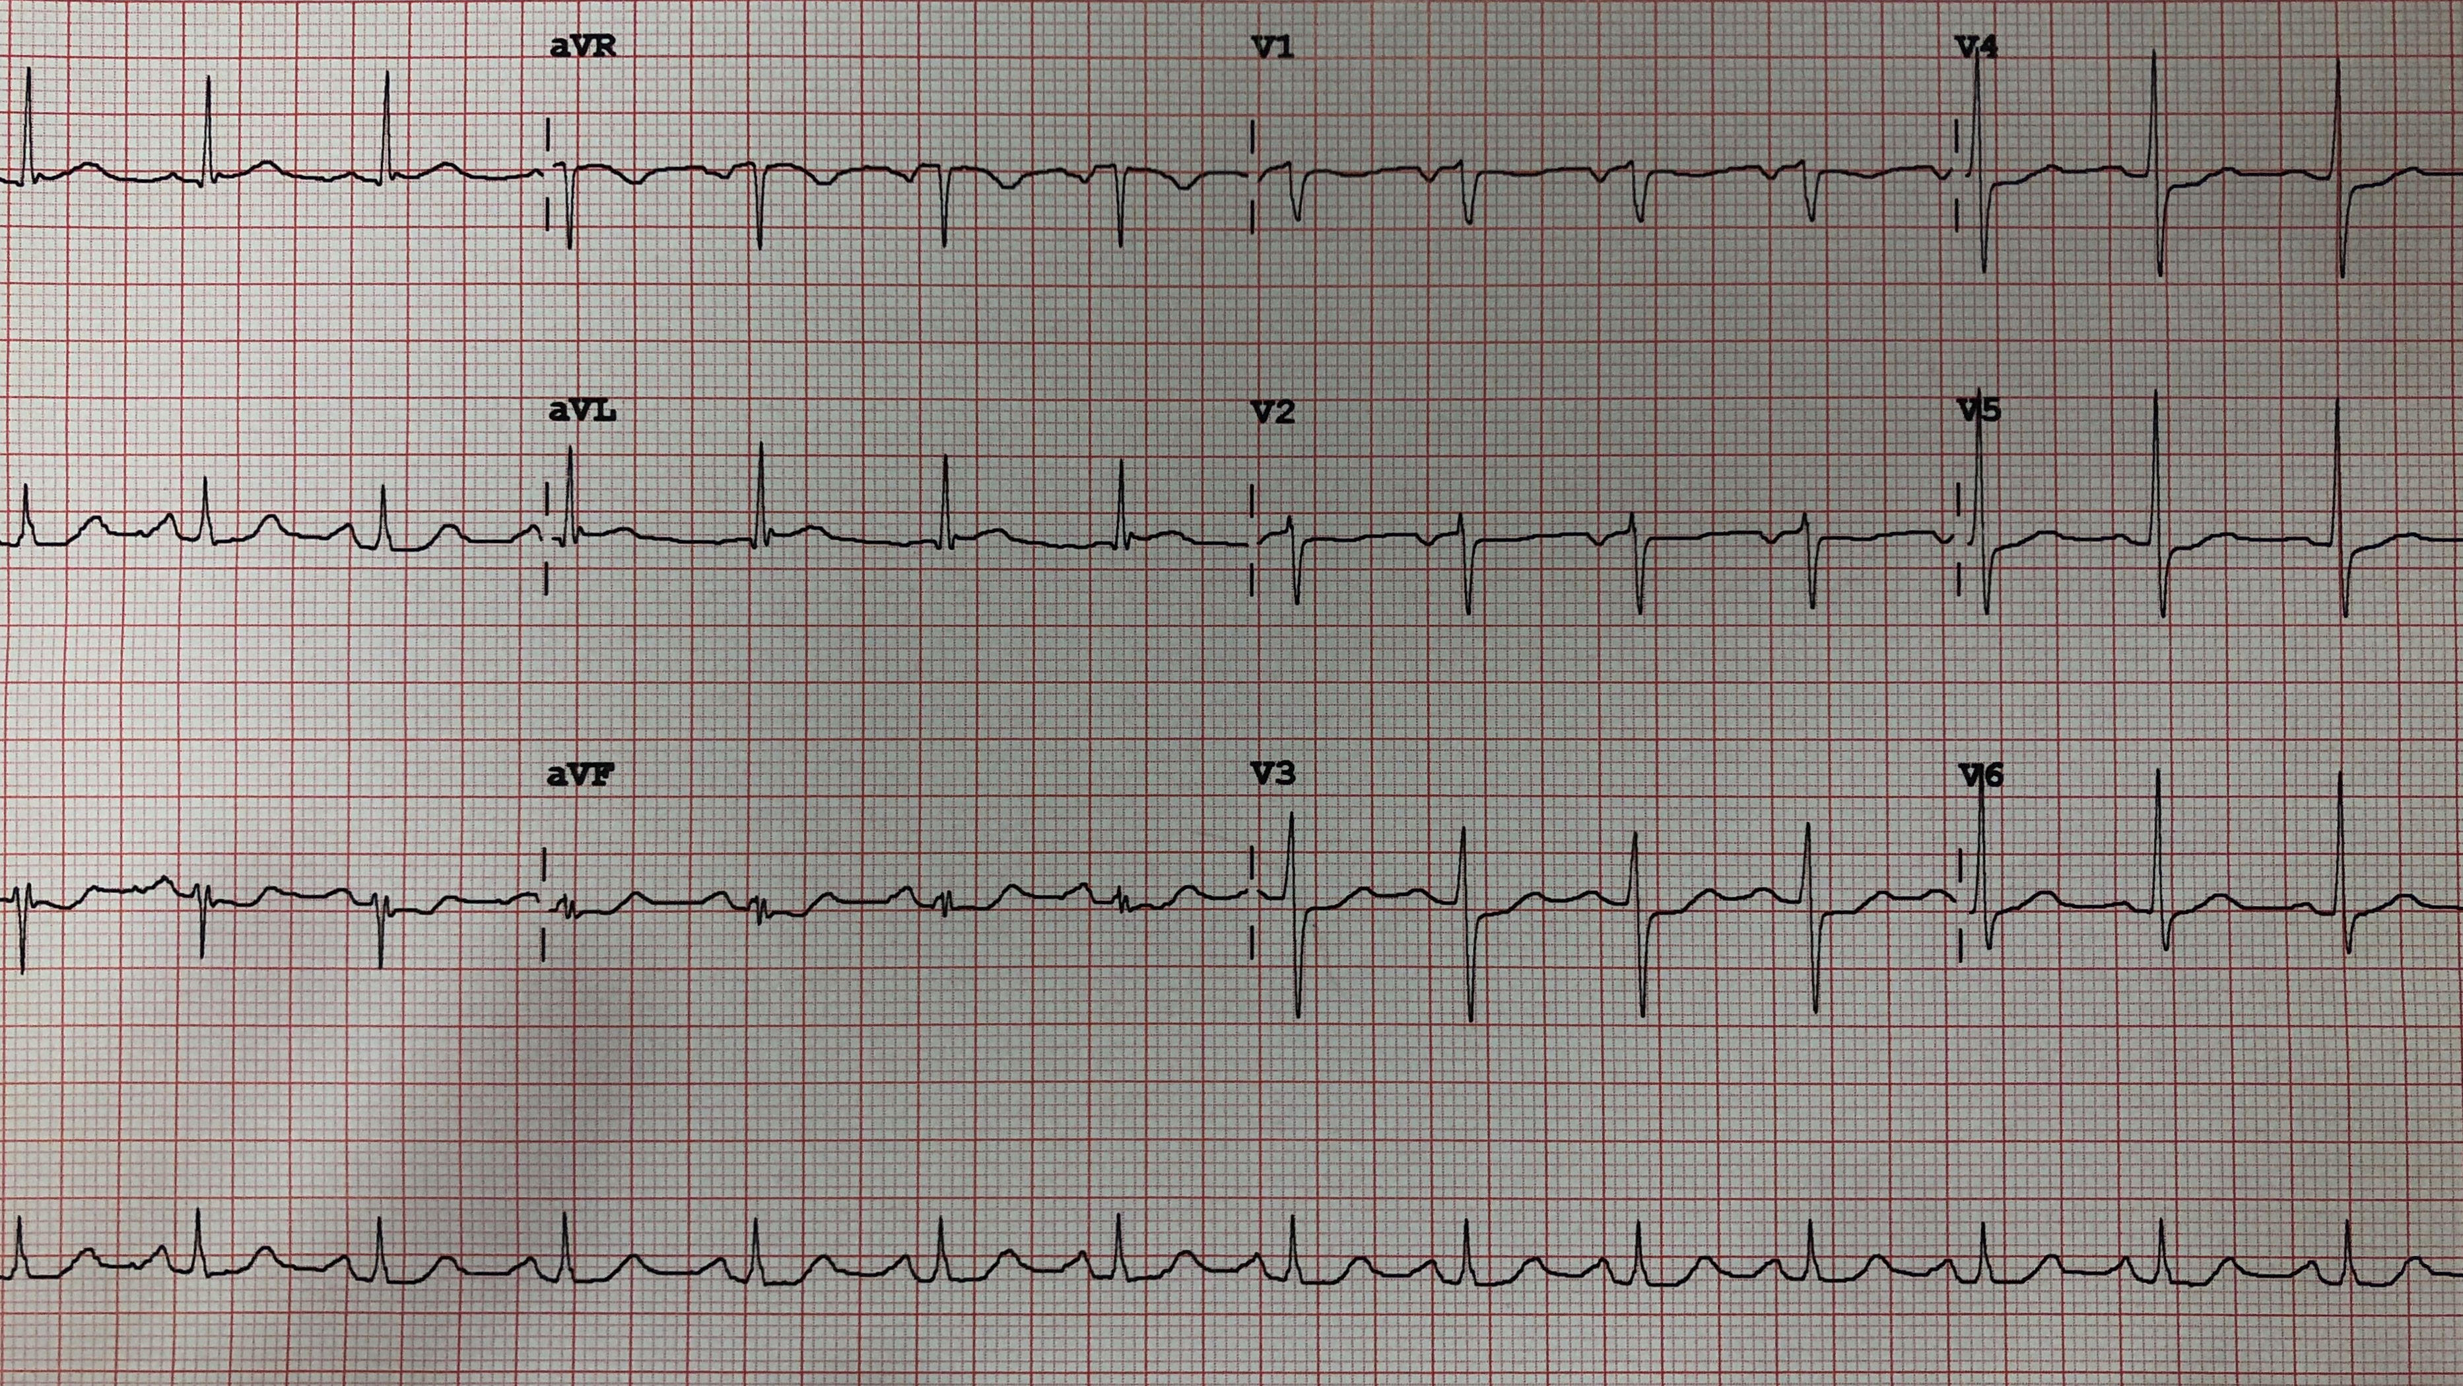
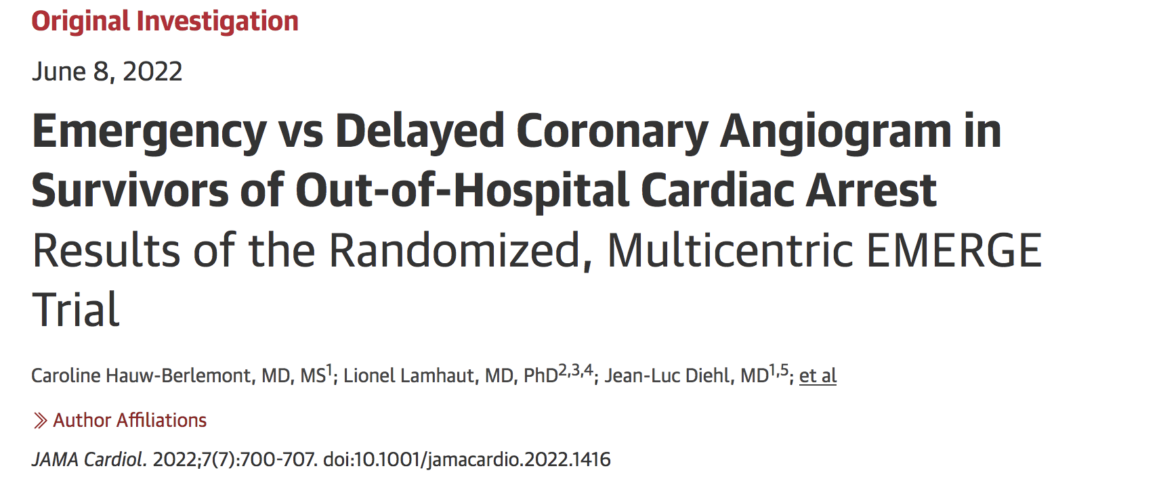
Cath all post-arrest survivors?
JAMA Cardiol 2022
Notes:
So we do NOT need to activate the cath lab

Slide 81
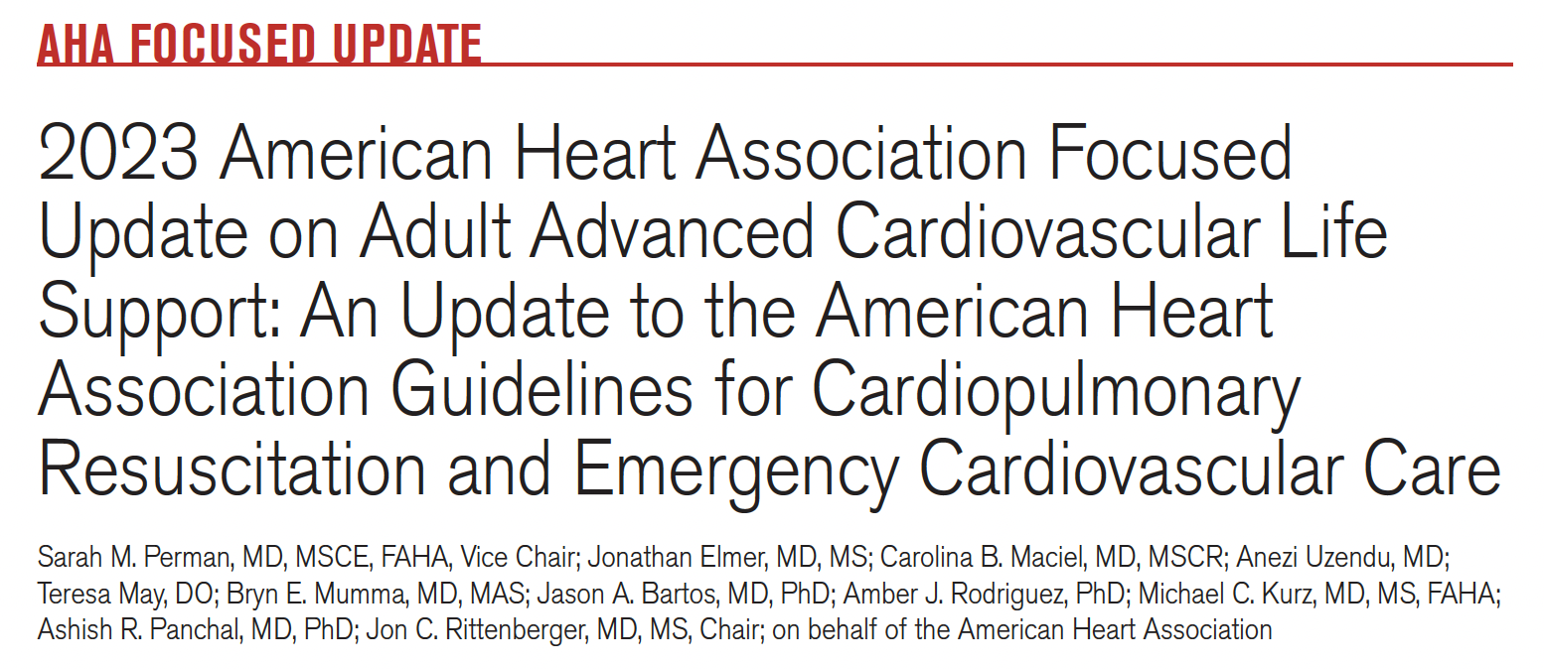
Circulation Dec 2023
Circulation Dec 2023

Slide 82
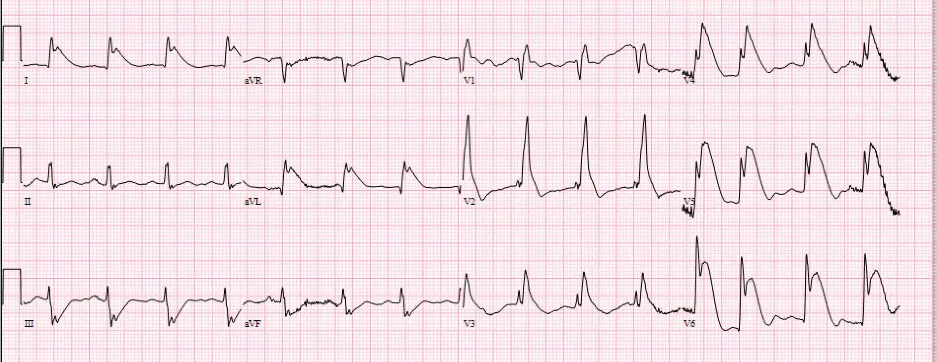
Key Points
Patients with STEMI should still go for immediate cath, but...

Slide 83
Key Points
Patients with STEMI should still go for immediate cath, but...
There is no benefit to routinely sending post-ROSC patients without ECG evidence of a STEMI for immediate cath
These patients need early stabilization, consideration of a delayed cath

Slide 84
Takehome Points
Electrical storm
Cardiovert/defib., reverse the underlying cause
Decrease the adrenergic tone
Immediate post-arrest ECGs can be unreliable
Consider using the 10-20 min ECG
Post-arrest STE → cath
Delayed/selective approach if NSTE

Slide 85
Thanks! amalmattu@comcast.net

