Slide 1
ED Delirium
Nida F. Degesys, MD, FACEP
Medical Director, UCSF Age Friendly Emergency Department
Some slides courtesy of Drs. Stephanie Rogers and Vanja Douglas

Slide 2
ILOs
Define delirium
Recognize morbidity of delirium
Prevention of delirium
Identify delirium using screening assessments
Treatment of delirium

Slide 3
Patient D
Notes:
Status quo​
72M PMhx Parkinsons, dementia, AF on Eliquis comes to ED after a fall while playing with grandkids, no LOC. Waits in WR for 4 hours, then goes to GZ or 25H, lights are on, loud, he gets head CT, then a 6hr head CT. Has been NPO since the afternoon when he fell, It is now 3am and he starts acting strangely, gets angry and starts to yell at staff. He is delirious and he gets admitted for AMS​
Of the 20 million older adults that go to the ED each year 8-17% have delirium.​
Delirium has a 12month mortality rate of 10-26%!!!

Slide 4
What is delirium?
A disturbance in attention and awareness
The disturbance develops over a short period of time (usually hours to a few days), represents a change from baseline attention and awareness, and tends to fluctuate in severity during the course of a day.
An additional disturbance in cognition (e.g., memory deficit, disorientation, language, visuospatial ability, or perception).
The disturbances in Criteria A and C are not better explained by another preexisting, established, or evolving neurocognitive disorder and do not occur in the context of a severely reduced level of arousal, such as coma.
There is evidence from the history, physical examination, or laboratory findings that the disturbance is a direct physiological consequence of another medical condition, substance intoxication or withdrawal, or is due to multiple etiologies.

Slide 5
TRUE
FALSE
Most delirious patients are agitated and trying to climb out of bed.
Notes:
(Peritogiannis et al. 2015)

Slide 6
FALSE
Only 25% of delirium cases are hyperactive. Most cases of delirium are hypoactive or mixed.

Slide 7
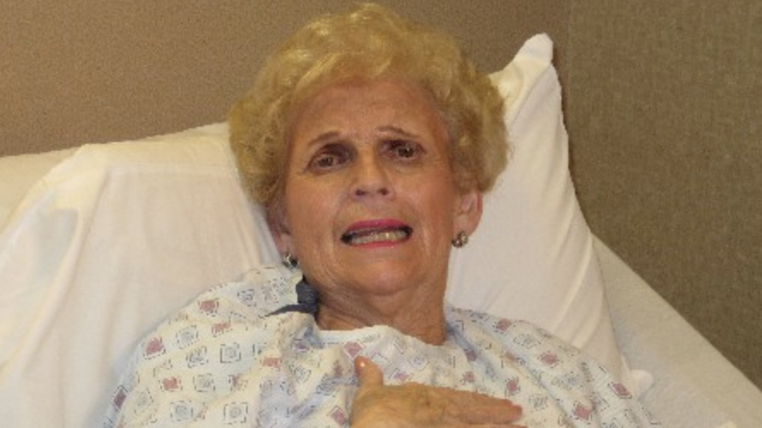
Hyperactive delirium
Hallucinations
Agitation (pulling at lines, getting OOB)
Restless
Irritable
Only 25%
Notes:
(Peritogiannis et al. 2015)

Slide 8
Hypoactive Delirium
Sleepy
Withdrawn
Hard to arouse
Slowed speech
Highest mortality rate
Higher rates of pressure ulcers and hospital-acquired infections.

Slide 9
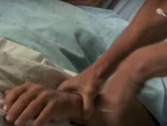
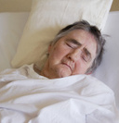
Mixed
Patients can exhibit characteristics of both hyperactive and hypoactive delirium across the day.
HYPERACTIVE DELIRIUM
MIXED
DELIRIUM
HYPOACTIVE DELIRIUM
Slide Courtesy of Dr. Stephanie Rogers
Notes:
http://www.ncbi.nlm.nih.gov/pmc/articles/PMC3065676/

Slide 10
Model of Delirium
Risk Factors
Specific Insults
Delirium
Slide courtesy of Dr. Vanja Douglas

Slide 11
Precipitating Insult: DELIRIUM
D- rugs E-lectrolytes (Na, Ca, CO2), E-nvironment change L-ack of drugs (withdrawal), L-ack of sleep I- ntracranial (stroke, bleed, meningitis)
R-estraints, R-educed sensory input (vision/hearing) I-nfection U-rinary retention, fecal impaction M-etabolic (hypoglycemia, uremia, liver failure, thyroid dysfunction, B1 deficiency) / M-yocardial (cardiac bypass)

Slide 12
Model of Delirium: Example 1
No risk factors
Encephalitis
Delirium
Slide courtesy of Dr. Vanja Douglas

Slide 13
Model of Delirium
Risk Factors
Specific Insults
Delirium
Slide courtesy of Dr. Vanja Douglas

Slide 14
Risk Factors
Age (>80)
History of DEMENTIA, stroke, or Parkinson’s disease
Functional impairment (ADLs, IADLs,)
Sensory impairment (hearing, vision)
Depression
Alcohol abuse
Long ED stay
Dehydration
Malnutrition
Notes:
Long ED Stay: Elder NM, Mumma BE, Maeda MY, Tancredi DJ, Tyler KR. Emergency Department Length of Stay Is Associated with Delirium in Older Adults. West J Emerg Med. 2023 May 3;24(3):532-537. doi: 10.5811/westjem.59383. PMID: 37278803; PMCID: PMC10284508.

Slide 15
Model of Delirium: Example 2
Mild Dementia
UTI
Delirium
Slide courtesy of Dr. Vanja Douglas

Slide 16
Model of Delirium: Example 3, Case D
Parkinson's
Lack of Sleep
Delirium
Slide courtesy of Dr. Vanja Douglas

Slide 17
Poll:
How Common is Delirium?
A.) 2%
B.) 5%
C.)20%
D.)80%

Slide 18
How Common is it?
29-64% of all hospitalized patients (1)
Medical patients:
Prevalence (present on admission): 18-35%
Incidence (develops in the hospital): 11-14%
Surgical patients:
Incidence: 11-51%
ICU patients
Prevalence + Incidence: 80-85%
10-17% of older ED patients (2)
Notes:
1)Inouye et al, Lancet 2013
2) Han JH, Zimmerman EE, Cutler N, et al. Delirium in older emergency department patients: recognition, risk factors, and psychomotor subtypes. Acad Emerg Med. 2009;16(3):193-200. doi:10.1111/j.1553-2712.2008.00339.x
3) Gustafson et al, J Am Geriatr Soc 1991

Slide 19
I know it when I see it…
50-75% of delirium is MISSED (3)
ED 76% missed rate (2)
Notes:
1)Inouye et al, Lancet 2013
2) Han JH, Zimmerman EE, Cutler N, et al. Delirium in older emergency department patients: recognition, risk factors, and psychomotor subtypes. Acad Emerg Med. 2009;16(3):193-200. doi:10.1111/j.1553-2712.2008.00339.x
3) Gustafson et al, J Am Geriatr Soc 1991

Slide 20
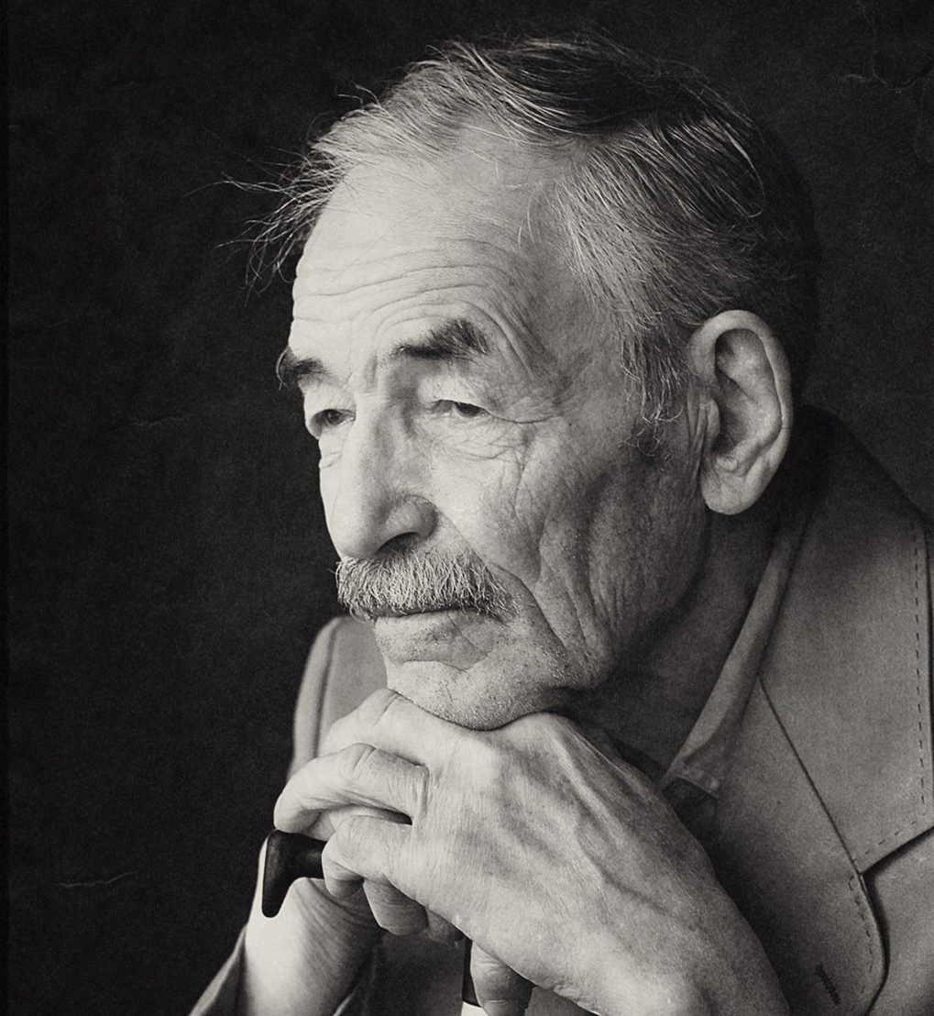
Why is Delirium Bad?
Mortality
5.5x more likely to die at 30d (1)
35-40% die within 1 year (2)
81% died by 3 yrs vs 49% w no delirium (3)
>/= acute MI and sepsis (4)
Complications
iatrogenic complications (falls, CAUTIS, PUs) (6)
Worsening dementia: 2x rate (7)
DC more to SNF/NH: 83% (9)
Increased LOS by 5-7 days (8)
Costly
Inc $4-6k per patient (8)
Notes:
Atul Anand, Michael Cheng, Temi Ibitoye, Alasdair M J Maclullich, Emma R L C Vardy, Positive scores on the 4AT delirium assessment tool at hospital admission are linked to mortality, length of stay and home time: two-centre study of 82,770 emergency admissions, Age and Ageing, Volume 51, Issue 3, March 2022, afac051, https://doi.org/10.1093/ageing/afac051
Moran JA, Dorevitch MI. Delirium in the hospitalized elderly. Aust J Hosp Pharm 2001;31:35-40
Melanie Dani, Lucy H Owen, Thomas A Jackson, Kenneth Rockwood, Elizabeth L Sampson, Daniel Davis, Delirium, Frailty, and Mortality: Interactions in a Prospective Study of Hospitalized Older People, The Journals of Gerontology: Series A, Volume 73, Issue 3, March 2018, Pages 415–418, https://doi.org/10.1093/gerona/glx214
Prest J, Nguyen T, Rajah T, Prest AB, Sathananthan M, Jeganathan N. Sepsis-Related Mortality Rates and Trends Based on Site of Infection. Crit Care Explor. 2022 Oct 10;4(10):e0775. doi: 10.1097/CCE.0000000000000775. PMID: 36248320; PMCID: PMC9556121.
Inouye SK, Westendorp RGJ, Saczynski JS. Delirium in elderly people. Lancet. (2014) 383:911–22. 10.1016/S0140-6736(13)60688-1
6.) Inouye SK. Delirium in older persons. N Engl J Med. 2006 Mar 16;354(11):1157-65. doi: 10.1056/NEJMra052321. Erratum in: N Engl J Med. 2006 Apr 13;354(15):1655. PMID: 16540616.
Han JH, Shintani A, Eden S, Morandi A, Solberg LM, Schnelle J, Dittus RS, Storrow AB, Ely EW. Delirium in the emergency department: an independent predictor of death within 6 months. Ann Emerg Med. 2010 Sep;56(3):244-252.e1. doi: 10.1016/j.annemergmed.2010.03.003. Epub 2010 Apr 3. PMID: 20363527; PMCID: PMC3768121.
7) Vasilevskis EE, Ely EW. The Danger of Delirium: Comment on “Delirium and Long-term Cognitive Trajectory Among Persons With Dementia”. Arch Intern Med. 2012;172(17):1331–1332. doi:10.1001/archinternmed.2012.3414
8) Dziegielewski C, Skead C, Canturk T, Webber C, Fernando SM, Thompson LH, Foster M, Ristovic V, Lawlor PG, Chaudhuri D, Dave C, Herritt B, Bush SH, Kanji S, Tanuseputro P, Thavorn K, Rosenberg E, Kyeremanteng K. Delirium and Associated Length of Stay and Costs in Critically Ill Patients. Crit Care Res Pract. 2021 Apr 24;2021:6612187. doi: 10.1155/2021/6612187. PMID: 33981458; PMCID: PMC8088381.
McCusker J, Cole MG, Dendukuri N, Belzile E. Does delirium increase hospital stay? J Am Geriatr Soc. 2003 Nov;51(11):1539-46. doi: 10.1046/j.1532-5415.2003.51509.x. PMID: 14687382.
9) McAvay GJ, Van Ness PH, Bogardus ST Jr, Zhang Y, Leslie DL, Leo-Summers LS, Inouye SK. Older adults discharged from the hospital with delirium: 1-year outcomes. J Am Geriatr Soc. 2006 Aug;54(8):1245-50. doi: 10.1111/j.1532-5415.2006.00815.x. PMID: 16913993.

Slide 21
Prevention
30-40% is preventable
Multi-component intervention
Cognitive stimulation
Sleep promotion
Mobilization
Adequate nutrition & hydration
Current evidence does NOT support the use of antipsychotics for prevention nor treatment of delirium (Inouye, Lancet 2013)
Notes:
Inouye SK, Westendorp RGJ, Saczynski JS. Delirium in elderly people. Lancet. (2014) 383:911–22. 10.1016/S0140-6736(13)60688-1

Slide 22
Prevention: Non-pharmacologic
Risk factor for delirium | Targeted intervention
Cognitive Impairment | Board with names of care team members and day’s schedule Frequent reorientation Cognitive stimulation activities
Sleep Deprivation | Bedtime routine, avoid naps, warm milk/decaf tea, relaxation Unit-wide noise-reduction strategies Schedule adjustments to allow sleep
Immobility | Early ambulation, bed exercises Minimal use of catheters and restraints, LESS TETHERS!
Vision impairment < 20/70 | Use of visual aids (magnifying glass) Adaptive equipment (large illuminated telephone keypads, large print books, fluorescent tape on call bell)
Hearing impairment | Portable amplifying devices Earwax disimpaction
Dehydration (BUN/Cr ratio >18) | Oral rehydration
Odds of Delirium decreased by 53%, NNT=14
Slide courtesy of Dr. Vanja Douglas
Notes:
Hshieh TT, Yue J, Oh E, Puelle M, Dowal S, Travison T, Inouye SK. Effectiveness of multicomponent nonpharmacological delirium interventions: a meta-analysis. JAMA Intern Med. 2015 Apr;175(4):512-20. doi: 10.1001/jamainternmed.2014.7779. Erratum in: JAMA Intern Med. 2015 Apr;175(4):659. PMID: 25643002; PMCID: PMC4388802.
odds of delirium were 53% lower in the intervention group compared with controls (OR 0.47, 95% CI 0.38–0.58). The number needed to treat in the combined sample was 14.3
mobiliation: Anada S, Iigaya M, Takahashi M, Soda K, Wada N. Impact of early mobilization on the duration of delirium in elderly hospitalized patients: A retrospective cohort pilot study. Medicine (Baltimore). 2022 Nov 4;101(44):e31641. doi: 10.1097/MD.0000000000031641. PMID: 36343083; PMCID: PMC9646638.
Lo AX, Kennedy M. It's time to mobilize: Moving mobility interventions for delirium from inpatient units to the emergency department. J Am Coll Emerg Physicians Open. 2023 Feb 6;4(1):e12900. doi: 10.1002/emp2.12900. PMID: 36776215; PMCID: PMC9902676.

Slide 23
Sleep Promotion: Earplugs
832 patients in 5 studies
Relative risk 0.59 (95% CI 0.44-0.78)
Part of sleep promotion bundle in some of these studies
Litton et al, Crit Care Med 2016
Slide courtesy of Dr. Vanja Douglas
Notes:
Litton E, Carnegie V, Elliott R, Webb SA. The Efficacy of Earplugs as a Sleep Hygiene Strategy for Reducing Delirium in the ICU: A Systematic Review and Meta-Analysis. Crit Care Med. 2016 May;44(5):992-9. doi: 10.1097/CCM.0000000000001557. PMID: 26741578.

Slide 24
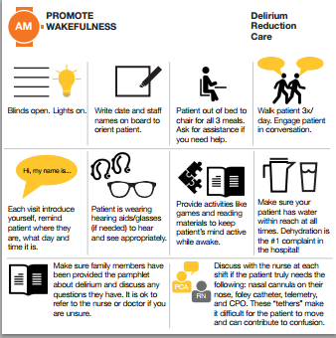
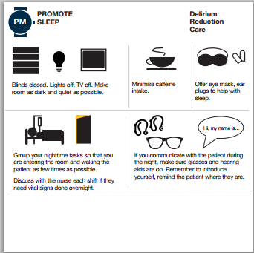
Non-pharmacologic behavioral intervention
Notes:
Studies have specificially looked at some of these interventions, like earplugs, which have reduced delirirum! Early mobility decreases days of delirium by half
Hshieh et al, JAMA Int Med 2015

Slide 25
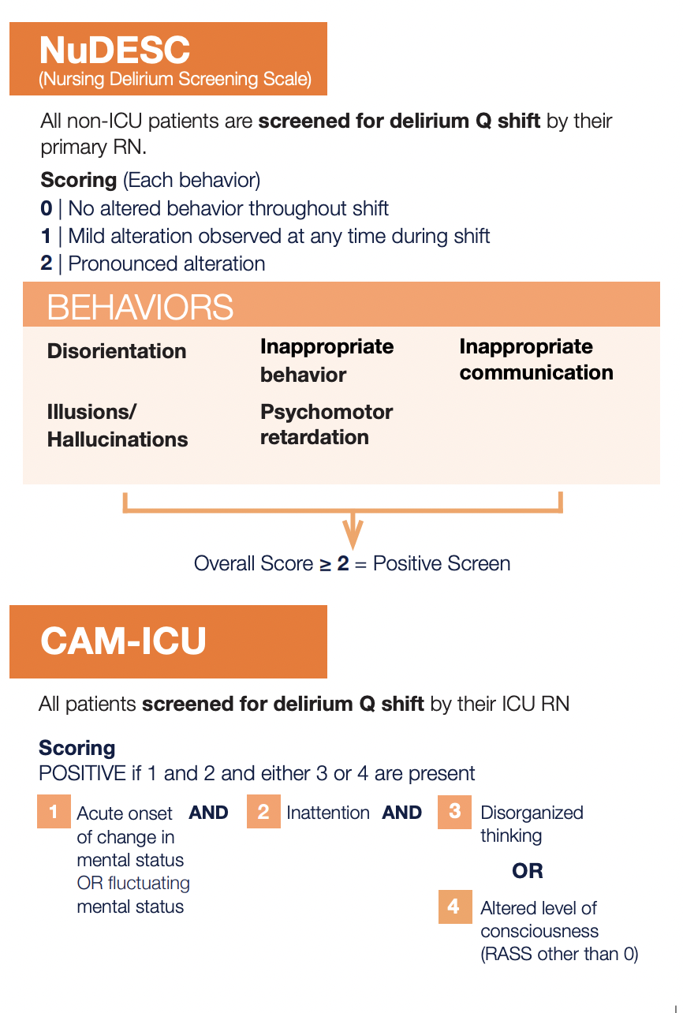

Slide 26
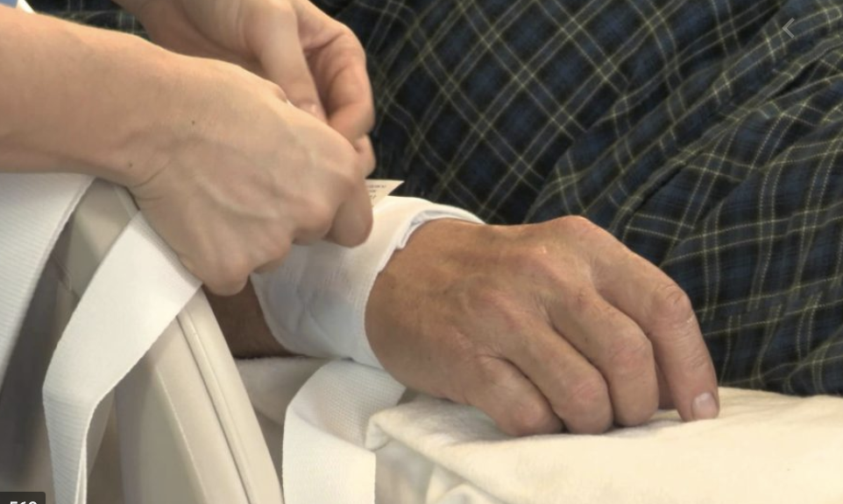
Treatment
Treat the underlying cause (MOVESSTUPID)

Slide 27
AMS: MOVESSTUPID
Metabolic – hepatic encephalopathy, hyper/hypoglycemia, Wernicke’s encephalopathy, B12 deficiency, pancreatitis, porphyria
Oxygen – hypoxia/anoxia, hypercarbia/acidosis
Vascular – stroke, hemorrhage, hypertensive emergency, MI
Electrolytes/Endocrine – hypo/hypernatremia, hypo/hypercalcemia, hypo/hypermagnasemia, hyper/hypothyroidism, adrenal insufficiency
Structural – subdural hematoma, hydrocephalus
Seizure – non-convulsive or complex partial status, post-ictal confusion
Trauma/Tumor – head trauma, brain tumor
Uremia
Psychiatric
Infectious – any infection (sepsis, meningitis, UTI, pneumonia)
Drugs – intoxication and withdrawal
Slide courtesy of Dr. Vanja Douglas

Slide 28
Treatment
Treat the underlying cause (MOVESTUPID)
Remove unnecessary medications

Slide 29
“BAD” Meds
Benzos- do not use unless ETOH/benzo w/d or seizures
Zolpidem, Carisoprolol,
Baclofen, Tizanidine- avoid unless serious spasms
Anti-nausea: Compazine, scolpolamine, meclizine
Preferred: Zofran (1st line), Haldol (2nd)
Antihistamines: loratidine, benadaryl, hydroxyzine
Tramadol
Gabapentin
Notes:
Palmaro A.
Dupouy J.
Lapeyre-Mestre M.
Benzodiazepines and risk of death: results from two large cohort studies in France and UK.Eur Neuropsychopharmacol. 2015; 25: 1566-1577
Benzodiazepine use is associated with a considerable increase in all-cause mortality, with exposed patients dying at a 1.2- to 3.7-times higher rate per year compared with unexposed individuals
Also cause delirium even in incidental use… like for anxiolysis.
Swart LM, van der Zanden V, Spies PE, de Rooij SE, van Munster BC. The Comparative Risk of Delirium with Different Opioids: A Systematic Review. Drugs Aging. 2017 Jun;34(6):437-443. doi: 10.1007/s40266-017-0455-9. PMID: 28405945; PMCID: PMC5427092.
“Use of tramadol or meperidine was associated with an increased risk of delirium, whereas the use of morphine, fentanyl, oxycodone, and codeine were not, when compared with no opioid. Meperidine was also associated with an increased risk of delirium compared with other opioids, whereas tramadol was not. The risk of delirium appeared to be lower with hydromorphone or fentanyl, compared with other opioids”

Slide 30
Treatment
Treat the underlying cause (MOVESTUPID)
Remove unnecessary medications
Remove bladder catheters
Treat urinary retention and constipation
Avoid restraints
Early mobilization
Normalize sleep-wake cycles

Slide 31
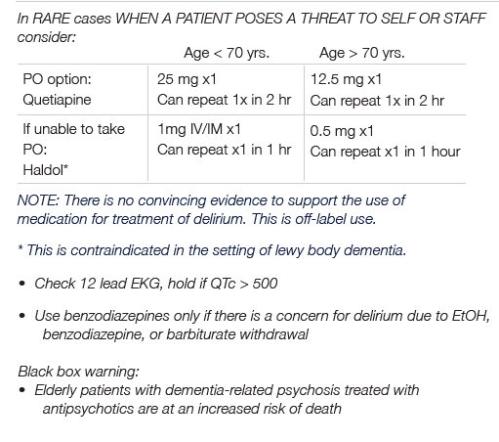

Slide 32
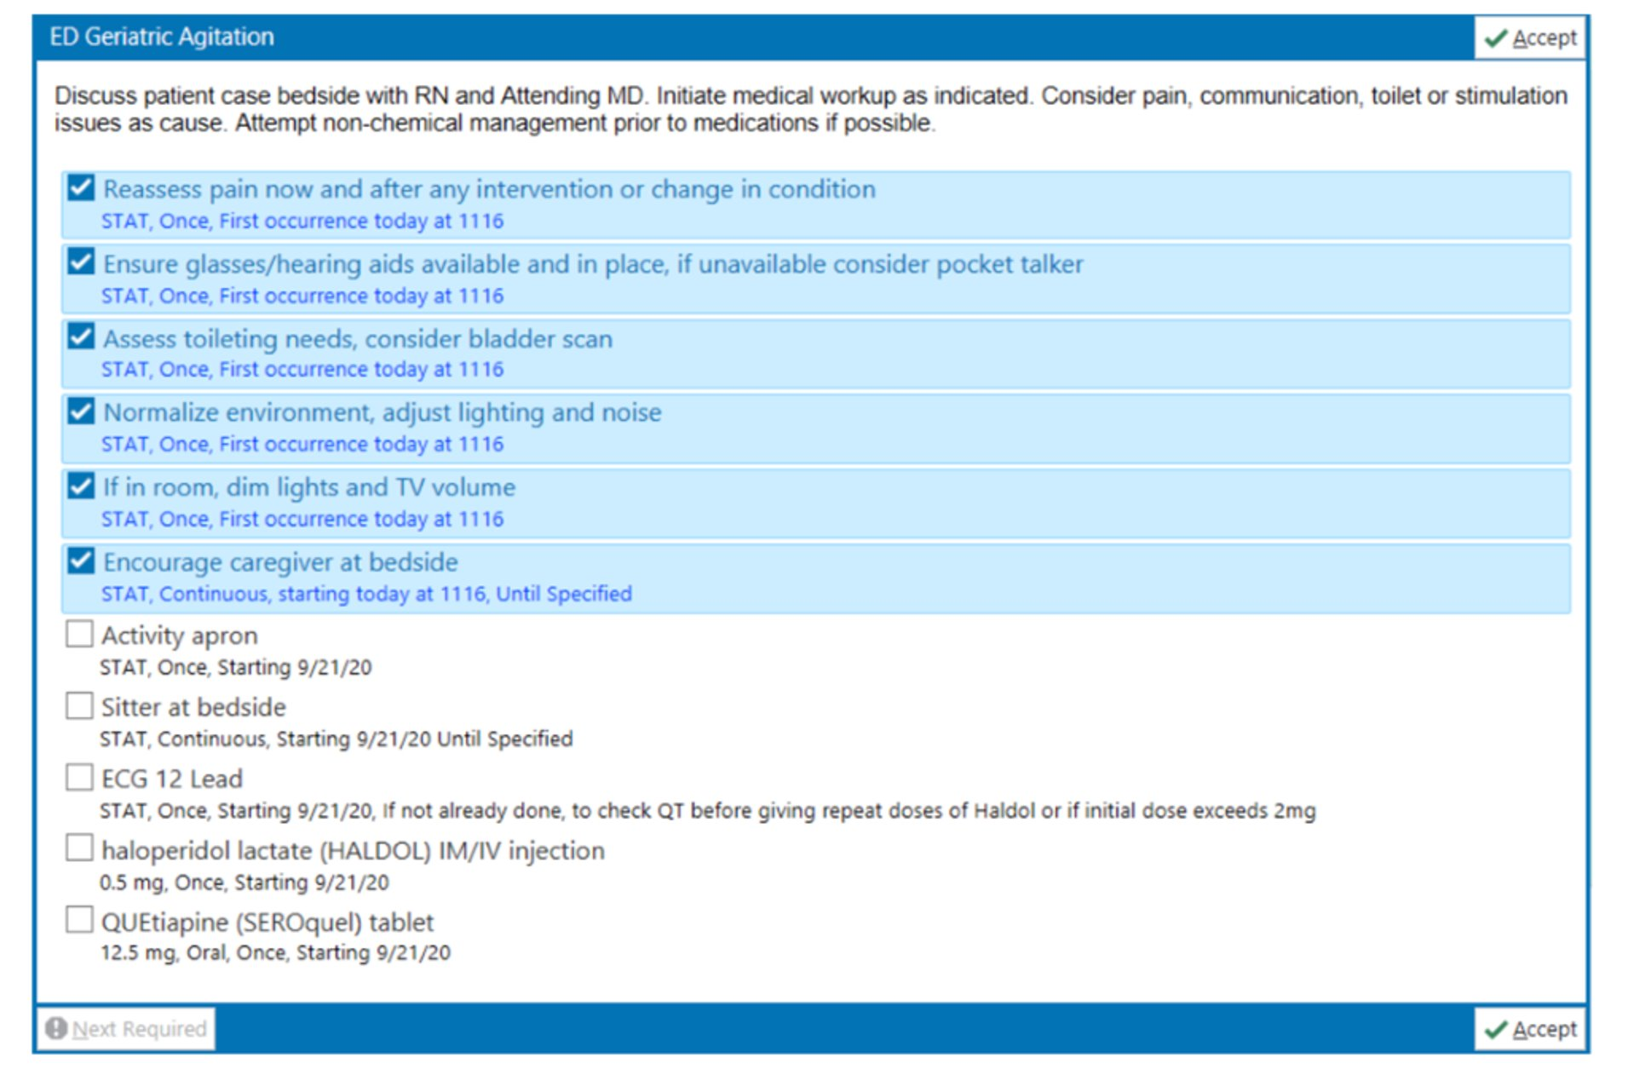
ED Geri Agitation OrderPanel

Slide 34
Summary
BZDZ are BAD
SUPER common
Hard to recognize
Is very morbid
But Preventable

