Slide 1
Precipitous Delivery
Christopher B. Colwell, MD
Zuckerberg San Francisco General Hospital and Trauma Center

Slide 2
ED Delivery
Rare
Most will go just fine!
Issues do occur

Slide 3
“Normal” Delivery
Confirm presentation
Digital stretching of the perineum
Particularly posteriorly
Controlled expulsion
Gentle downward traction on the head
Subsequent upward motion
Suction the mouth and nose
Clamp and cut the cord
Dry and stimulate the infant
Notes:
It is happening in the ED, so by definition it isn’t really normal. The gentle downward traction of the head will often deliver the anterior shoulder and the subsequent upward motion pulls the posterior shoulder through the pelvic outlet. Placenta should be delivered 5-7 minutes later.

Slide 4
Biggest Issues
Breach
Most common
4%
Shoulder dystocia
3%
Prolapsed cord
Less the 0.2%
Notes:
Breech presentations occur in 4% of all deliveries. Less the 0.2% or about one in every 300 births.

Slide 5
Breech Presentation
Notes:
The buttocks and legs to not provide a sufficient wedge, hindering cervical accommodation of the relatively larger head. Also, because the presenting part does not occlude the cervical opening completely, umbilical cord prolapse may occur.

Slide 6
Breach Delivery
Three types
Complete
Incomplete
Footling
Frank
Diagnosis
Physical exam
Ultrasound
Notes:
Basically the feet or buttocks aren’t shaping the birth canal in the same way the head does.

Slide 7
Breech Delivery
Don’t pull!
Hands off until fetal umbilicus is visualized
Allows better cervical dilation
Then you can assist delivery
Arms
Head in flexed position

Slide 8
Breech Delivery
Mauriceau maneuver
Uses the fetal oral aperture to flex the fetal neck and draw in the chin
Should be done after delivery of the elbows
Notes:
Left finger in the mouth to flex the neck and the right index finger at the back of the head.

Slide 9
Episiotomy
Notes:
A generous episiotomy may be necessary to facilitate the Mauriceau maneuver in a full-term infant

Slide 10
Shoulder Dystocia
3% of vaginal deliveries
Turtle sign
Retraction of baby’s head back into the perineum between contractions
Several maneuvers
30 seconds each

Slide 11
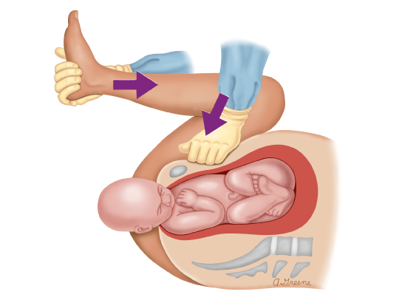
Shoulder Dystocia
McRoberts
Hyperflexion of the thighs
Back flat
Pressure over the pubic synthesis
Not fundal pressure
Relieves 50% of dystocias

Slide 12
Shoulder Dystocia
Delivery of the posterior shoulder
Insert your hand and locate the posterior elbow
Flex the elbow and sweep the forearm across the chest and face

Slide 13
Shoulder Dystocia
Wood’s corkscrew maneuver
2 fingers behind the anterior shoulder and 2 fingers in front of the posterior shoulder
Reverse Wood’s corkscrew maneuver

Slide 14
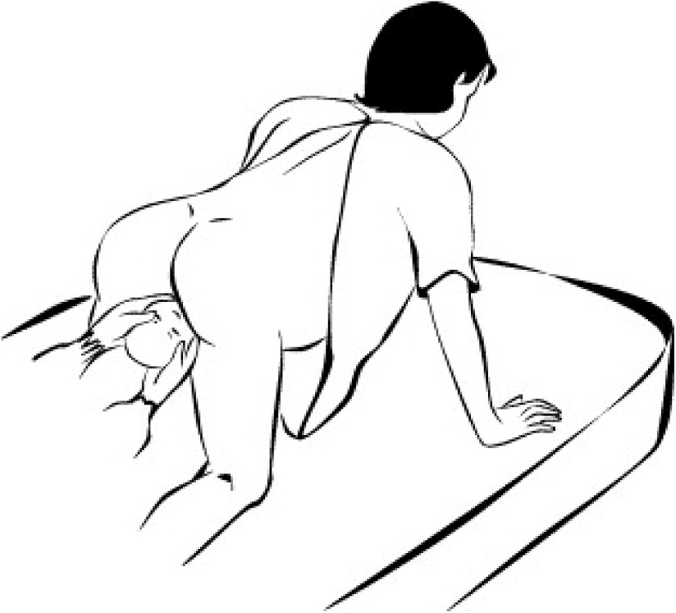
Shoulder Dystocia
Gaskin maneuver
Roll to “all fours”
Act of turning the mother may be most useful
Can get an extra 10-20 mm of the pelvic outlet

Slide 15
Shoulder Dystocia
HELPER
Help
Episiotomy
Legs flexed
McRoberts’
Pressure
Suprapubic
Enter
Vagina
Remove
Posterior arm

Slide 16
Umbilical Cord Prolapse

Slide 17
Prolapsed Cord
Cord slides past the presenting part
Cord compression
Hypoxia, acidosis
Diagnosis
Palpation of the umbilical cord on vaginal examination or
Visualization of the cord protruding through the introitus

Slide 18
Prolapsed Cord
Manually lift up presenting fetal part
Relieving pressure on the umbilical cord
Maintain presenting part away from prolapsed cord
Prepare for emergency delivery while maintaining presenting part off the cord

Slide 19
Post-Delivery Care
Baby
Postpartum hemorrhage
Uterine massage
Oxytocin
20-40 IU diluted in 500 cc NS
Misoprostol
600-1000 ug PR/PO or 800 ug SL
Notes:
Kind of like you can find a room almost empty within minutes of an intubation, it can be similar after a delivery, but your job is not done!

Slide 20
Peri-Mortem C-Section
Resuscitative hysterotomy
Indications
Will depend to some degree
Within “4 minutes” of arrest
Not a hard stop, but a goal
Most difficult part with be the decision to pick up the knife
Notes:
You can’t define a set of indications that will apply to all situations. There will be some dependence on where you are, what resources you have available, and how far along the patient is. 22 weeks gestation at a rural center with no additional help is a different situation from 39 weeks at an urban trauma center.

Slide 21
Resuscitative Hysterotomy
Viable?
Improves maternal survival
Improves maternal cardiac output by 25%
Reduces uterine blood flow
Relieves aortocaval compression and diaphragmatic pressure
Some argue this is the primary purpose
Notes:
Extreme situations call for extreme actions.

Slide 22
Resuscitative Hysterotomy
Vertical incision
Xyphoid (uterine fundus) to pubic synthesis
Pubic synthesis to at least the umbilicus
Along linea nigra
To peritoneum
10 blade
Cut through peritoneum vertically and inferiorly
Scissors
Deliver the uterus
Notes:
You can initiated the peritoneum incision with a scalpel inferiorly. After you deliver the uterus, cut vertically and inferiorly to avoid the placenta. Use 2 fingers to lift up the uterus from the fetus and then use scissors to extend the incision upwards until you reach the baby.

Slide 23
Notes:
Again, once you have delivered the uterus, cut vertically and inferiorly until you can insert two fingers to lift the uterus away from the fetus, and use a scissors to open the rest of the uterus and deliver the fetus.

Slide 24
Resuscitative Hysterotomy
Deliver the baby
Anticipate need for neonatal resuscitation
Clamp and cut the umbilical cord
Place packing/towels in the open uterus/abdomen
Oxytocin
5 units IV
Notes:
As with crycothyrotomy and some other procedures we do, I would argue that the hardest part of this procedure is the decision to pick up the knife.

Slide 25
Resuscitative Hysterotomy
Over 200 successful cases reported in the literature
Maternal CPR less than 5 minutes
Fetal survival very possible
Very low survival
> 20 minutes maternal CPR
23 weeks gestation or less
Can also be a maternal resuscitation procedure
Notes:
Some have described fetal survival as excellent (70%) with less than 5 minutes of maternal CPR. Survival is up to 70% if delivered within 4 minutes.

Slide 26
Summary
Think about this before it happens
If one maneuver is not working, move to another
30 seconds
For resuscitative hysterotomy
What are your indications?
What is your situation?
The hardest part will be the decision to pick up the knife
Don’t forget post-delivery care
Notes:
In most situations, the most difficult part of these procedures will be the decision to pick of the knife and to a certain extent, you can think about your indications for making this decision before the situation arises….maybe even right now.

Slide 27
Thank you!
Christopher.Colwell@ucsf.edu

