Slide 1
Joint Reduction – Pearls and Pitfalls
Christopher B. Colwell, MD
Zuckerberg San Francisco General Hospital and Trauma Center

Slide 2
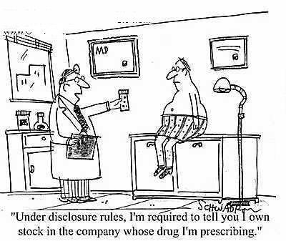
Disclosures
None

Slide 3
Primary Pitfall - Inadequate Analgesia and/or Sedation
Appropriate analgesia/sedation is key to safe, effective, and humane joint reduction
What medication to use?
Fentanyl
Versed
Propofol
Ketamine

Slide 4
Sedation
Randomized, double-blinded, clinical trial of propofol, 1:1 propofol/ketamine, and 4:1 propofol/ketamine for deep procedural sedation in the emergency department
Miner et al
Ann Emerg Med, 2015

Slide 5
Intra-articular Injections
Intra-articular lidocaine vs. IV sedation for closed reduction of anterior shoulder dislocation in the ED: A systematic review and meta-analysis
Sithamparapillai et al
CJEM, 2022
No difference in reduction success
Fewer adverse events
Shorter ED stay
No difference in pain score
Longer procedural time it IAL
Lower patient satisfaction with IAL

Slide 6
Hip Dislocation Pitfalls
Time from injury
> 3.5 hours resulted in significantly reduced success rates
Lai et al
J Ortho Traumatology, 2022
Avascular necrosis
Missing other injuries
Hip dislocation requires significant force
Sciatic nerve injury
Common peroneal branch
Notes:
Common peroneal branch will cause weakness in great toe extension and foot dorsiflexion with decreased sensation to the dorsum of the foot.

Slide 7
Hip Reduction

Slide 8
Hip Reduction
Notes:
Rocket launcher

Slide 9
Hip Reduction
Notes:
Bigelow

Slide 10
Hip Reduction

Slide 11
Shoulder Dislocation
Back up techniques
Have 2
Traction – countertraction
Scapular manipulation
Stimson technique
External rotation
FARES method
Gottlieb M.
J Emerg Med, 2020

Slide 12
Traction – Countertraction
Notes:
Not a procedure of “strength”.

Slide 13
Scapular Manipulation

Slide 14
Stimson Technique

Slide 15
External Rotation

Slide 16
FARES Method

Slide 17
Shoulder Dislocation Pitfalls
Believing it is a procedure of strength
Not recognizing posterior dislocations

Slide 18
Knee Dislocation Pitfalls
Not appreciating a dislocation occurred
50% self-reduce before ED arrival
Sillanpaa et al
J Trauma Acute Care Surg, 2014
Associated injuries
Popliteal artery
Peroneal nerve
Normal exam does not exclude vascular injury

Slide 20
Knee Dislocations
Careful neurologic exam
Signs of peroneal nerve injury
Foot drop
Weakness in dorsiflexion
Numbness/paresthesia in the lateral leg/dorsal foot
Ankle-brachial index (ABI)
Ratio of the systolic blood pressure of the lower extremity (ankle) and upper extremity
Normal is > 0.9
Notes:
Another way of saying this is anything less than 0.9 is abnormal.

Slide 21
Knee Dislocations
Larger individuals can dislocate with more minor mechanisms
Posterolateral dislocations are very difficult to reduce in the ED
Delay of popliteal artery repair of greater than 8 hours often results in amputation

Slide 22
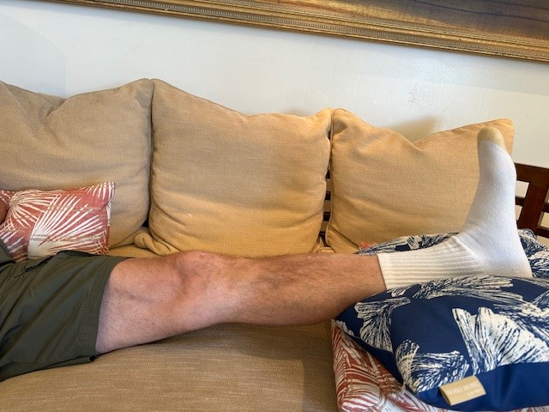
Patella Dislocations
Hyper-extend the knee
Flexion at the hip shortens the quadriceps

Slide 23
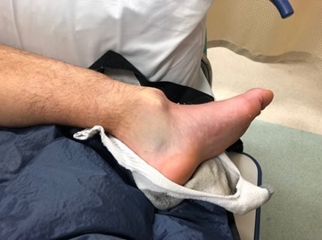
Ankle Dislocation
Ankle rarely dislocates without associated fractures
Ligamentous injury
Imaging is not needed prior to reduction
Counter-traction is key
May need to “re-create” the injury (direction)

Slide 24
Elbow Dislocation
Slow, steady traction-counter traction
Matched with appropriate sedation/analgesia
May require a particular “closeness” with your patient
Brachial artery
Ulnar and median nerves

Slide 26
Elbow Dislocation

Slide 27
Wrist Dislocation
This can be for
Wrist dislocation
Displace distal radius fracture
Works great with hematoma blocks
Notes:
Thanks to Tom Dalton for the photos

Slide 28
Wrist Dislocation/Reduction

Slide 29
Summary
Adequate analgesia/sedation is the key
Have a go to method
At least 1 back up
2 for shoulders
Good neurovascular exam before and after
Specific to the injury

Slide 30
Thank You!
Christopher.Colwell@ucsf.edu

