Slide 1
Complex Shoulder Instability
UCSF Sports Medicine Sports Injury and Rehab Conference
Sara L. Edwards, MD
Associate Professor, Department of Orthopaedic Surgery
Shoulder and Sports Medicine

Slide 2
Shoulder Instability Controversies
When do we operate?
Which procedure?
  Arthroscopic Stabilization?
  Remplissage?
  Open Anterior Stabilization?
  Laterjet Procedure?
  Allograft Reconstruction?

Slide 3
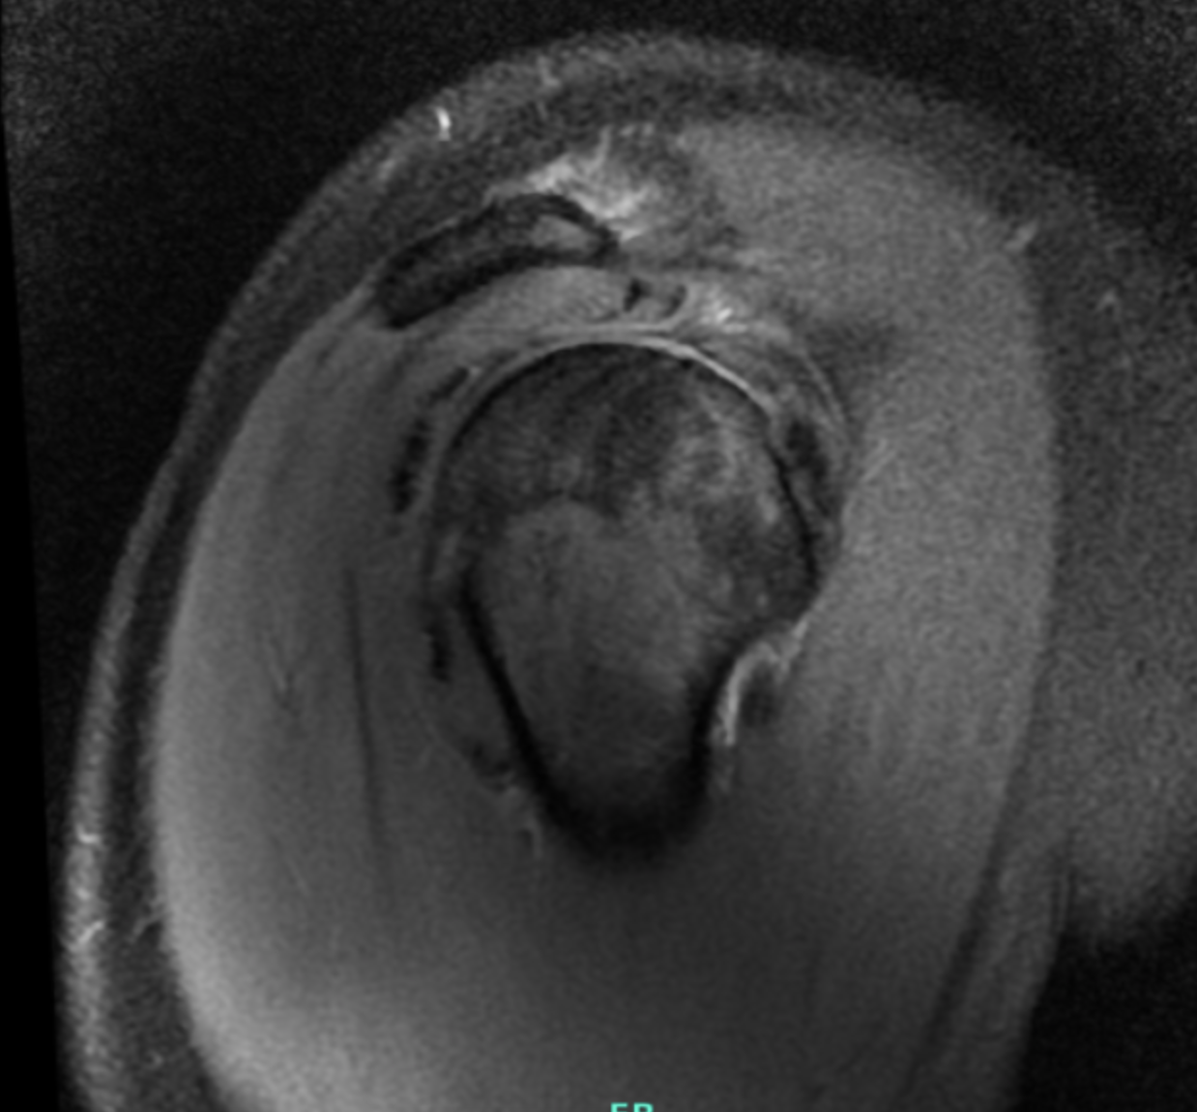
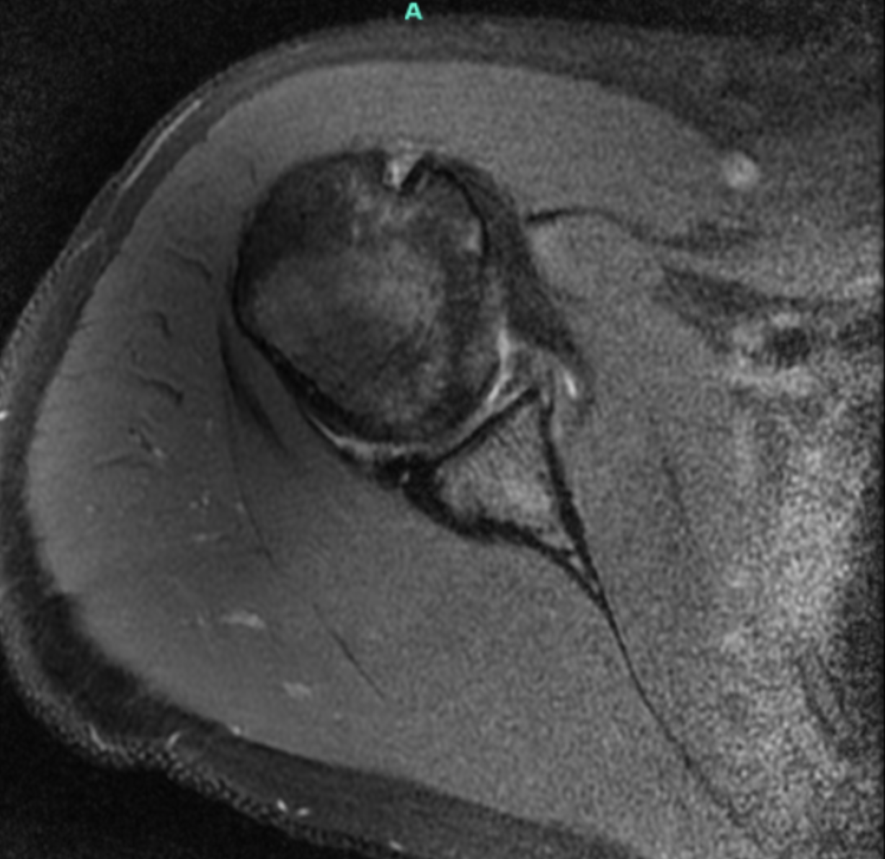
Shoulder Instability Controversies: Case 1
31 yo female with history of multiple dislocations to R shoulder (6)
Also underlying hypermobility
Has tried multiple courses of PT, activity modification
Now daily pain and sense of subluxation sleeping and with overhead activities
Exam with FROM, + anterior apprehension, + sulcus sign at neutral and ER

Slide 4
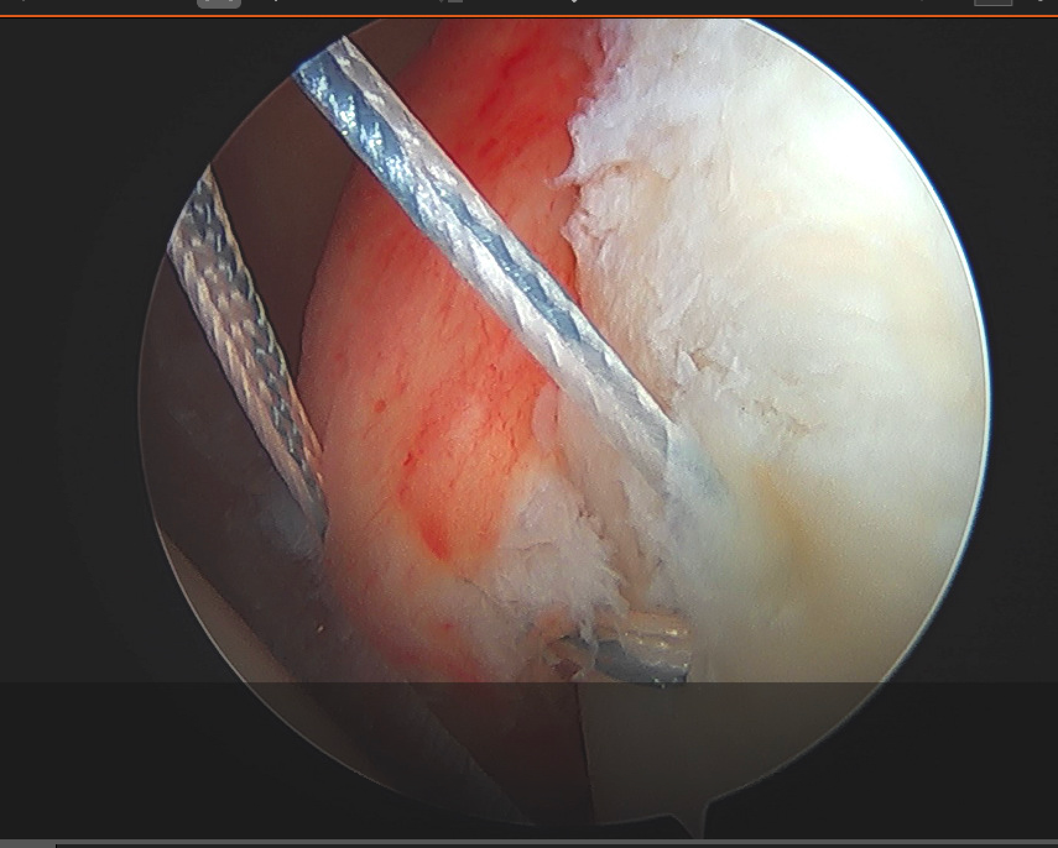
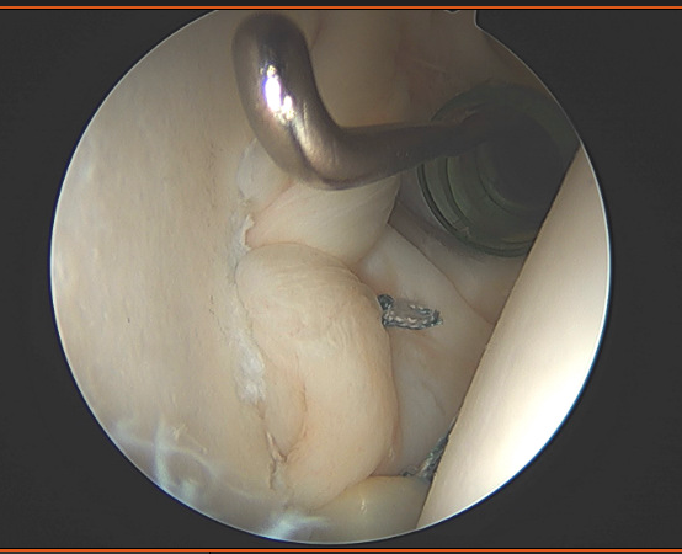
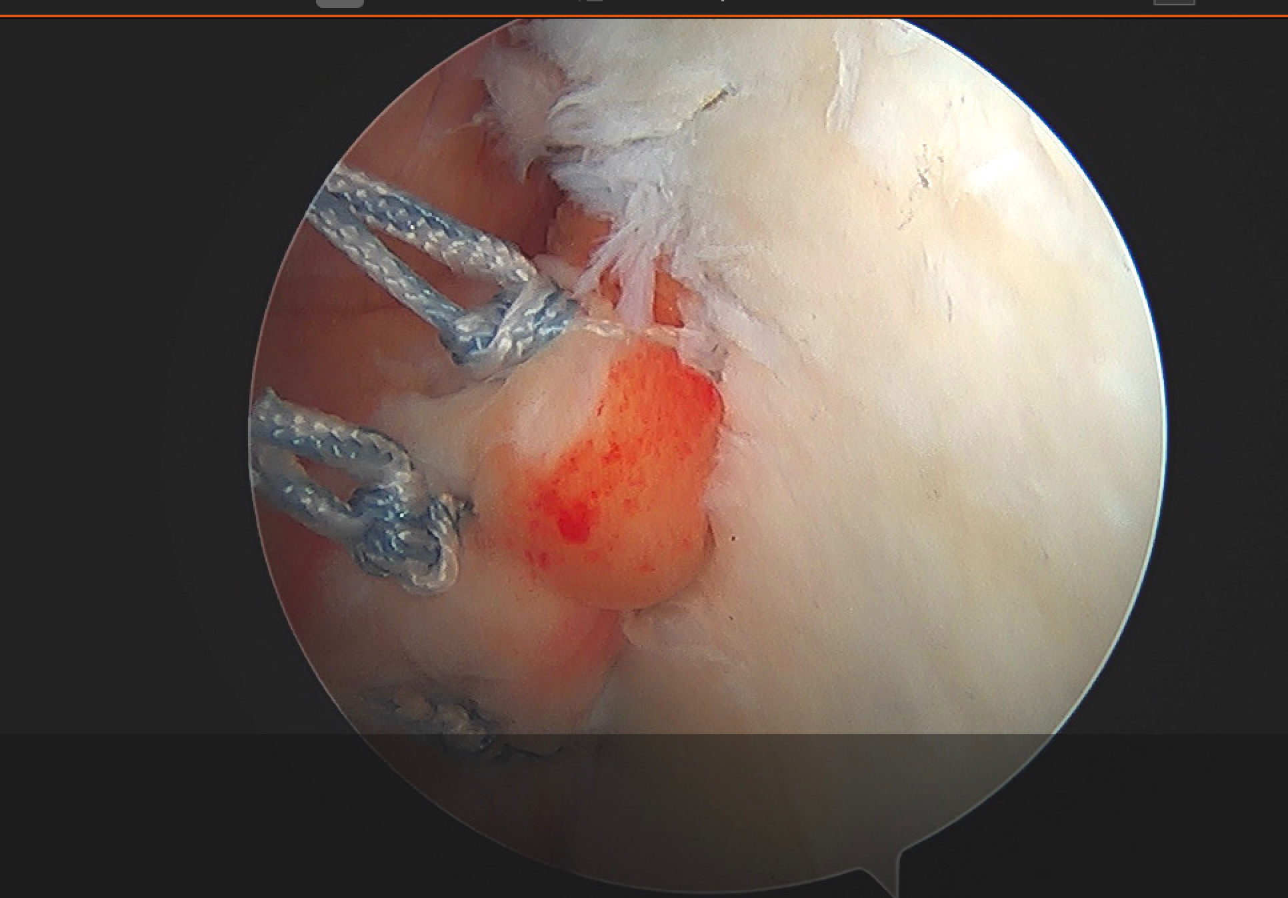
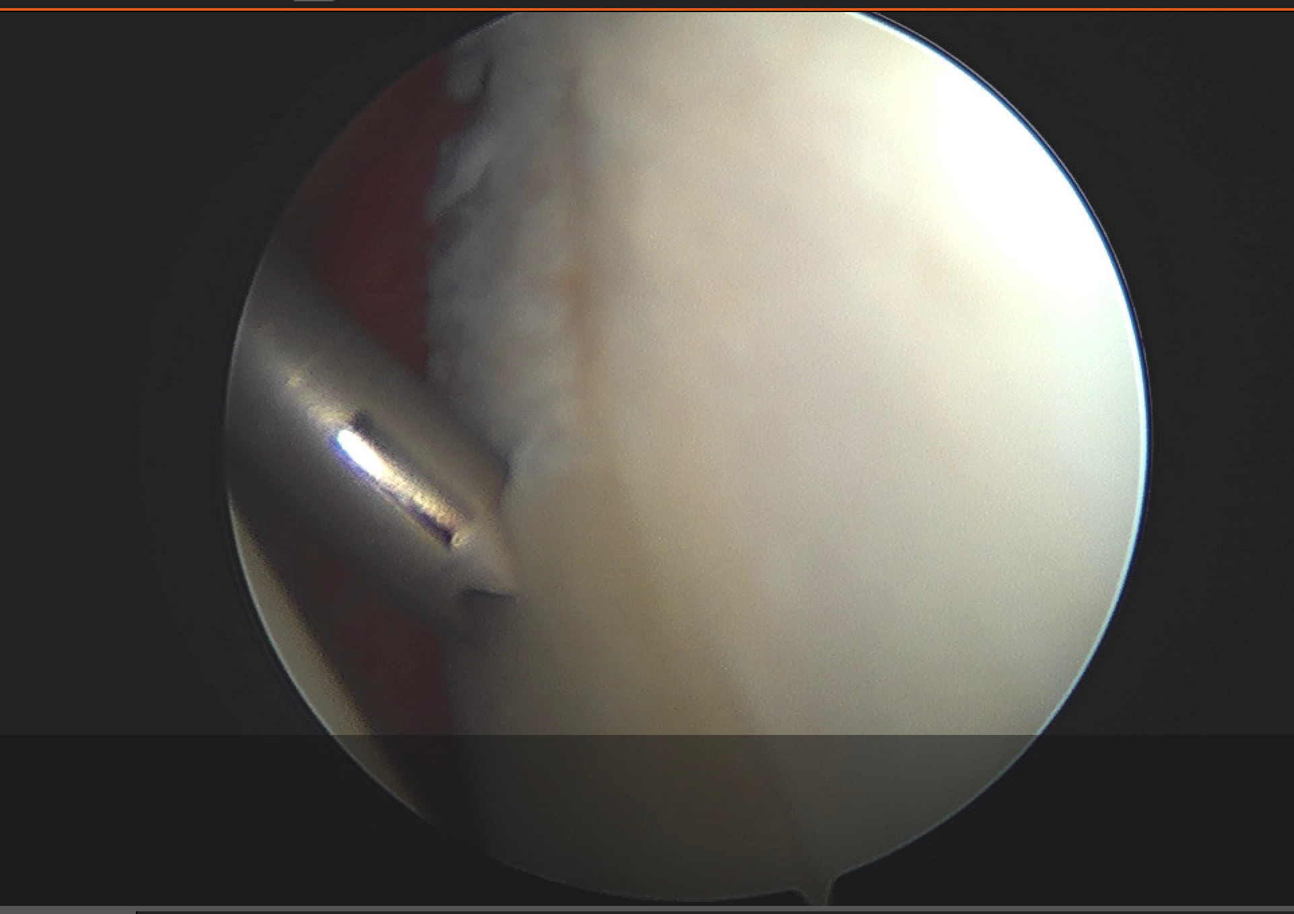
Shoulder Instability Controversies: Case 1

Slide 5
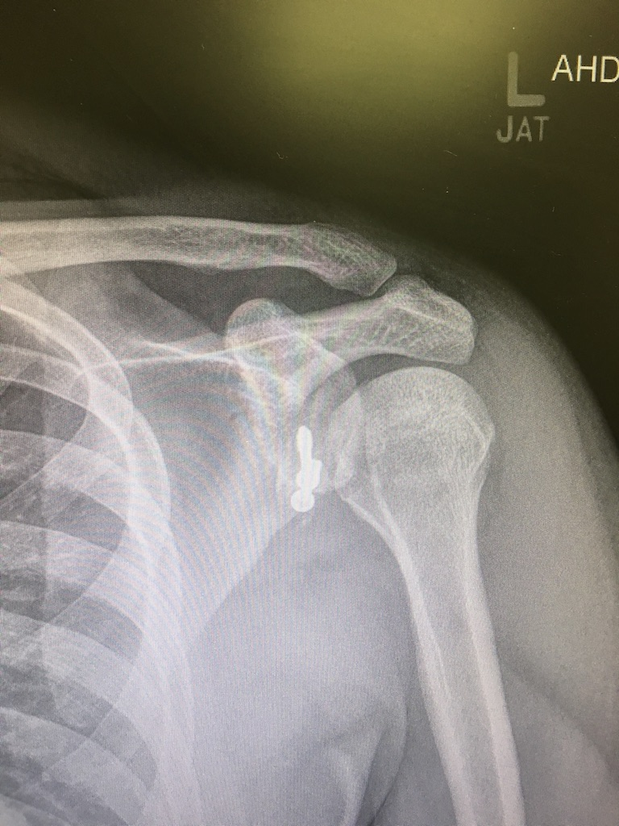
Shoulder Instability Controversies: Case 2
27 yo medical student with CC of L shoulder instability
Had prior arthroscopic stabilization procedure that failed
Had prior laterjet procedure
On exam has crepitus in shoulder, positive load and shift, anterior apprehension, severe guarding on exam

Slide 6
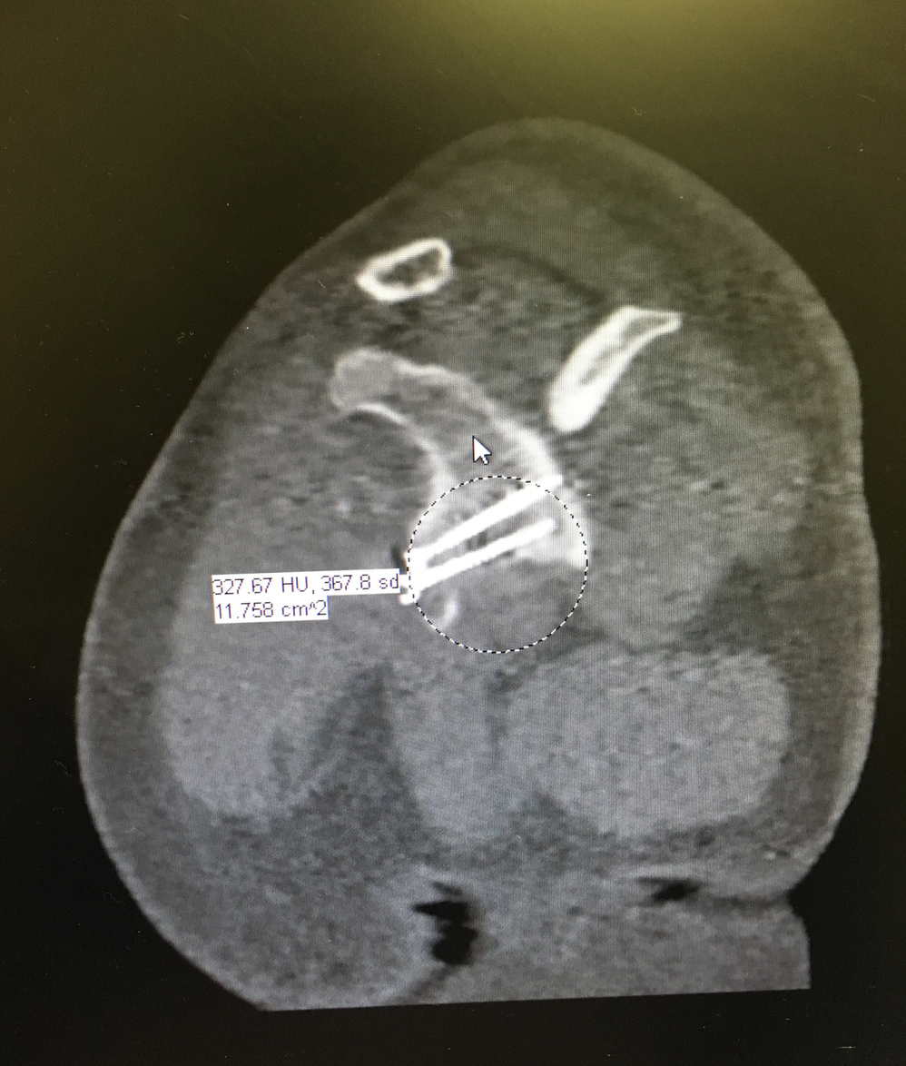
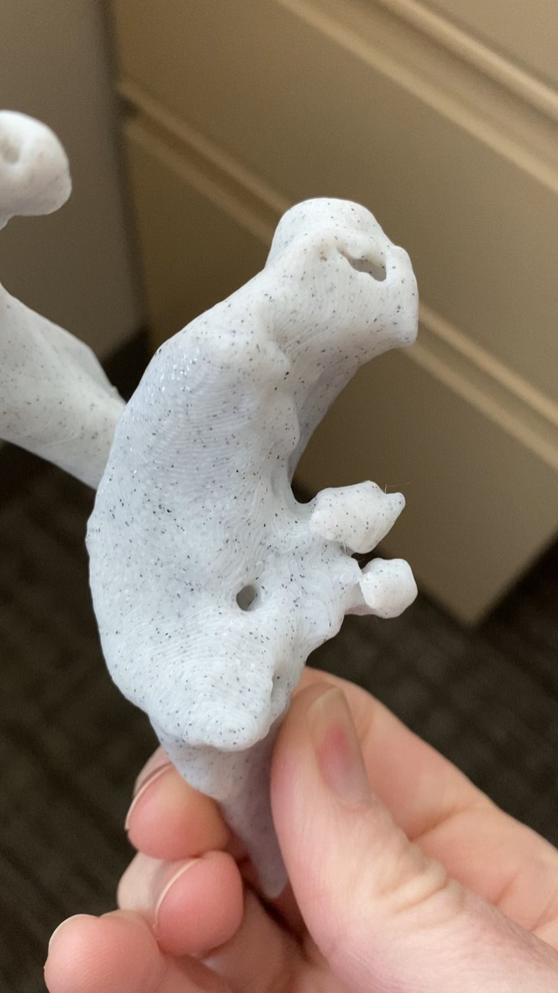
Shoulder Instability Controversies: Case 2

Slide 7
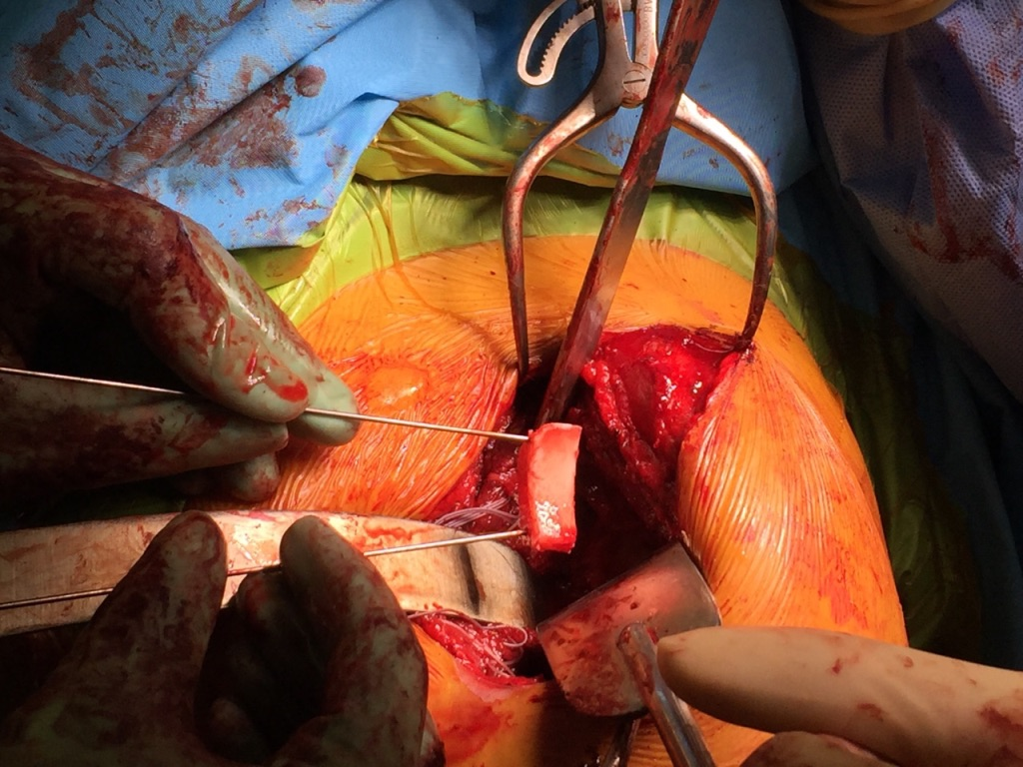
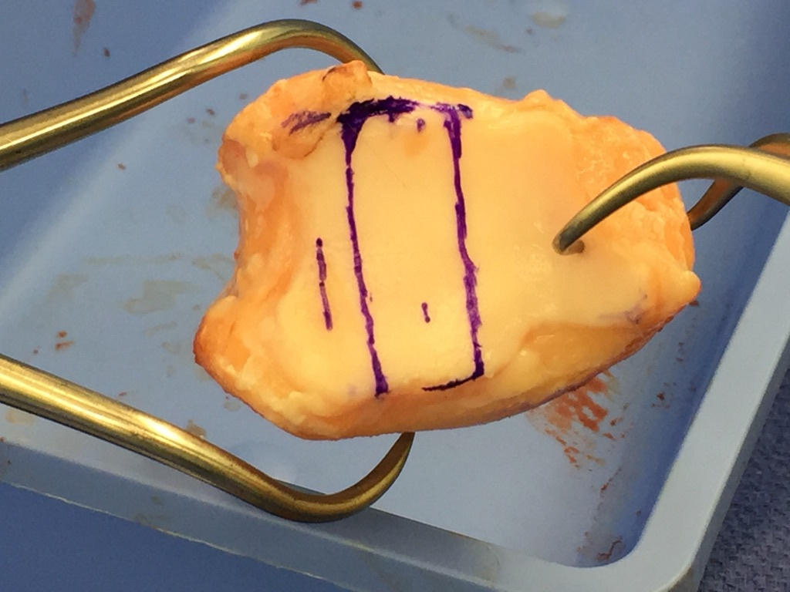
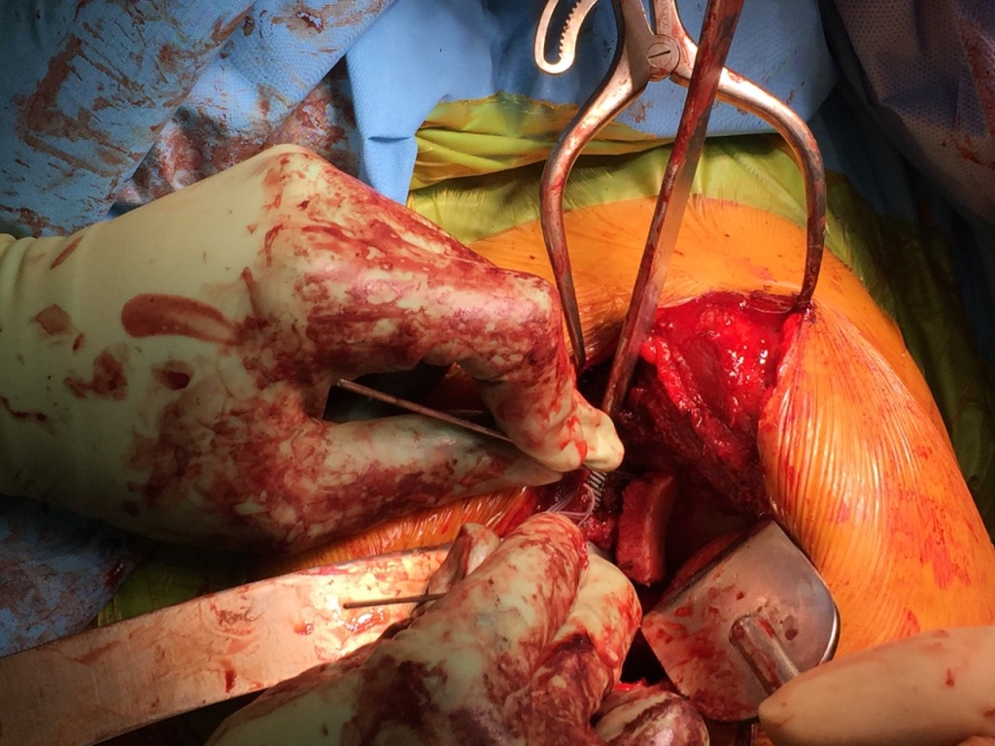
Shoulder Instability Controversies: Case 2

Slide 8
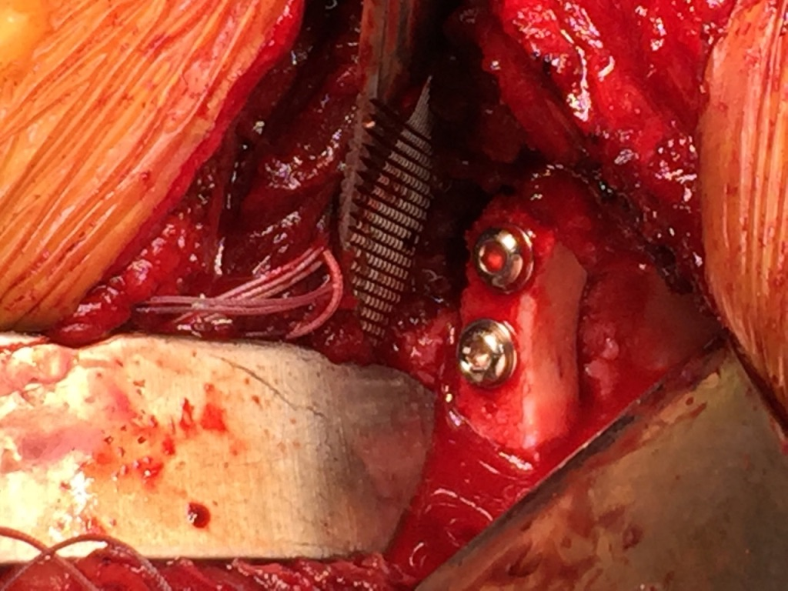
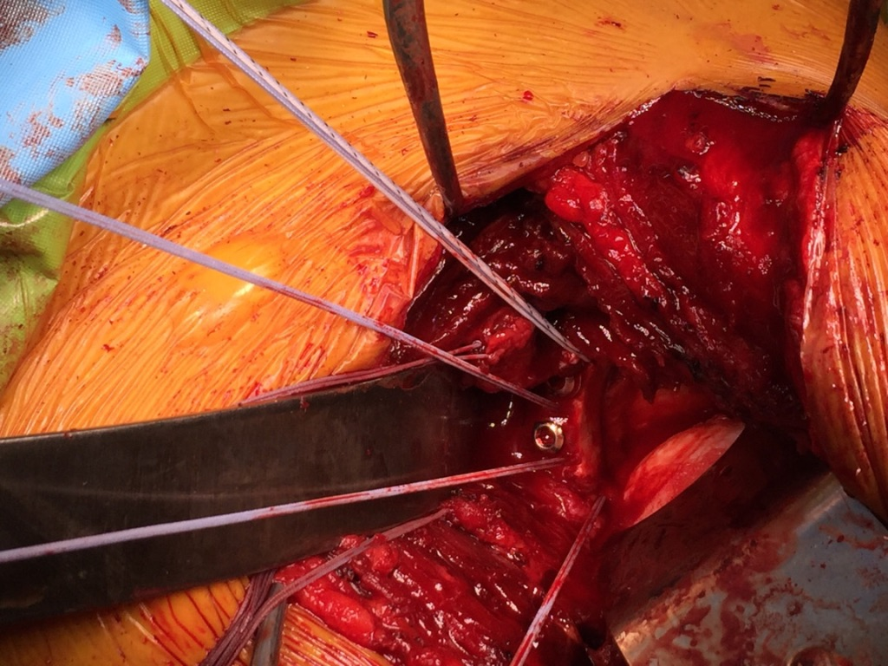
Shoulder Instability Controversies: Case 2

Slide 9
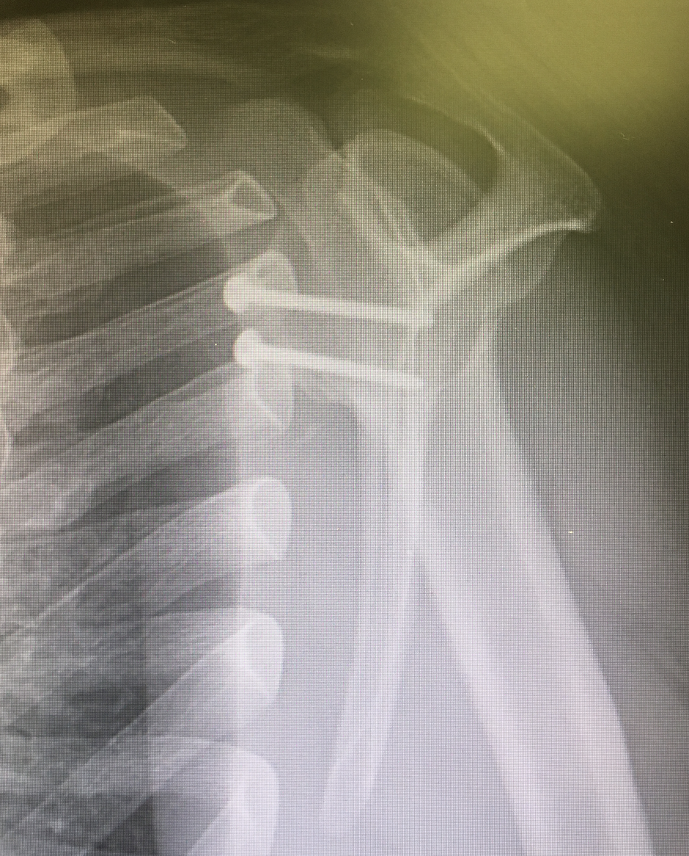
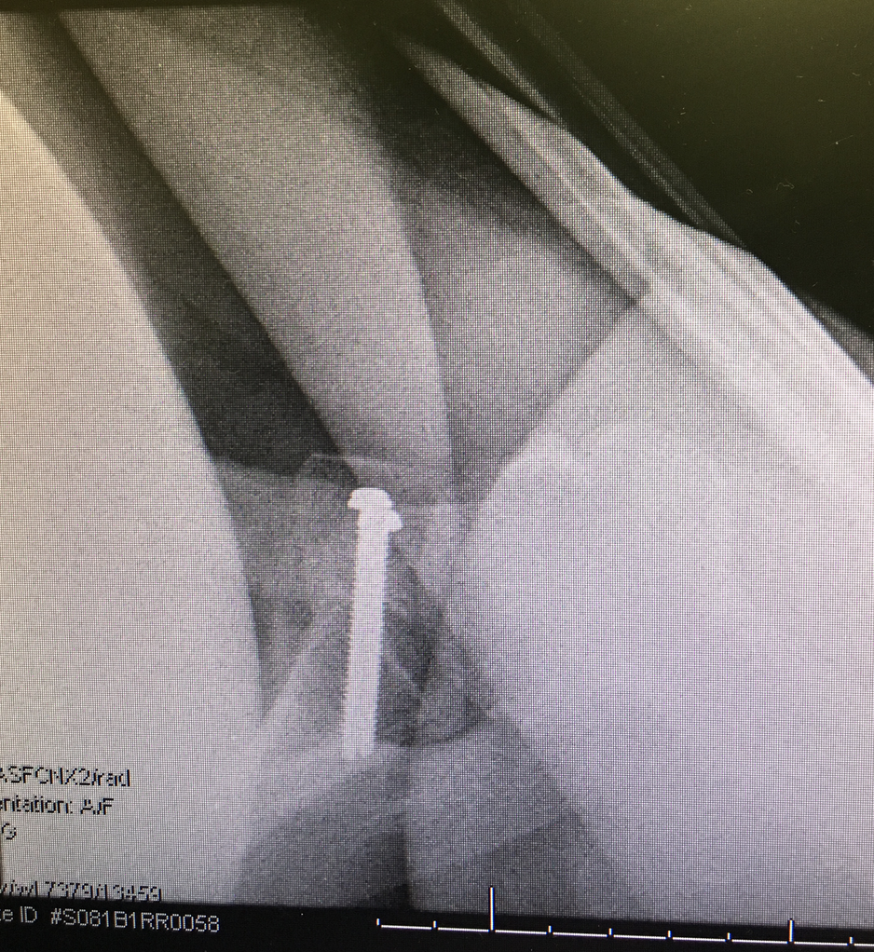
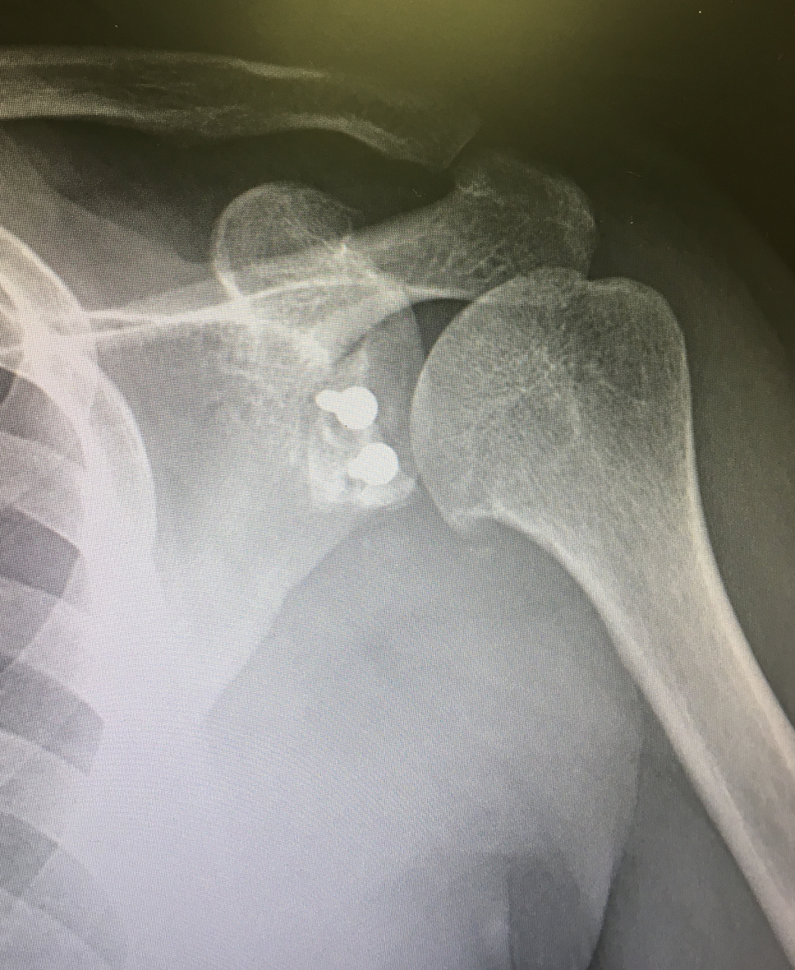
Shoulder Instability Controversies: Case 2

Slide 10
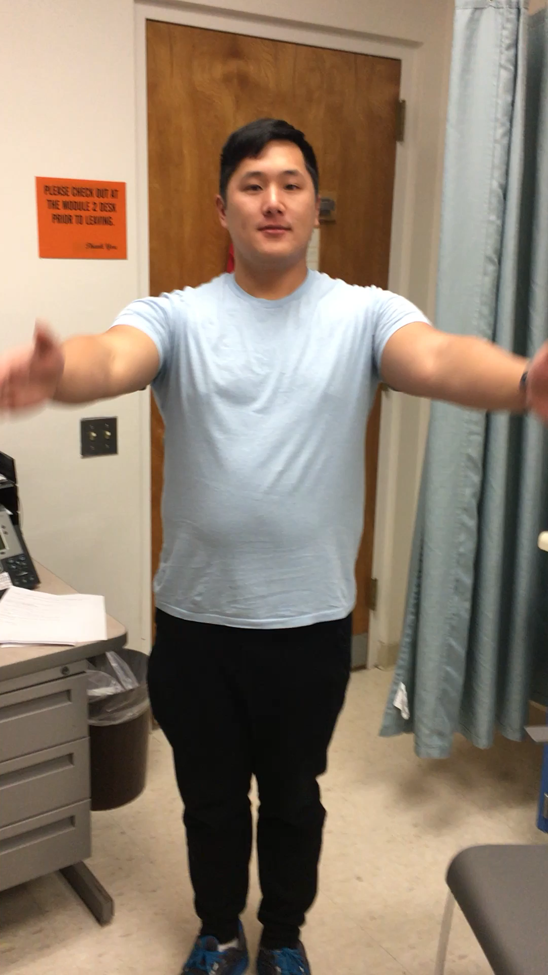
Shoulder Instability Controversies: Case 2

Slide 11


Thank you!

